Slide 1
The Blessed Life
Psalm 1
Notes:
Define blessed
Worldly sense
Godly sense
Spiritual quality of joy, peace, contentment, that is independent of external influences
Job

Slide 2
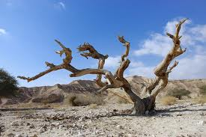
The Blessed Life
Ps 1:1; Negatives
Do Not
Walk – in Council of Wicked
Stand – in way of Sinners
Sit – in Seat of Scorners
I Cor 15:33, Evil Companions
II Cor 6:12-17, Unequally Yoked
Notes:
Walk in counsel of wicked
Live by their ways/by their standards by their advice
II Cor 6 unequally yoked
Stand in way of sinners
Passive participation
Do not reprove, keep silence, go along with, laugh at jokes
I Cor 15:33
Rom 1
Sit in seat of scorners: mockers/scoffers
Those that poke fun at Christian life style, purity, doing good, God’s ways,
They think we are fools
Peter denial of Christ
Lot?

Slide 3
The Blessed Life
Ps 1:2; Positives
Do
Attention to God’s Will
Delight in it
Meditate in it

Slide 4
The Blessed Life
Ps 1:3; Condition of Righteous
Tree planted by Rivers of Water
Bears Fruit
Leaf Does Not Wilt
Shall Prosper

Slide 5
The Blessed Life
Ps 1:4-5; Condition of Ungodly
Chaff in Wind
Cannot Stand in Judgment
Will not Stand in Congregation of Righteous

Slide 6
The Blessed Life
Ps 1:6
Lord knows the way of the Righteous
The way of Ungodly will perish

Slide 7
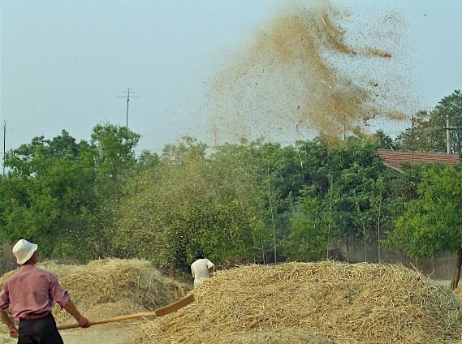
Which Life Are You Living?
Tree planted by Water
OR
Chaff in Wind

