Slide 1
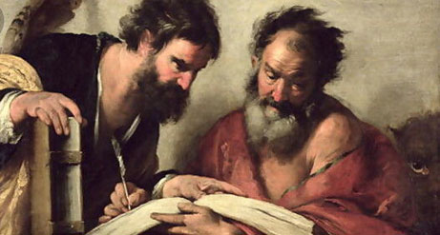
Barnabas
Encourager
Acts 4:31-37

Slide 2
Barnabas Encourager His Work
Acts 4:31-37, Barnabas Active in Early Jerusalem Church
Acts 9:26-30, Approached Saul
Acts 11:19-24, Barnabas Active in Antioch
Acts 11:25-26, Barnabas seeks out Paul
Acts 15:35-41, Barnabas Takes John Mark

Slide 3
Barnabas Encourager Being a Barnabas
We all have a Purpose and Ability
I Cor. 12, Various Gifts
Rom. 12, Various Abilities
Eph. 4, Various offices
Tit. 2:3-5, Importance of Women

Slide 4
Barnabas Encourager Being a Barnabas
Results according to Ephesian letter
Unity of Faith
Knowledge of Jesus
Complete Man
Attain Proper Moral Character
Not Tossed About
Joined Together
Compacted Together

Slide 5
Barnabas Encourager Being a Barnabas
Look out for others Best interest
Develop and Encourage Fellow Workers
Develop and Encourage Teachers & Preachers
Develop and Encourage Participation
Develop and Encourage Elders

