Slide 1
The Chinese Language
Bible Evidences
From around the World
C.H. Kang “The Discovery of Genesis”
(Concordia publishing, Kang/Nelson)

Slide 2
The Chinese Language
Is the oldest, continuous written language in the World
First written over 4,500 years ago
The inventors of the written language drew pictures to express words or ideas
Simple pictures were combined to make more complex thoughts
Notes:
Goals of this lesson:
Demonstrate the bible is not just an English book but refers to their history as well. It applies to them.
Tie the two languages together.
Give them a foundation of understanding and build their faith
Build their faith in the Bible as God’s word
Ensure the Chinese people read the bible in their language and work with them on the English as appropriate

Slide 3
Simple pictures were combined to make more complex thoughts
Well known history and
common everyday things were
used to make a word so people
could remember it
For Example…..
+
=
Mouth
Man (legs)
Older Brother
The “mouth man” or “spokes person” for the family was usually the oldest son or brother
Notes:
Building blocks
Why did they choose these two words to mean this?
I’m going to give a guess, you’re free to give your own. The older brother or the oldest is the spokes person.
A book was written by a Chinese man named C.H. Kang called “The Discovery of Genesis” (Concordia publishing. Kang/Nelson)

Slide 4
Long before Buddha, the Chinese people worshipped the same God described in the Bible!!!!
The Proof is in the Ancient Chinese Characters

Slide 5
Long before Buddha, the Chinese people worshipped the same God described in the Bible!!!!
The Proof is in the Ancient Chinese Characters
2500 B.C.
1400 B.C.
600 B.C.
30 A.D.
2017 A.D.
Chinese language first written
Buddha
Death of Jesus
Today
First five books of Bible written
Notes:
Approx 1500 years after the flood

Slide 6
Long before Buddha, the Chinese people worshipped the same God described in the Bible!!!!
“Shang Di” was the god of China before Buddha. He was the creator God and animal sacrifice was offered to him.

Slide 7
Long before Buddha, the Chinese people worshipped the same God described in the Bible!!!!
Shang Di
2500 B.C.
600 B.C.
30 A.D.
2017 A.D.
Chinese language first written
Buddha
Death of Jesus
Today
During the first three dynasties of China: Hsia, Shang, Chou… The Chinese people worshiped Shang Di
Notes:
Shaw, Shung, Chou are the phonetic pronunciations

Slide 8
Long before Buddha, the Chinese people worshipped the same God described in the Bible!!!!
Buddha
Shang Di
2500 B.C.
600 B.C.
30 A.D.
2017 A.D.
Chinese language first written
Buddha
Death of Jesus
Today
Worship of Buddha: 50 B.C.
Europeans reintroduced God to the Chinese people
Notes:
The purpose of this slide is to demonstrate that Jehova/Shang Di/I am has been God in China much longer than Buddha. And Buddha is a fairly recent god.

Slide 9
Chinese View Of Bible:
A western book?
  They believe it is simply myth and fable written by western men
  They think of it as an English book
The Bible is NOT western in origin:
  Written in Hebrew and Greek
  First five books by Moses, adopted son of Egyptian Pharaoh (1400 BC)
  Not just Jewish history but the history of ALL men!
Notes:
Major point of lesson:
Validates message of Moses; language predated Moses writing Gen
Evangelism tool in Far East

Slide 10
3,000-5000 Miles

Slide 11
Chinese View Of Bible:
The Chinese Language Tells The Stories Of The Gen 1-11!
Yet it was developed before Moses penned these books!
2500 B.C.
1400 B.C.
600 B.C.
30 A.D.
2017 A.D.
Chinese language first written
Buddha
Death of Jesus
Today
First five books of Bible written

Slide 12
Creation Of Nations & Tongues
Genesis 11:1-9
  Took place 5000 years ago
  Chinese language is more that 4500 years old
  Languages were divided
  People were scattered
3000 B.C.
2500 B.C.
1400 B.C.
Tower of Babel
Chinese language first written
First five books of Bible written
Notes:
Get your bible out here and go through these verses with them in chinese

Slide 13
If the Bible is true, all nations migrated or moved from Babylon
(Modern: Iraq)

Slide 14
The Chinese would have migrated or walked from the west to China

Slide 15
Genesis 11:1-9
  Languages were divided
  People were scattered
The Chinese
walked from the
west after a
great division
To Migrate, to Move
+
+
=
+
Great
Division
West
Walk
Migrate
Notes:
NOTICE: the character above for migrate is quite ancient. Some people will not recognize it, but they will not deny it typically.
You might want to ask if they recognize it.
Mention it may be coincidence. But you let me know when you no longer believe it is a coincidence.

Slide 16
The Creation
Gen 2:7, Then the LORD God formed man of dust from the ground, and breathed into his nostrils the breath of life; and man became a living being.

Slide 17
The Creation
Gen 2:7, Then the LORD God formed man of dust from the ground, and breathed into his nostrils the breath of life; and man became a living being.
+
+
=
Dust Breath Alive To Talk
(mouth)
+
=
To talk Walking To Create
Notes:
Bring up the fact that the word mouth over time came to represent the whole body or the whole person – a “man”.
Thus this is a “Dust Man”. He did breath. Thus a “Living Dust Man”
Note that the slash for alive is also ancient and is seldom used by itself. You may need to explain this to the younger kids.
Many of these ancient characters where dropped when the Chinese language was simplified over time. The latest simplification occurred under “Mau – See – Tongue” (Mauste Tung) in approx 1971.

Slide 18
The Creation
The FIRST man was a living man of dust
+
+
=
Alive
Dust
Man
FIRST
4500 years ago this was believed in China!

Slide 19
Western Heritage
Gen 2:8-9, God’s Garden For Man:
+
+
=
One, First
Person
Enclosure Garden
West

Slide 20
Western Heritage
Garden of Eden
West for the Chinese
Eden was east for Moses
N
W
E
S
Notes:
What you want to show the Chinese with this slide is that the people in China who came from the tower of babel would get asked by their kids where they came from they would say west and point toward the tower of babel.

Slide 21
The Creation
Gen. 2:18-24, The First Man Needs a Woman
+
=
West
Woman
To want, to desire, necessary
Notes:
Before going on to the bottom line, ask them Why would the people putting the language together originally? Why not choose north or south or another word to go with woman to make desire/want/necessary.
But if you break it down, the west really is first man in the garden. So you can see why they didn’t choose west, they chose one man in the garden with a woman was necessary. Look how important the woman was – she was necessary to hold up the man… ☺
Still coincidence? Or do you see something here. Let’s go on and see.

Slide 22
The Creation
+
=
Two
People
Beginning, First

Slide 23
The Garden Of Eden
Happiness or Blessing
+
+
+
God
One
Man
Garden
Notes:
Nice word. It has the word Shan-Di. For example, necklaces have this word on them.

Slide 24
First Sin & Consequences
Gen 2:16-17, God’s command
Man was forbidden to eat one of the two trees -- if he ate the forbidden tree he’d lose access to the tree of life!
+
=
Two Trees
Command
Forbidden
Notes:
From time to time go back and re-iterate the time line and the fact that these characters where written before the bible, and many years after these stories but not so long after that the stories were forgotten.

Slide 25
First Sin & Consequences
Gen 3:1-8, Eve’s temptation and fall
+
=
Two Trees
Woman
To Covet, desire
Notes:
Emphasize the read points above. Make it fun. She looked up and saw that tree and Uummmmmm. It looked good. This character also is one used with sexual connotations of lust and desire.

Slide 26
First Sin & Consequences
+
+
+
=
Life or Motion
Secret, private
Garden
Man
Devil, Satan
+
+
=
Devil
Two Trees
Cover
Tempter
Notes:
Note without mentioning that the Chinese call white western people the word devil/Satan
NOTE: the first two characters above are ancient and more modern Chinese people may not be familiar with them.
IMPORTANT: Emphasize before going to the next slide “ Now what did the man and woman realize once they ate from the forbidden tree” . Make them say the word “Naked”

Slide 27
First Sin & Consequences
D
D
Then the eyes of both of them were opened, and they knew that they were naked; and they sewed fig leaves together and made themselves coverings. (Genesis 3:7)
Notes:
Isn’t it interesting that in the bible the word fruit and the word naked are connected. Can you think of any other reason or explanation for why your ancestors would connect fruit and man/clothing into the word naked.

Slide 28
First Sin & Consequences
Notes:
Isn’t it interesting that in the bible the word fruit and the word naked are connected. Can you think of any other reason or explanation for why your ancestors would connect fruit and man/clothing into the word naked.

Slide 29
First Sin & Its Consequences
FELLOWSHIP IS LOST
Man commits sin
Is forced to leave the Garden
SIN
God
Man
That Happiness Was Lost!
Notes:
Emphasize the rest of the bible is about restoring fellowship that was lost with this sin.

Slide 30
First Sin & Consequences
Gen. 3:17-19, Man is punished with weeds & thorns
+
=
Ancient Weeds Sorrow
Notes:
Why weeds in the word sorrow?

Slide 31
First Sin & Consequences
Gen 3:6, 16, Woman’s Pain:
+
=
A piece
Two Trees
Pain

Slide 32
First Sin & Consequences
Righteousness or “not Guilty”
Notes:
It is difficult to know when to do this slide. It is powerful but must be used when they are ready for it. It should typically brought in when talking about recompense and forgiveness through baptism.

Slide 33
Cain And Abel
The First Older Brother
in the Bible was violent
The words for “elder son”
and “violent” are both
Pronounced “SHUN”
Gen 4:15, And the Lord said, Truly, if Cain is put to death, seven lives will be taken for his. And the Lord put a mark on Cain so that no one might put him to death.
+
=
MOUTH MAN ELDEST SON
Cruel, Violent
Notes:
Note the mark. Further note that the pronunciation of older brother and violent is the same “Shun”. You may want them to say both.

Slide 34
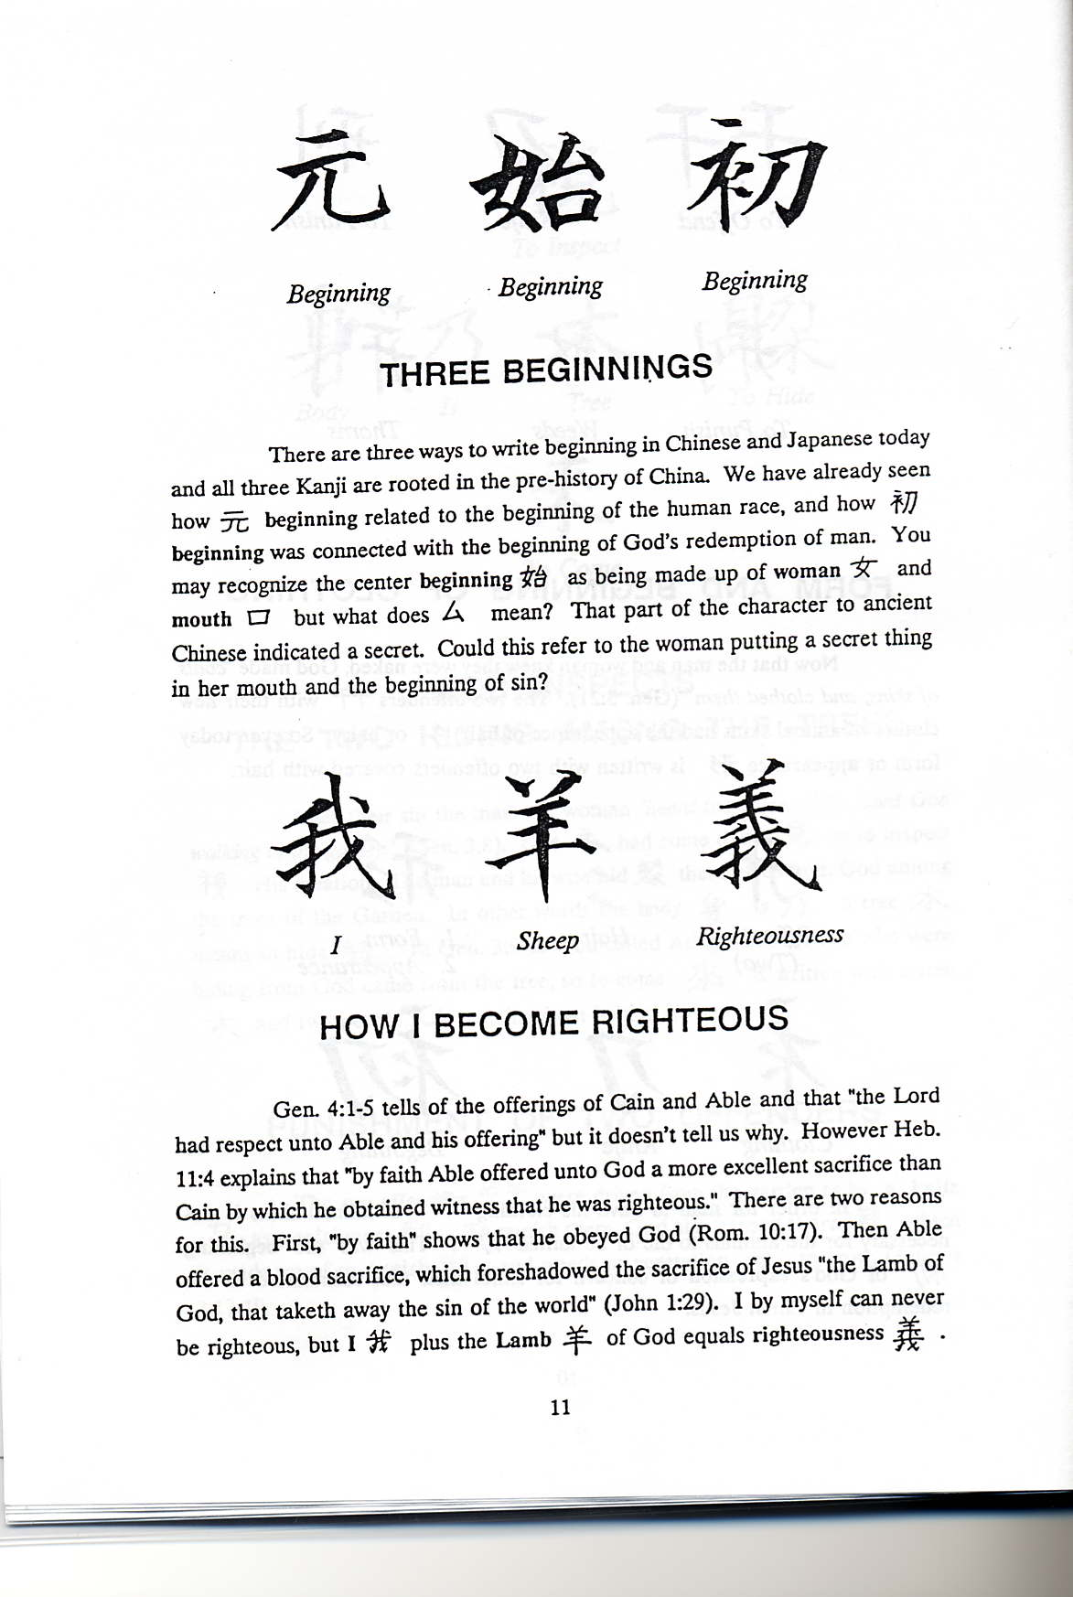
Sacrifice
Gen 4:4, Able brought of the first of his flock
+
I
Lamb
Righteousness

Slide 35
The Great World Flood
Gen 6:11-18, On the ark: Noah, his wife, three sons, and their wives
+
+
=
Person
Eight
Boat
Large Ship
Notes:
Tell the story and make sure they understand it. Ask them how many were on the boat - 8

Slide 36
The Great World Flood
How did the ancient people
Of China know these things?
They did not have a Bible!

Slide 37
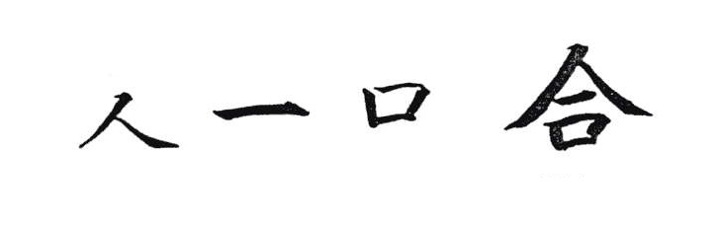
Tower of Babel
Gen 11:1, Now the whole earth used the same language and the same words.
+
+
Mankind
One
Mouth
United

Slide 38
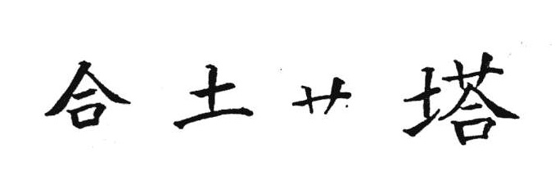
Tower of Babel
Gen 11:3-5, building of the tower of Babel
+
+
United
Clay
Straw
Tower
Mankind One Mouth

Slide 39
Evidences
Which accounts from Genesis are found in ancient Chinese Language?
  Creation (Gen. 1)
  Garden of Eden & Fall of man (Gen. 2-3)
  Cain & Abel (Gen. 4)
  The Flood (Gen. 6-9)
  The Tower of Babel (Gen. 11)

Slide 40
Long before Buddha, the Chinese people worshipped the same God described in the Bible!!!!
The Proof is in the Ancient Chinese Characters
2500 B.C.
1400 B.C.
600 B.C.
30 A.D.
2017 A.D.
Chinese language first written
First five books of Bible written
Buddha
Death of Jesus
Today
“Shang Di” was the god of China before Buddha. He was the creator God and animal sacrifice was offered to him.

