Slide 1
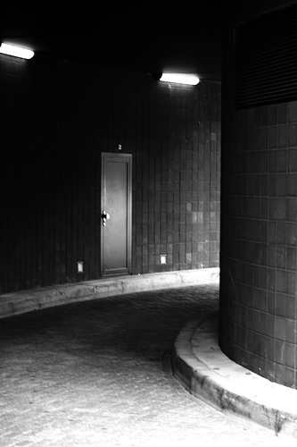
What’s Around The Corner?
F
aith to
ace the
uture

Slide 2
Having Faith in God
Knows All About Us
Mt 10:28-31, The hairs of our head are numbered
Mt 6:25-34, Jesus teaches on worry in the Sermon on the Mount

Slide 3
Having Faith in God
Protection from any and all external forces
Rom 8
We are Promised we can overcome
Paul endured many hardships and was able to write such a faith and confidence inspiring scripture

Slide 4
Having Faith in God
A Way of Escape When Tempted
I Cor 10:13
We will have a way of escape
God has our safety net

Slide 5
God Helps us Along the Way
Heb 12, Chastening of God as a Father
Mt 6, dealing with anxiety
Sometimes we might want more than God promises us

Slide 6
God Helps us Along the Way
Lk 18:1-8, Prayer & Inopportune Widow
Heb 4:14-15, Jesus is a High Priest that has been tempted in all ways as we have
Heb 9:14-15, Mediator of NT

Slide 7
God Allows
The Trials of this life Help us Grow
Jas 1:2-4, produces Patience (Endurance)
I Pet 1:6-7 trial of our faith is more precious than Gold
Necessary for Growth
May seem insurmountable at first

Slide 8
We Must Do Our Part
Heb 12:1; Don’t carry unnecessary burdens
Lay aside the Weights of Life
Lay aside Sin
Heb 12:1, Run Race
With Endurance (Patience)
Mt 25, Work
II Tim 2:15, 3:15, Study

Slide 9
We Must Do Our Part
Consider the faithful of Heb 11
Consider Jesus our great example
Endure Trials
Heb 12:5-13, Chastening of God
Jas 1:2-4, I Pet 1:6-7, Trials of Life

Slide 10
We Must Do Our Part
Mt 6, No Reason to Worry for the Faithful

Slide 11
Conclusion
By understanding how God works in our life; We can have Faith to Face the Future without Worry or Fear
We can live a life of Faith just as all those in Heb 11

