Slide 1
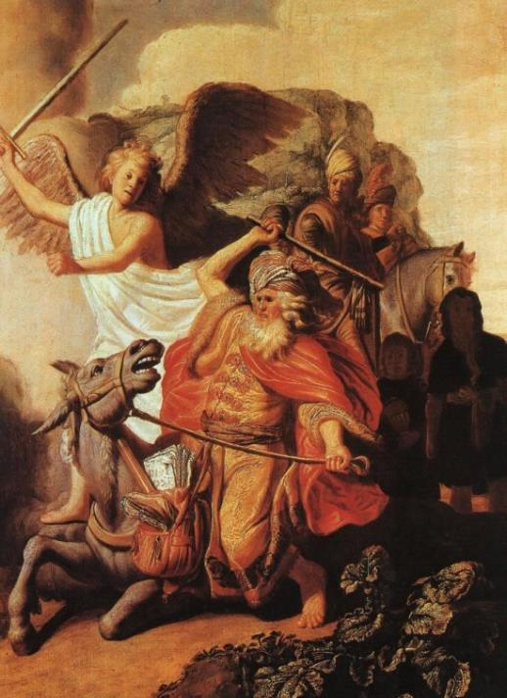
Lessons from Balaam
Num 22-24

Slide 2
Balaam – A Prophet of God
Balak is Threatened, Num 22:2-4
Balak Knows of a Prophet Whose Word Stands True, Num 22:5-6

Slide 3
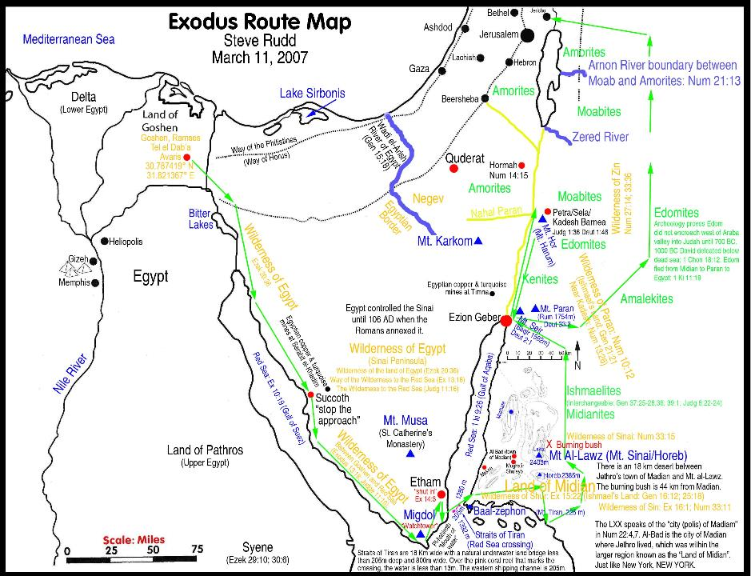
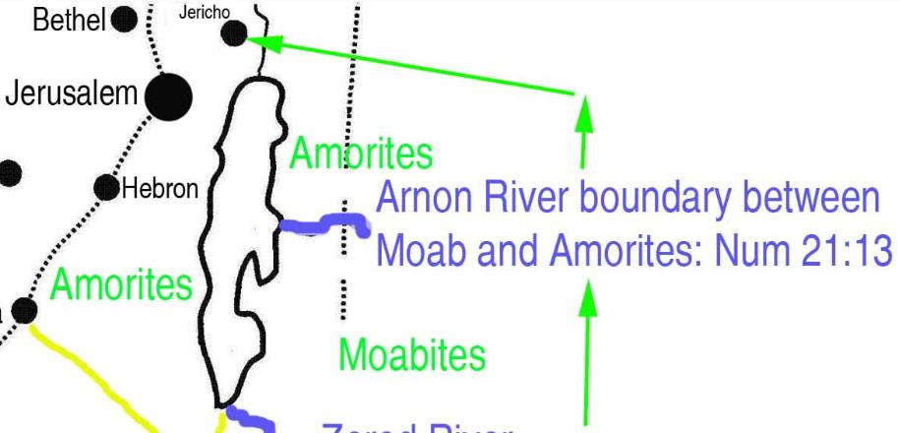

Slide 4
Balaam – A Prophet of God
Balak is Threatened, Num 22:2-4
Balak Knows of a Prophet Whose Word Stands True, Num 22:5-6
Balak Uses Several Ploys to Convince Balaam, Num 22:7-20, 23:1-12, 24:10-14
Flattery
Money
Intimidation

Slide 5
Balaam – A Prophet of God
A Prophet Existed Outside the Nation of Israel
Num 22:6, 8-12, 38, 23:4-10, 16-24, 24:13
Not a Faithful Prophet
Num 31:16, Rev 2:14, Idol Worship
II Pet 2:15-16, Jd 11, Greed
Balaam Recognized the Authority of God
Num 22:13, 18, 23:8-10, 19, 24:13
Deut 4:1-2, 5:32, 18:15-22, Josh 23:6, Mt 7:21-23

Slide 6
Balaam – A Prophet of God
Balaam was tempted by Wealth, Flattery, & Intimidation
Num 22:13, 37, 23:11, 25-26, 24:10-13
Jude 11
Mt 6:19-34

Slide 7
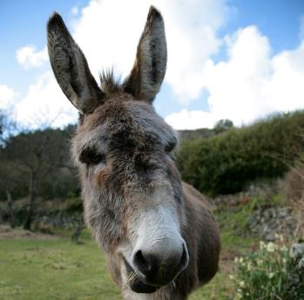
Balaam – A Prophet of God
Balaam’s persistence Causes Problems
It was against God’s will
Received more than he really wanted
Num 22:19-20, 22, Num 22:33-35, Num 23:11, Num 24:10-11
God was not going to
Curse Israel
Num 22:12, 24:1

Slide 10
Lessons from Balaam
Authority of God’s Command
Authority of God’s Prophets
Temptation of Wealth and Flattery
Intimidation from the World
Be Careful What You Ask
God’s Will Would not be Changed
Be Converted

