Slide 1
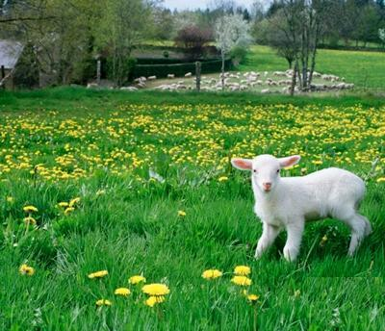
The Lamb Of God

Slide 2
John the Baptizer’s Profession
“Behold! The Lamb of God who takes away the sin of the world!”
John 1:29-36

Slide 3
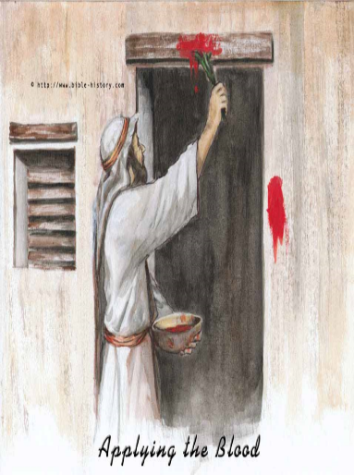
The Lamb Of God
The Passover
Lamb
Deliverance of the Firstborn From Death Ex 12:1-14, 25-28

Slide 4
The Lamb Of God
The Passover
Lamb
I Cor 5:7, Jesus is our Passover
Purge out the leaven…

Slide 5
The Lamb Of God
OT Sin-Bearing Lambs
Lamb Sacrifice Leviticus 4-5
Increasing value based on who sinned; ruler, people, rich, poor
stench , sounds

Slide 6
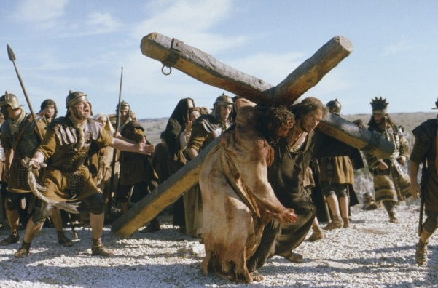
The Lamb Of God
The Better Sacrifice
OT Pattern, Heb 10:1-10
Christ is our Sacrifice, Heb 9:6-14
Capable of purging our Conscience
Remission of Sin, Heb 9:22-28

Slide 7
The Lamb Of God
No Substitute For The Lamb
I Pet 1:17-23
The need for Respecting the Value of the Sacrifice

Slide 8
The Lamb Of God
Our Passover Lamb
Our Sin Offering Lamb

Slide 9
The Lamb Of God
OT Daily Sacrificial Lambs
Every Day, Morning & Evening Outside the Tabernacle Exodus 29:38-44

