Slide 1
Jesus Prophet – Priest - King
Heb 1:1-3

Slide 2
Jesus - Prophet
A Prophet was Prophesied
Deut 18:15-22, Moses Prophesied “A Prophet” would come

Slide 3
Jesus - Prophet
Jesus Fulfilled that Prophecy
Jn 1:19-23, John the Baptizer was asked IF he was That Prophet
Acts 3:19-26; Peter states that Jesus WAS That Prophet
Acts 7:37-39; Stephen states that Jesus WAS That Prophet

Slide 4
Jesus - Prophet
The Work of a Prophet
Lk 19:10, Jesus came to seek and save the lost
Jn 8:28-32, Jesus says his Father taught him and he teaches
Jn 12:44-50, the words Jesus speaks will judge us in the last day
Jn 17:8, 14; I (Jesus) have given unto them the words that You (God) gave me
Mt 23:34-39, Tormented by the Jews

Slide 5
Jesus - Prophet
Results – A New Covenant
Mt 5:17-19, Jesus did not come to destroy but to fulfill; not one jot or tittle will fail till all is fulfilled.
Heb 9:15-17, Took the death of the testator

Slide 6
Jesus - Prophet
Results – A New Covenant
Heb 8:1-13; New Covenant with His People
Heb 12:24-25; Jesus is the Mediator of a New Covenant
Jn 12:44-50, the words Jesus speaks will judge us in the last day

Slide 7
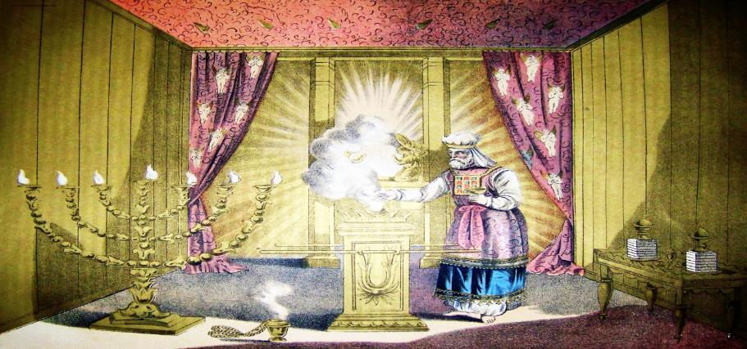
Jesus - Priest
Jesus is the Apostle and High Priest of our Profession, Heb 3:1

Slide 8
Jesus - Priest
Appointed by God
Heb 5:5-10

Slide 9
Jesus - Priest
Relating to OT Priesthood
Heb 5:5-6, 10, After the order of Melchisedec
Heb 7:1-4, Who Abraham was subject to, Without father or mother, Without beginning or ending of days

Slide 10
Jesus - Priest
Relating to OT Priesthood
Heb 2:17-18, Merciful and Faithful High Priest
Heb 4:14-16; He walked in our shoes, without sin
Heb 9:11-12, 24-28; Jesus entered the Holy place and offered the sacrifice for sin

Slide 11
Jesus - Priest
Work of a Priest
Heb 5:1-4, For every high priest taken from among men is ordained for men in things pertaining to God, that he may offer both gifts and sacrifices for sins
Heb 9:11-12, 24-28; Jesus entered the Holy place and offered the sacrifice for sin
He is a Mediator between God and the People

Slide 12
Jesus - Priest
Mediator of the Covenant
Heb 7:22-27, He Lives Forever to Make Intercessions for Us
Heb 9:15, Mediator of New Testament
Heb 8:6, Mediator of a Better Covenant
I Tim 2:5, One Mediator Between God and Man

Slide 13
Jesus - King
I Tim 6:15, King of Kings

Slide 14
Jesus - King
Prophesied in OT
II Sam 7:12-16, God speaking to King David, his throne will last forever
Jer. 23:5-6, A king shall come out of the lineage of David a righteous Branch.
Dan 2:36-45, God will establish a kingdom, which shall never be destroyed and it shall stand forever

Slide 15
Jesus - King
King of His Kingdom
Lk 1:32-33, given throne of David, kingdom shall have no end
Mt 2:1-2, Wise men looking for Jesus the King of the Jews
Mt 21:1-11, Jesus, King of Jews, rides a donkey
Mk 9:1, Some present would see the Kingdom of God come with power

Slide 16
Jesus - King
King of His Kingdom
Jn 1:43-51, Nathan proclaims Jesus to be the King of Israel
Jn 18:33-40, Jesus is asked if he was King during his trial
Jn 19:1-7, Soldiers put a crown of Thorns on Jesus, mocked him calling him King of the Jews
Jn 19:19-22, Title placed over his head
I Tim 6:15, King of Kings

Slide 17
Jesus - King
Reining on His Throne Forever
Lk 1:32-33, given throne of David, kingdom shall have no end
Mk 16:19, Acts 2:29-36 Jesus is received up into Heaven and is seated at the Right Hand of God
Act 5:31, God exalted to His Right Hand to be a Prince and a Savior
Acts 7:55-56, Stephen sees Jesus standing at the Right Hand of God.

Slide 18
Jesus - King
I Cor 15:24, He Will Deliver His Kingdom back to God

Slide 19
Jesus
Prophet – He gave us the Words to live by
Priest – He lived among men and offered the Sacrifice for our sins
King – He Reigns over his Kingdom waiting to collect his children home

