Slide 1
The Ark of God is Lost – I Sam 4-II Sam 6,
Recovery of the Ark of God – 1 Chr 13:1-14, 15:1-29

Slide 2
The Ark of God Takes A 7 Month Journey - 1 Sam 4-6
Ark of God
1 Sam 4:1-11, The Ark of God Captured by The Philistines, Eli’s Sons die
1 Sam 4:12-18, Eli Dies when told of Losses
1 Sam 4:19-22, Phinehas’ wife goes into labor, (has a son/names him Ichabod), and dies
Philistine
Army
Israel
Army

Slide 3
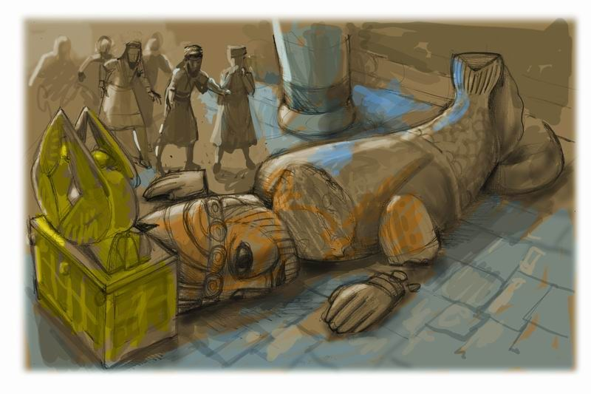
The Ark of God Takes A 7 Month Journey - 1 Sam 4-6
Philistines & the Ark
1 Sam 5:1-5, Ark carried to Ashdod set by god Dagon falls
I Sam 5:6-8, people of Ashdod stricken with tumors
1 Sam 5:9, Men of Gath made sick with tumors
1 Sam 5:10, Men of Ekron made sick with tumors and many died
1 Sam 5:11-12, Ark sent back to Israel

Slide 4
The Ark Taken To Kirjath-Jearim - 1 Sam 6:13-7:1
1 Sam 6:13-19, Men of Beth Shemesh stricken because they looked into the ark
1 Sam 6:20-7:1, “The men of Kirjath-Jearim came and took the ark of the Lord, and brought it into the house of Abinadab on the hill, and consecrated Eleazar his son to keep the ark of the Lord.”
Note this is Uzzah’s father and brother.

Slide 5
I Sam 4 – II Sam 6
Nearly 100 years passed since the ark of the covenant was taken from the tabernacle - (about 1094 to 1003 b.c.)
The ark had been in Kirjath-Jearim 20 years when Samuel spoke to the people & prayed for them in 1 Sam 7
Israel demands a king in 1 Sam 8 after Samuel gets old.
Saul is finally appointed king in chapters 9 & 10 & reigns for 42 years - (1 Sam 10:17-31:6)

Slide 6
I Sam 4 – II Sam 6
Nearly 100 years passed since the ark of the covenant was taken from the tabernacle - (about 1094 to 1003 b.c.)
Saul’s son, Ishbosheth Made King of Israel & reigns 2 years - (2 Sam 2:8-11; 4:5-8)
David reigns over Judah for 7 1/2 years - (2 Sam 2:11)
There is civil war between Israel & Judah, (Ishbosheth & Abner vs. David & Joab)

Slide 7
I Sam 4 – II Sam 6
Nearly 100 years passed since the ark of the covenant was taken from the tabernacle - (about 1094 to 1003 b.c.)
David is made king over all Israel - (2 Sam 5:1-5)
David takes Jerusalem from the Jebusites and calls it “the city of David” (2 Sam 5:6-14)

Slide 8
I Sam 4 – II Sam 6
Nearly 100 years passed since the ark of the covenant was taken from the tabernacle - (about 1094 to 1003 b.c.)
David fights off the Philistines, driving them out of Israel solidifying his kingdom - (2 Sam 5:17-25)
David works to retrieve the ark & bring it to Mount Zion - (2 Sam 6:1-11;1 Chr 13:1-14)

Slide 9
2 Sam 6:1-11, 1 Chr 13:1-14
Retrieving the Ark of God
David gathers all the chosen men of Israel, 30,000 men (2 Sam 6:1-2, 1 Chr 13:1-6)
The Ark of God is loaded on a new cart (2 Sam 6:3-5, 1 Chr 13:7-8)
Uzzah touches the Ark to steady it (2 Sam 6:6, 1 Chr 13:9)
God punished Uzzah (2 Sam 6:7, 1 Chr 13:10)
David did not know what to do next (2 Sam 6:8-11, 1 Chr 13:11-14)

Slide 10
When “Good” is Bad
2 Sam 6:1-11;1 Chr 13:1-14
David’s attempt to move the ark to Jerusalem was Stopped when Uzzah loses his life; David is now afraid of the Lord!
What did David do wrong?
What did David learn?
How could David accomplish his desire & please God?

Slide 11
When “Good” is Bad
David’s plans were formed using “human wisdom” instead of divine revelation - (1 Chr15:11-15)
His wisdom was no different than Philistines - (2 Sam 6:3; 1 Sam 6:7)
God had specified how the ark was to be moved - (Num 3:30-31; 4:15; 7:9; Ex 25:14-15).
Thus David disobeyed God - (1 Chr15:13)

Slide 12
When “Good” is Bad
The anger of the Lord was aroused against Uzzah - (2 Sam 6:6,7; 1 Chr 13:9-10)
Uzzah touched the ark - (Num 4:15, 19, 20)
Should have known better - (2 Sam 6:3; 1 Chr 13:7; 1 Sam 7:1,2)
Though trying to do what he thought was good, Uzzah sinned.

Slide 13
Lessons from David’s Ox Cart - When “Good” is Bad
Popularity or public approval does not make one right. - (1 Chr 13:1-4)
David consults every leader (v 1),
His plans met public approval (v 4).
He did consult with God or His word. (1 Chr15:13; Num 3:30-31; 4:15; 7:9; Ex 25:14-15; Ex 23:2).

Slide 14
Lessons from David’s Ox Cart - When “Good” is Bad
Popularity or public approval does not make one right. - (1 Chr 13:1-4)
If an action violates the will of God is evil, regardless of how many people approve - (Ex 23:2; Num 14:1-10; 1 Sam 15:9,24; Prov 14:12; Mat 7:13,14, 21-23).

Slide 15
Lessons from David’s Ox Cart - When “Good” is Bad
Zeal does not make one right - (2 Sam 6:1-5; 1 Chr 13:8)
David & Israel prepared a new ox cart - made big plans - honored God with their words - but rushed ahead without “consulting the proper order” - (1 Chr 15:13)
The Jews in Paul’s day were zealous for God but lost — Rom 10:1-2

Slide 16
Lessons from David’s Ox Cart - When “Good” is Bad
Ignorance is not an Excuse:
Zeal without knowledge is dangerous! - We must be zealous & obedient - Rom 12:11; Eph 5:15-18
Ignorance is no excuse (1 Chr 13:12; Hos 4:6).
Young and Old prophet, I Kng 13

Slide 17
Lessons from David’s Ox Cart - When “Good” is Bad
Good intentions are not sufficient:
David had good intentions - 2 Sam 6:2; 1 Chr 13:3,4
Uzzah had good intentions when he reached out to steady the ark - 2 Sam 6:6,7
No substitute for obedience - (1 Sam 15:22,23; Mt 7:21-23)
A good conscience does NOT make one right (Prov 14:12; Acts 23:1)

Slide 18
Lessons from David’s Ox Cart - When “Good” is Bad
When God specifies - we CANNOT substitute. (1 Chr 13:5-8)
David’s best attempt to serve God according to his own thinking dishonored God instead of honoring Him - (Lev 10:1-4; 1 Chr 15:2,13; Isa 55:6-9; Hos 14:9; Col. 3:17)

Slide 19
Lessons from David’s Ox Cart - When “Good” is Bad
When God specifies - we CANNOT substitute. (1 Chr 13:5-8)
Nadab and Abihu – (Lev. 10:1,2)
Moses – (Num 20:8-24)
King Saul – (1 Sam. 13 & 15)
Jeroboam – (1 Kings 12:25-33)
Uzziah – (2 Chr. 26:16-23)

Slide 20
Lessons from David’s Ox Cart - When “Good” is Bad
When God specifies - we CANNOT substitute. (1 Chr 13:5-8)
What happens to our worship when we put it on a “Ox Cart” rather than following the divine order?
What happens to our work when we load it on an “Ox Cart” we have made (institutionalism) rather than following the divine order?

Slide 21
David and Uzzah's Error
Consequences of the Ox Cart
Lessons from David’s Ox Cart - When “Good” is Bad
Man Cannot Know the Man of God Except through Revelation
I Cor 2:10-14
Eph 3:3-5
Isa 55:8-9
God has revealed everything that He wants from us
2 Pet 1:3
2 Tim 3:16-17
Jude 3

Slide 22
David and Uzzah's Error
Consequences of the Ox Cart
Lessons from David’s Ox Cart - When “Good” is Bad
Mt 21:23-27
Only Two Possible Sources
From Heaven
1 Jn 4:4-6
Gal 1:6-9
Col 2:6-10
2 Thes 2:15
From Men
Mt 15:1-9
Gal 1:10-23
Col 2:8
2 Thes 2:2-4

Slide 23
David and Uzzah's Error
Consequences of the Ox Cart
Lessons from David’s Ox Cart - When “Good” is Bad
Walking by faith means walking
by what God has said
2 Cor 5:7, We walk by Faith not by Sight
1 Cor 4:6, Do not put man above God
Gal 1:6-9, Nobody can change the Gospel

Slide 24
How to Please God
1 Chr 13:12, David was afraid of God that day, saying, “How can I bring the ark of God to me?”
Consult the proper order (1 Chr 15:2; 12-13; Acts 17:11)
Follow the proper order (1 Chr 15:14-15; 2 Tim 2:15; Jam 1:22-25)

