Slide 2
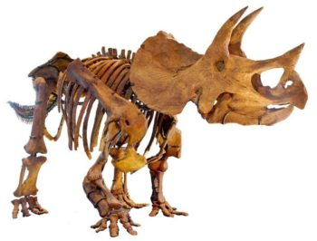
Best Cases for a Young Earth
Soft Tissue in Dinosaur Bones
A Triceratops
CSUN scientist Mark Armitage
Notes:
Web Page: http://blog.godreports.com/2017/08/university-settles-lawsuit-with-scientist-fired-after-he-found-soft-tissue-in-dinosaur-bones/

Slide 3
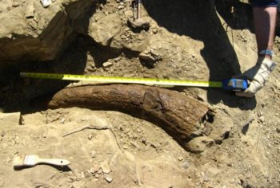
Best Cases for a Young Earth
Soft Tissue in Dinosaur Bones
CSUN scientist Mark Armitage found soft tissue in a dinosaur bone, a discovery that throws significant doubt on evolution. In May 2012, at the famous fossil site of Hell Creek in Montana,
Notes:
Web Page: http://blog.godreports.com/2017/08/university-settles-lawsuit-with-scientist-fired-after-he-found-soft-tissue-in-dinosaur-bones/

Slide 4
Best Cases for a Young Earth
Soft Tissue in Dinosaur Bones
A biology professor had come into his office and said, “ “We are not going to tolerate your religion in this department.”
Notes:
Web Page: http://blog.godreports.com/2017/08/university-settles-lawsuit-with-scientist-fired-after-he-found-soft-tissue-in-dinosaur-bones/

Slide 5
Best Cases for a Young Earth
Soft Tissue in Dinosaur Bones
Schweitzer, a molecular paleontologist at North Carolina State University
But the real astonishment came when Schweitzer’s team dissolved some fragments in weak acid… When Schweitzer looked at the only remaining chunk under the microscope, she couldn’t believe its elasticity. It took her quite some time to realize that it was soft tissue, which, being from a dinosaur bone, had never before been seen by a scientist.
Notes:
http://blog.godreports.com/2017/07/discovery-of-soft-tissue-in-dinosaur-bones-upends-evolutionary-timetable/
https://www.smithsonianmag.com/science-nature/dinosaur-shocker-115306469/

Slide 6
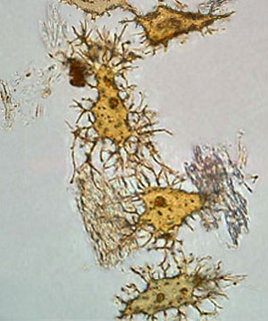
Best Cases for a Young Earth
Soft Tissue in Dinosaur Bones
a “68 million” year old T. rex
Notes:
Soft Tissue in a T. Rex Fossil? by Dr. Marcus Ross on January 1, 2010
Web Page: http://blog.godreports.com/2017/08/university-settles-lawsuit-with-scientist-fired-after-he-found-soft-tissue-in-dinosaur-bones/

Slide 7
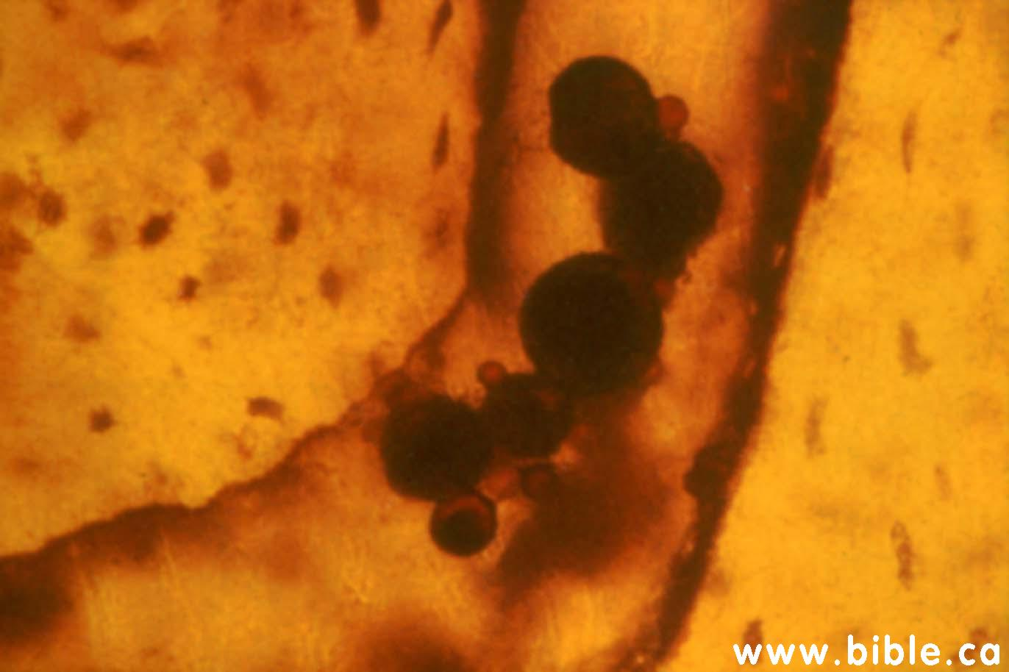
Best Cases for a Young Earth
Soft Tissue in Dinosaur Bones
Notes:
http://www.bible.ca/tracks/rapid-fossils-rapidly-perishing-detail-preserved.htm

Slide 8
Best Cases for a Young Earth
Soft Tissue in Dinosaur Bones
"Round and tiny and nucleated, they were threaded through the bone like red blood cells in blood vessels. But blood cells in a dinosaur bone should have disappeared eons ago. 'I got goose bumps. ...It was exactly like looking at a slice of modern bone. But, of course, I couldn't believe it. ...The bones are, after all 65 million years old. How could blood cells survive that long?'" (Science, Research News, V.261, 9/7/'93) From Bible.ca
Notes:
http://www.bible.ca/tracks/rapid-fossils-rapidly-perishing-detail-preserved.htm

Slide 9
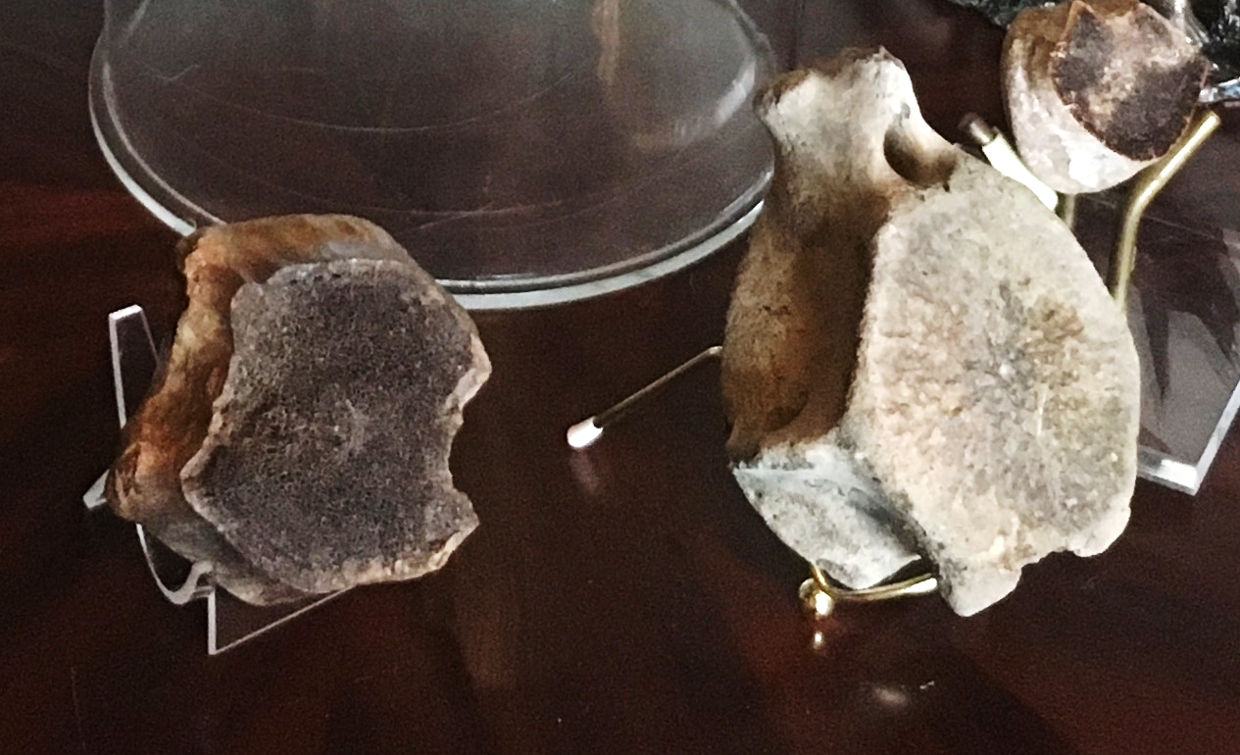
Best Cases for a Young Earth
Non-Fossilized Dinosaur Bones
Don Patton’s Personal Artifacts
Notes:
Don Patton’s personal collection
http://www.bible.ca/tracks/rapid-fossils-rapidly-perishing-detail-preserved.htm

Slide 10
What They Say
Richard Dawkins, Oxford "alleged human bones in the Carboniferous coal deposits. If authenticated as human, these bones would blow the theory of evolution out of the water." (Free Inquiry, V.21, No.4, 10/11/2001)
Richard Dawkins, Oxford "...there are certain things about the fossil record that any evolutionist should expect to be true. We should be very surprised, for example, to find fossil humans appearing in the record before mammals are supposed to have evolved! If a single, well verified mammal skull were to turn up in 500 million year old rocks, our whole modern theory of evolution would be utterly destroyed. Incidentally, this is a sufficient answer to the canard, put about by creationist and their journalistic fellow travelers, that the whole theory of evolution is an 'unfalsifiable' tautology. Ironically, it is also the reason why creationist are so keen on the fake human footprints, which were carved during the depression to fool tourist, in the dinosaur beds of Texas," (The Blind Watchmaker, 1986, p.225)

Slide 11
What They Say
Steven M. Stanley, Johns Hopkins University, "There is an infinite variety of ways in which, since 1859, the general concept of evolution might have been demolished. Consider the fossil record--a little known resource in Darwin's day. The unequivocal discovery of a fossil population of horses in Precambrian rocks would disprove evolution. More generally, any topsy-turvy sequence of fossils would force us to rethink our theory, yet not a single one has come to light. As Darwin recognized, a single geographic inconsistency would have nearly the same power of destruction." (The New Evolutionary Timetable, 1981, p.171)
NOVA TV Special, God, Darwin And The Dinosaurs, "...dinosaur footprints, side by side with humans. Finding them would counter evidence that humans evolved long after the dinosaurs became extinct and back up...[the] claim that all species, including man, were created at one time."

Slide 12
What They Say
Louis Jacobs, Southern Methodist University, Former President of the Society of Vertebrate Paleontology, "co-occurrence of men and dinosaurs. Such an association would dispel an Earth with vast antiquity. The entire history of creation, including the day of rest, could be accommodated in the seven biblical days of the Genesis myth. Evolution would be vanquished." (In Quest of the African Dinosaur, p.261)

Slide 13
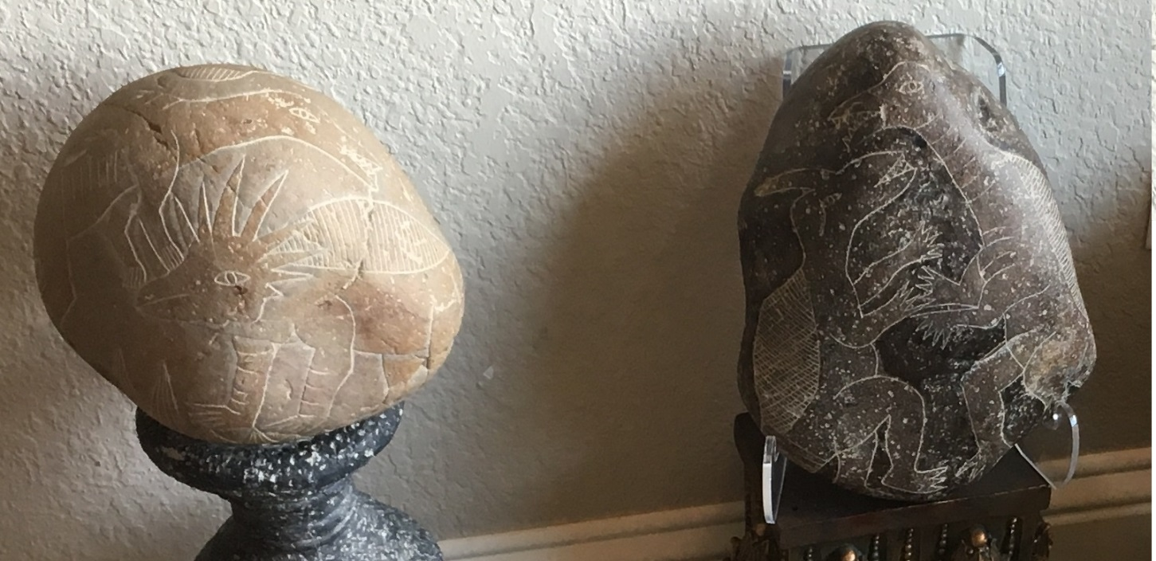
Best Cases for a Young Earth
Man & Dinosaurs Co-Existed
Inca Burial Stones from South America
Don Patton’s Personal Artifacts
Notes:
Don Patton’s personal artifacts, Hot Springs, AR
Dinosaurs in Central America!
How did a human know what a Dinosaur looked like? These are not skeletons that are dug up but renditions of actual creatures as it would have lived here.
These are much more crude figures but still yet. Can we really doubt the person that made these actually saw a Dinosaur (or somebody else’s depiction of one)?

Slide 14
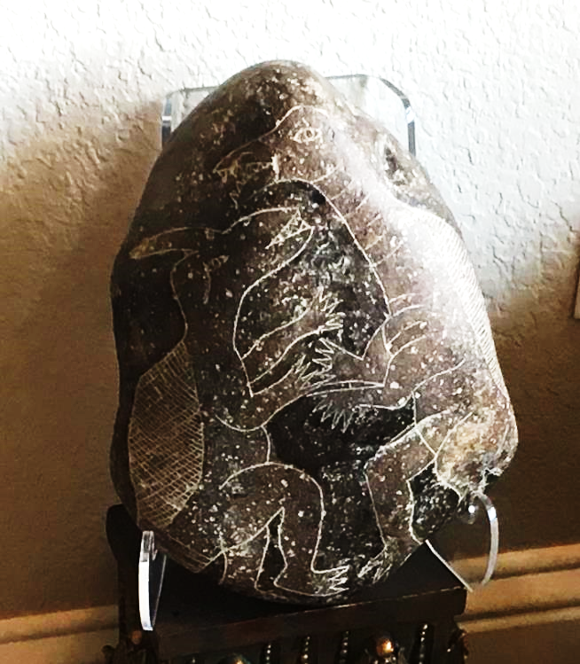
Best Cases for a Young Earth
Don Patton’s Personal Artifacts
Notes:
Don Patton’s personal artifacts, Hot Springs, AR
Dinosaurs in Central America!
How did a human know what a Dinosaur looked like? These are not skeletons that are dug up but renditions of actual creatures as it would have lived here.
These are much more crude figures but still yet. Can we really doubt the person that made these actually saw a Dinosaur (or somebody else’s depiction of one)?

Slide 15
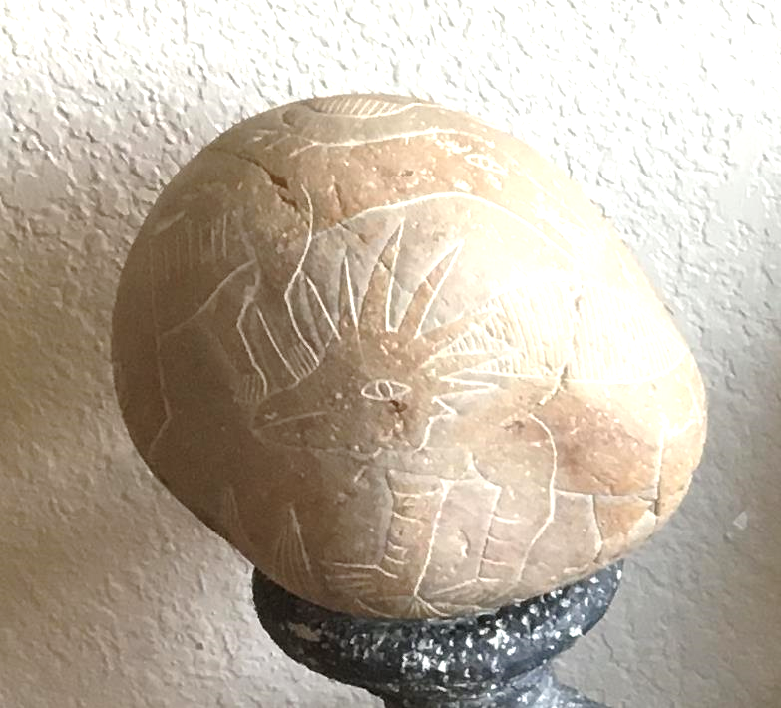
Best Cases for a Young Earth
Man & Dinosaurs Co-Existed
Don Patton’s Personal Artifacts
Notes:
Don Patton’s personal artifacts, Hot Springs, AR
Dinosaurs in Central America!
How did a human know what a Dinosaur looked like? These are not skeletons that are dug up but renditions of actual creatures as it would have lived here.
These are much more crude figures but still yet. Can we really doubt the person that made these actually saw a Dinosaur (or somebody else’s depiction of one)?

Slide 16
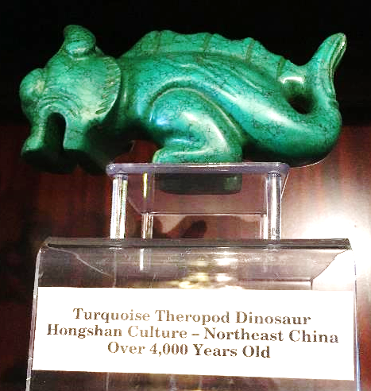
Best Cases for a Young Earth
Man & Dinosaurs Co-Existed
Don Patton’s Personal Artifacts
Notes:
Don Patton’s personal artifacts, Hot Springs, AR
Dinosaurs in China!
How did a human know what a Dinosaur looked like? These are not skeletons that are dug up but renditions of actual creatures as it would have lived here.
These are much more crude figures but still yet. Can we really doubt the person that made these actually saw a Dinosaur (or somebody else’s depiction of one)?

Slide 17
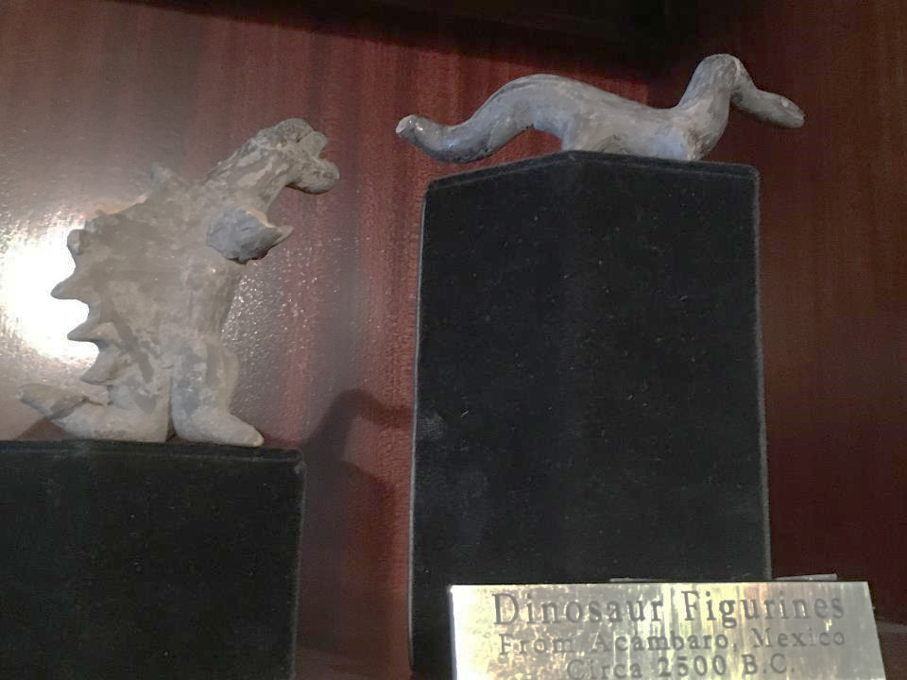
Best Cases for a Young Earth
Man & Dinosaurs Co-Existed
Don Patton’s Personal Artifacts
Notes:
Don Patton’s personal artifacts, Hot Springs, AR
Dinosaurs in Central America!
How did a human know what a Dinosaur looked like? These are not skeletons that are dug up but renditions of actual creatures as it would have lived here.
These are much more crude figures but still yet. Can we really doubt the person that made these actually saw a Dinosaur (or somebody else’s depiction of one)?

Slide 18
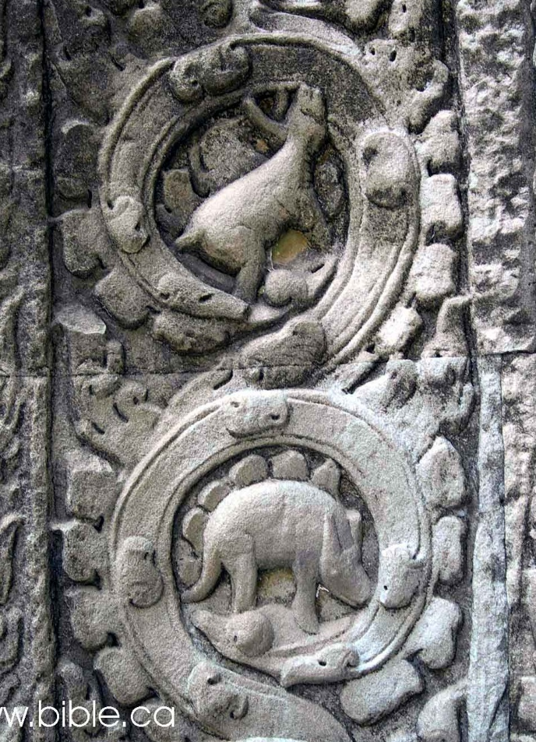
Best Cases for a Young Earth
Man & Dinosaurs Co-Existed
Stegosaur
Dinosaurs in ancient Cambodian temple
Notes:
http://www.bible.ca/tracks/tracks-cambodia.htm
The obvious indication is that the stone carvers of the tenth century saw a stegosaurus as they saw monkeys, buffalo and deer.

Slide 19
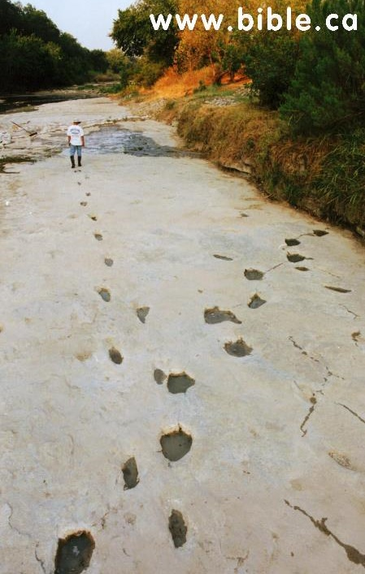
Best Cases for a Young Earth
Man & Dinosaurs Co-Existed
Notes:
Dinosaur tracts everywhere! Woah, wait, are those Human tracks. Check out the next slide.
Glenn Rose TX, Taylor Trail

Slide 20
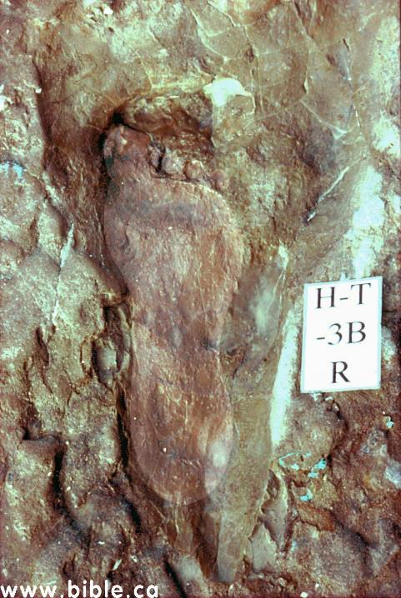
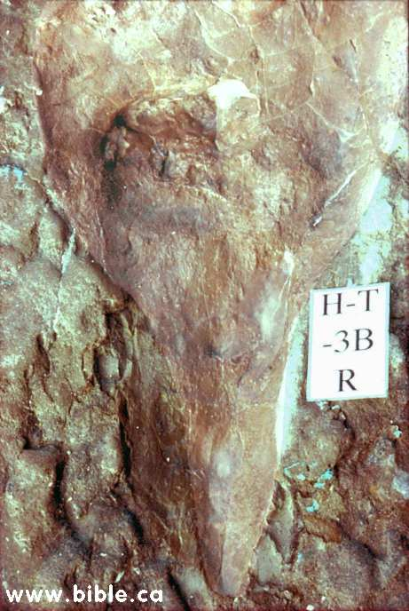
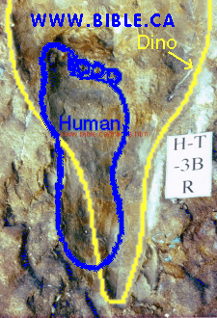
Best Cases for a Young Earth
Man & Dinosaurs Co-Existed
Notes:
Human and Dinosaur tracts are highlighted for emphasis.
The left pic is with Human track highlighted; The right pic is Dinosaur track is highlighted.
Several of these best tracks were destroyed shortly after evolutionary “scientist” arrive to review findings. See Bible.ca for story

Slide 21
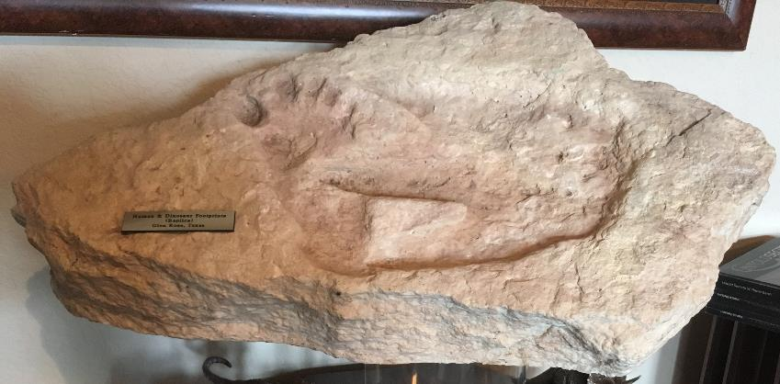
Best Cases for a Young Earth
Man & Dinosaurs Co-Existed
Notes:
A casting of another set of tracks in Glen Rose TX

Slide 22
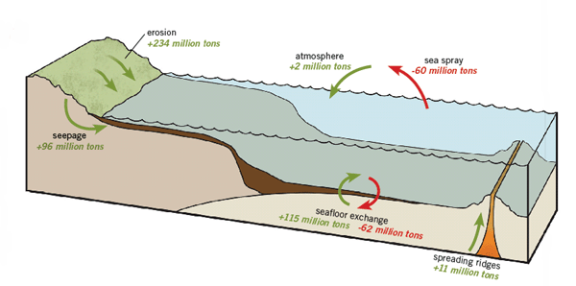
Best Cases for a Young Earth
Salt Concentration in the Ocean
Salt Clock
AIG
Notes:
AIG; https://answersingenesis.org/evidence-for-creation/the-10-best-evidences-from-science-that-confirm-a-young-earth/

Slide 23
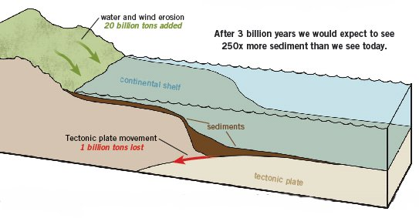
Best Cases for a Young Earth
Sediment level in the Ocean
AIG
Notes:
AIG; https://answersingenesis.org/evidence-for-creation/the-10-best-evidences-from-science-that-confirm-a-young-earth/

Slide 24
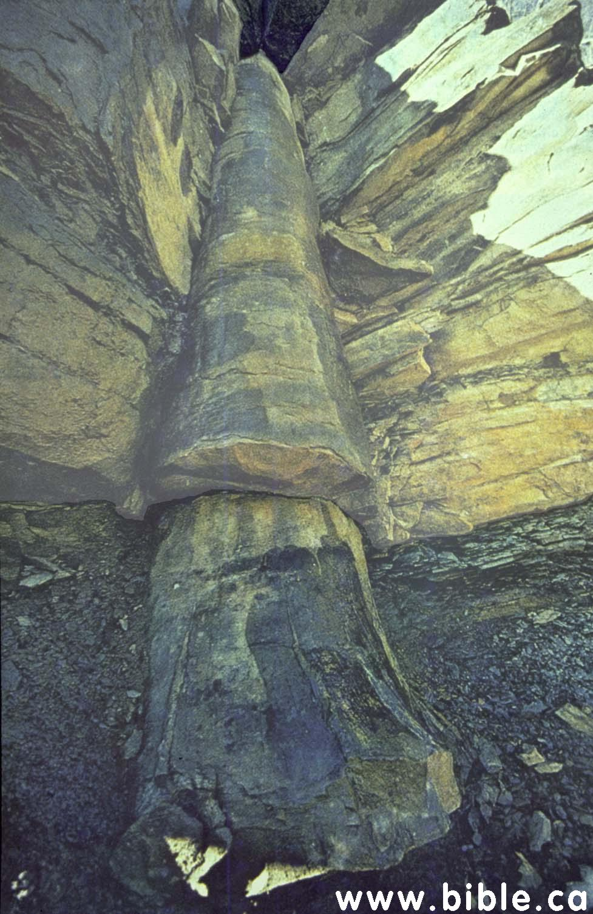
Best Cases for a Young Earth
Rapid Formation of Layers & Coal
Notes:
Supposedly slowly deposited layers of the earth crust, but there is a petrified tree laying vertical through those layers.

Slide 25
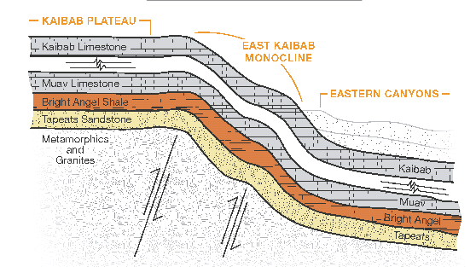
Best Cases for a Young Earth
Rapid Formation of Layers & Coal
AIG
The Grand Canyon

Slide 26
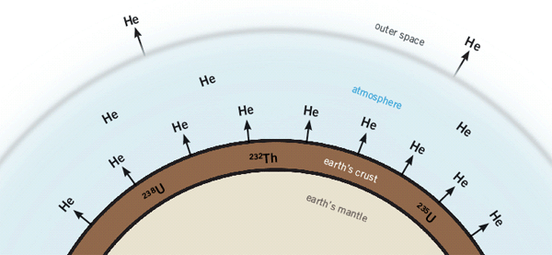
Best Cases for a Young Earth
Helium in Radioactive Rocks
AIG
During the radioactive decay of uranium and thorium contained in rocks, lots of helium is produced
Notes:
https://answersingenesis.org/evidence-for-creation/the-10-best-evidences-from-science-that-confirm-a-young-earth/

Slide 27
Best Cases for a Young Earth
Helium in Radioactive Rocks
AIG
While drilling deep Precambrian (pre-Flood) granitic rocks in New Mexico, geologists extracted samples of zircon (zirconium silicate) crystals from different depths. The crystals contained not only uranium but also large amounts of helium.
Notes:
https://answersingenesis.org/evidence-for-creation/the-10-best-evidences-from-science-that-confirm-a-young-earth/

Slide 28
Best Cases for a Young Earth
Helium in Radioactive Rocks
Helium diffuses so rapidly that all the helium in these zircon crystals should have leaked out in less than 100,000 years. The fact that so much helium is still there means they cannot be 1.5 billion years old, as uranium-lead dating suggests. Indeed, using the measured rate of helium diffusion, these pre-Flood rocks have an average “diffusion age” of only 6,000 (± 2,000) years
AIG
Notes:
https://answersingenesis.org/evidence-for-creation/the-10-best-evidences-from-science-that-confirm-a-young-earth/

Slide 29
Best Cases for a Young Earth
Summary of Evidences
Soft Tissue in Dinosaur bones
Man and Dinosaurs Co-Existed
Salt Concentration in Oceans
Sediment in Oceans
Rapid Formation of Earth’s Layers
Helium in Radioactive Rocks

