Slide 1
Christ’s Church
The “Local” Church
Rom 16:16

Slide 2
THE CHURCH OF CHRIST
Church – Ekklesia
Strong’s G1577
a calling out, a popular meeting
Thayer
a gathering of citizens called out from their homes into some public place, an assembly

Slide 3
THE CHURCH OF CHRIST
Names and Metaphors for the Universal Church
Family/Household
Body of Christ
Bride of Christ
Holy City/New Jerusalem/Bride
The Saved
The Book of Life
The Kingdom of God/Heaven
Belongs to Christ
Christ is Head
Church is Subject to Christ
Membership is Determined by Jesus/God
Notes:
Some names and metaphors are also used for the local church, or could be vague references to either.

Slide 4
THE CHURCH OF CHRIST
Universal Church
All the Saved
The Book of Life
Local Churches
Acts 2:41-47
Notes:
Both the local and universal church seen in Acts 2;
it is entirely possible that some assemblies do not contain any of the saved.

Slide 5
Notes:
Jew’s Cleansing procedure. One way 3,000-5,000 people could be baptized in one day.

Slide 6
THE CHURCH OF CHRIST
Ekklesia – A Local Assembly of Christians
Names/Titles
A Flock
Acts 20:28-29, Take heed therefore unto yourselves, and to all the flock… not sparing the flock.
I Pet 5:2-3, Feed the flock of God which is among you…but being ensamples to the flock.
A Body
I Cor 12:12-31, each member has a purpose

Slide 7
THE CHURCH OF CHRIST
Ekklesia – A Local Assembly of Christians
Names/Titles
Church of God
Acts 20:28-29, the church of God
I Pet 5:2-3, Feed the flock of God which is among you…but being ensamples to the flock.
I Cor 1:2, 10:32, 11:16, 11:22 …to the church of God
II Cor 1:1, …the church of God
Gal 1:13, …the church of God
I Tim 3:15, … the church of God

Slide 8
THE CHURCH OF CHRIST
Ekklesia – A Local Assembly of Christians
Names/Titles
Churches of Christ
Rom 16:16, The Churches of Christ salute you
House of God
I Tim 3:15, …the house of God…
Church of the Saints
I Cor 14:33, as in all churches of the saints

Slide 9
THE CHURCH OF CHRIST
Ekklesia – A Local Assembly of Christians
Local Churches
A Local Assembly of Christians
Acts 11:22, …church at Jerusalem…
Acts 13:1, …church that was at Antioch…
Acts 20:17, call the elders of the church at Ephesus
Rom 16:1, church which is at Cenchrea
Rom 16:5, I Cor 16:19, Church in the house of Priscilla and Aquila
I Cor 1:2, II Cor 1:1 to the church of God which is at Corinth…

Slide 10
THE CHURCH OF CHRIST
Ekklesia – A Local Assembly of Christians
Local Churches
A Local Assembly of Christians
II Cor 8:1, the churches of Macedonia
Col 4:16, church of Laodicean's
I Thes 1:1, II Thes 1:1, to the church of the Thessalonians…
I Tim 3:15, that thou may know how thou ought to behave thyself in the house of God, which is the church of the living God…
Rev 2-3, 7 churches of Asia

Slide 11
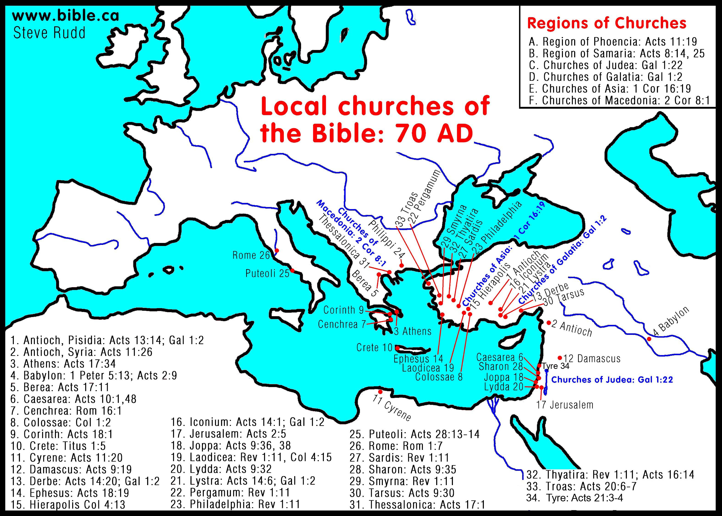

Slide 12
THE CHURCH OF CHRIST
Ekklesia – A Local Assembly of Christians
Local Churches
Organization (Elders/Bishops)
Tit 1:5-16, Titus to appoint Bishops
I Tim 3:1-13, Bishop & Deacons
Acts 20:28-31, work of the Elders of the church at Ephesus
I Pet 5:1, Elders among you…
Presbyter/Pastor interchangeable
The only Leadership given to the local church
Notes:
Discuss world view of preachers, evangelist, and deacons

Slide 13
THE CHURCH OF CHRIST
Ekklesia – A Local Assembly of Christians
Local Churches
Leadership was Limited to Local assembly
Acts 20:28-29, Take heed therefore unto yourselves, and to all the flock…
I Pet 5:2-3, Feed the flock of God which is among you…but being ensamples to the flock.
Autonomy of local works
Some suppose the elders in cities in instructions like Titus implies a hierarchy outside the local group
Notes:
Discuss world view of preachers, evangelist, and deacons

Slide 14
THE CHURCH OF CHRIST
Ekklesia – A Local Assembly of Christians
Local Churches
Organization (Deacons)
I Tim 3:8-13, qualifications
Phil 1:1, with elders and deacons
Acts 6:1-6, similar of works but not of the “office”

Slide 15
THE CHURCH OF CHRIST
Ekklesia – A Local Assembly of Christians
Local Churches
Value of Membership
Eph 4:12-16, perfecting of the saints, for the work of the ministry, for the edifying of the body of Christ:13 Till we all come in the unity of the faith, and of the knowledge of the Son of God, unto a perfect man

Slide 16
THE CHURCH OF CHRIST
Ekklesia – A Local Assembly of Christians
Local Churches
Responsible to Live Righteously, Eph 1:3-12,
we should be holy and without blame
adoption …To the praise of the glory of his grace
In whom we have redemption… according to the riches of his grace;
predestinated …That we should be to the praise of his glory
Gal 5&6

Slide 17
THE CHURCH OF CHRIST
Ekklesia – A Local Assembly of Christians
Local Churches
Active Workers
I Cor 12:12-20, greatest to the least
Eph 4:11-16, various workers in the Church with unifying purpose
Acts 8:3, Christians went everywhere teaching the word

Slide 18
THE CHURCH OF CHRIST
Ekklesia – A Local Assembly of Christians
Local Churches
Local Collections & Treasury
Acts 4:35, 5:2, 6:1, Church in Jerusalem
I Cor 16:1, Church in Corinth
I Tim 5:4-16, Widows at Ephesus

Slide 19
THE CHURCH OF CHRIST
Ekklesia – A Local Assembly of Christians
Local Churches
Limited Membership
Acts 9:26, Saul of Tarsus was refused admittance
I Cor 5:1-13, II Thes 3:6-15, Dealing with the Rebellious
We will cover in detail at a later date
The Church is not for everyone

Slide 20
THE CHURCH OF CHRIST
Ekklesia – A Local Assembly of Christians
Local Churches
It’s Work (Purpose)
Worship together (Song, Prayer, Lord’s Supper)
Edification
Evangelism
Benevolence
We will cover these in detail at a later date

Slide 21
THE CHURCH OF CHRIST
Ekklesia – A Local Assembly of Christians
Local Churches
Failing Churches
Rev 2-3, Churches of Asia…
Corinthians struggled with worldliness and unity
Galatians left the Gospel for Judaizing teachings

Slide 22
THE CHURCH OF CHRIST
Ekklesia – A Local Assembly of Christians
Titles
A Flock
A Body
Churches of Christ
Church of God
House of God
Church of the Saints
A Local Assembly of Christians
Organization
Local (Elders)
Local (Deacons)
Members (with Purpose)
Collections & Treasury
Limited Membership
It’s Work (Purpose)
Failing Churches
Divine Organization and Purpose

