Slide 1
Names & Titles of Jesus

Slide 2
Who is Jesus
Importance of Names
Naming Children
Name for Church
Titles in the Church
Forbidden Names

Slide 4
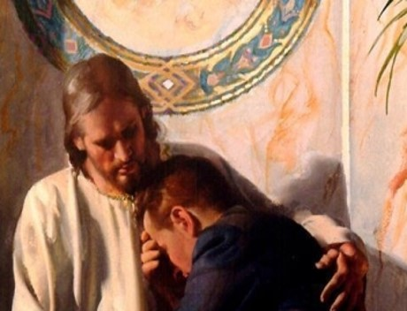
Wonderful Counselor

Slide 5
Who is Jesus
Wonderful Counselor
Definitions
Wonderful
Miraculous
“beyond understanding”
“too wonderful for words”

Slide 6
Who is Jesus
Wonderful Counselor
Definitions
Wonderful – Miraculous
Counselor – To Advise
His teachings are perfect and therefore can make us complete

Slide 7
Who is Jesus
Wonderful Counselor
His Counsel is Truth
Jn 8:31-32, If you continue in Jesus word, the truth, then you are his disciple

Slide 8
Who is Jesus
Wonderful Counselor
Jesus provided for His counsel to be delivered to Apostles
Jn 14:26, 16:13, comforter would come from the Father and teach them all things
Mt 28:18-20, Apostles commanded to teach all mankind to observe what He had commanded

Slide 9
Who is Jesus
Wonderful Counselor
His Counsel Helps us with Issues of Life
Mt 11:28-30, his yoke is easy and burden is light
I Pet 5:5-7, cast our care upon him

Slide 10
Who is Jesus
Wonderful Counselor
His Counsel Changes Lives
All who are His disciples
Rom 13:12 let us therefore cast off the works of darkness, and let us put on the armor of light.
Eph 4:22-24, put off old man and put on new man

Slide 11
Who is Jesus
Wonderful Counselor
His Counsel Gives Hope
I Cor 15:51-57, resurrection from the Dead

Slide 12
Who is Jesus
Wonderful Counselor
Jesus never gives bad advice.
Jesus never steers us wrong.
Jesus never makes mistakes.

Slide 13
Who is Jesus
Mighty God
Mt 1:21-23, Immanuel (God with Us)
Jn 1:1, Word was God
Heb 1:8, He is God
Powerful

Slide 14
Who is Jesus
Everlasting Father
Heb 1:8, His Throne is Eternal
Jn 14:5-11, seeing the Son you have seen the Father
By nature, being God he is Eternal

Slide 15
Who is Jesus
Isa 9:6
Wonderful Counselor
Mighty God
Everlasting Father
Prince of Peace
Word is Truth
Powerful God
Eternal God
Reconciled us to God

