Slide 1
Evangelism

Slide 2
Evangelism
Being Good Gardeners

Slide 3
Evangelism
In The Early Church
Mt 28:18-20, Great Commission

Slide 4
Evangelism
In The Early Church
Acts 2, Apostles
Phil 1:12-13, Paul
Acts 8:1-4, Christians spread the word
Acts 11:19, Christians spread the word

Slide 5
Evangelism
Recognizing Our Opportunities
Ezk 3:17-21, Ezekiel's Responsibility
Learning from Conversions in Acts
God Left the Gospel in Man’s Hands to Spread and to Teach

Slide 6
Evangelism
Poll: How / Why did you come to attend your church?
I had a special need - 2%
I just walked in - 3%
I like the minister - 6%
I visited there - 1%
I like the Bible classes - 5%
I attended a gospel meeting - 0.5%
I liked the programs - 3%
A friend or relative influenced me - 79%

Slide 7
Evangelism
Establishing Credibility
Apostles had Holy Spirit
Jn 14:26, 16:7-13, Comforter the Holy Spirit Promised
Mk 16:17-18, signs given
Acts 2, Holy Spirit came upon the Apostles and they began preaching

Slide 8
Evangelism
Establishing Credibility
We have the Bible
Result of the Holy Spirit’s Work
Our Reputation
Caution against minimizing this effect

Slide 9
Evangelism
“The best argument for Christianity is Christians”
“What you ARE speaks so loudly, I can’t hear what you are SAYING.”

Slide 10
Evangelism
II Pet 1:5-11, add to..
Gal 5:22-23, Fruit of Spirit
Love (Agape) for Fellow Man
Sincerity
Honesty
Patience
Endurance

Slide 11
Evangelism
Being Good Gardeners
I Cor 3:6, Paul planted, Apollos watered; God gave increase
Acts 14:21-22, returned to strengthen the disciples

Slide 12
Evangelism
Gardening – Reasonable Goals
Start Where They Are
Soil Preparation
Seed Planters
Full Grown Plant
Listen vs. talking
Recognizing where they are in knowledge and spiritually

Slide 13
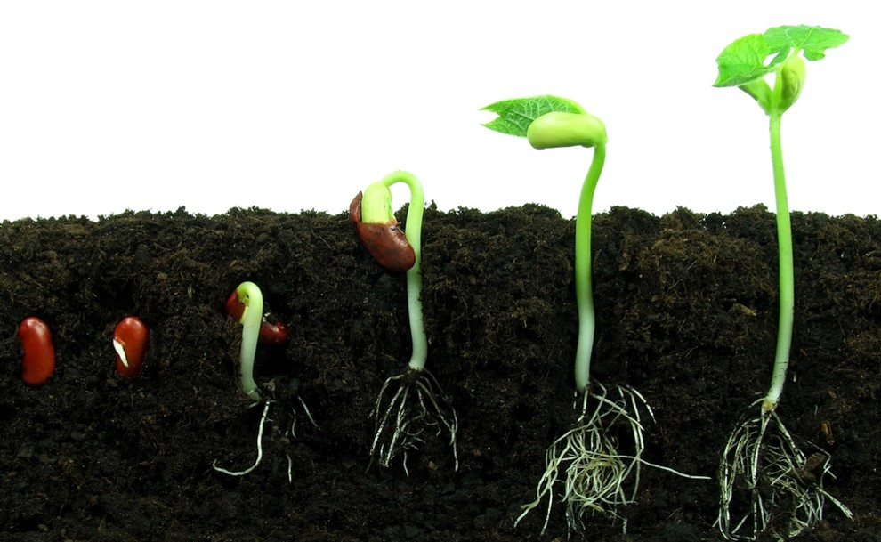
Evangelism
Being Good Gardeners
Goal:
Progress

