Slide 1
Who is Jesus
Jn 14:6
The Way, the truth,
the life

Slide 2
I Am the Way
Isa 35:8-10, Prophecy of God preparing the way
Way would be cleared of all obstacles and dangers
Way would be ready for travel
Excitement and Joy of those traveling on the Way
Jesus Prepared the Way

Slide 3
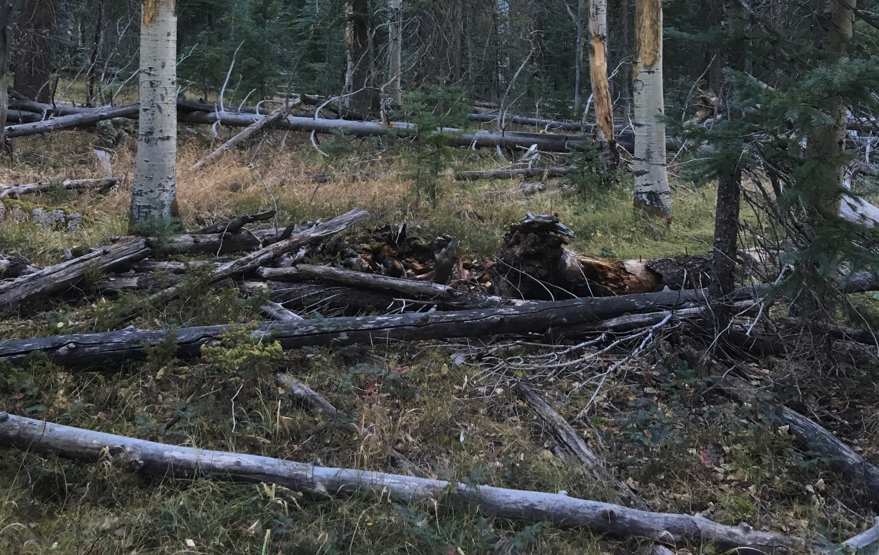
Jesus is The Way
Trail
Notes:
When the way is not cleared; when we go our own way; down timber and difficult and dangerous travel

Slide 4
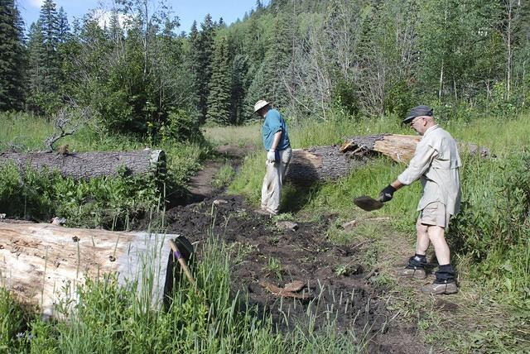
Jesus is The Way
Trail
Notes:
Clearing the way of obsticales

Slide 5
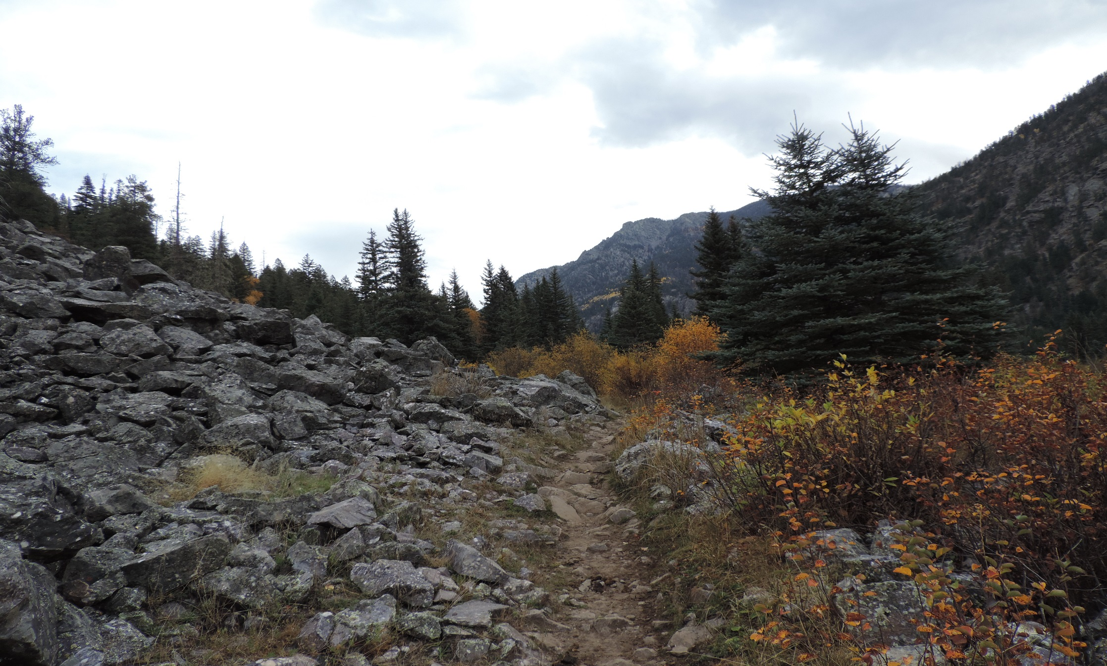
Jesus is The Way
Trail
Notes:
Clearing the way of obstacles

Slide 6
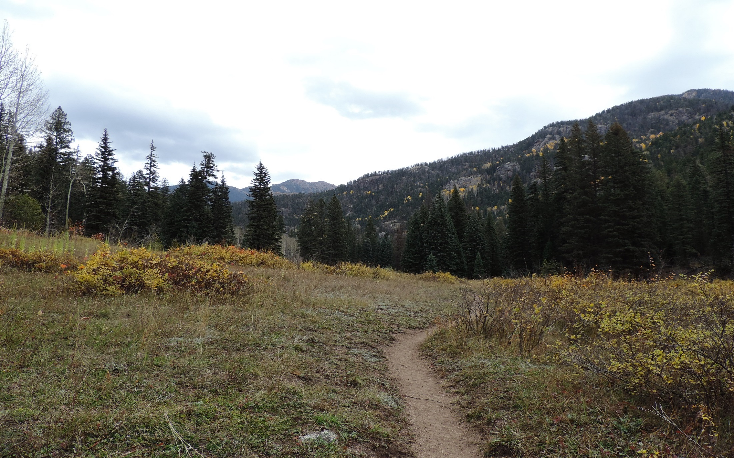
Jesus is The Way
Trail
Notes:
a prepared way; easy travel

Slide 7
I Am the Way
Walked the Way
Heb 2:14-18, took on the form of man
Heb 4:14-16, was tested like we are
Jesus Prepared the Way

Slide 8
I Am the Way
Sent Spirit to Provide the Way
Jn 14:15-17, comforter
Jn 14:26, 17:4-14, will guide them into all truth
Gives Light to the Way
Jn 8:12, I am the light of the world, he that follows me shall not walk in darkness
Jesus Prepared the Way

Slide 9
I Am the Way
Removed Barriers in our Way
Eph 2:14, barrier between Jew and Gentile
Jn 8:31-34, released our bondage to Sin
Jesus Prepared the Way

Slide 10
Jesus is The Way
Trail
Notes:
Do you really want to go your own way

Slide 11
I Am the Way
Finding and Staying on the Way Takes Effort
Mt 7:13-14, straight and narrow
The Only Way
There are no shortcuts or alternate routes
Jn 14:6, no man comes to Father except by Jesus
Jn 10:1-7, Parable of the Door
Acts 4:12, there is salvation by no other
Jesus Prepared the Way
Notes:
There are challenges on the way but they have been prepared for travel. We still have our mountains to climb

Slide 12
Jesus is The Way
Notes:
The world wants all people to be accepted and all of these leaders to be equal.

Slide 13
Jesus - “I Am the Way”
Prophecy about The Way
Jesus Walked in the Way
Jesus sent Spirit to Guide in the Way
Jesus Gives Light for the Way
Jesus Removed Barriers from the Way
Finding and Staying on the Way takes Effort
Jesus is the Only Way

Slide 14
Jesus is The Way
Trail

Slide 15
Jesus is The Way
Trail

Slide 16
Jesus is The Way
Trail

