Slide 1
Who is Jesus?
Jn 10:1-21

Slide 2
Who is Jesus?
Jn 10:1-6
I AM The Shepherd

Slide 3
Who is Jesus?
Jn 10:7-10
I AM The Door

Slide 4
Who is Jesus?
Jn 10:11-18
I AM The Good Shepherd

Slide 5
I AM the Good Shepherd
Background of Parable
Jn 9, Jesus Heals the Bind Man
Jn 10:1, verily, verily…
Jn 10:21, Jesus is teaching the same audience
Parable Taught to Address Kingdom Leadership and Membership
Notes:
There are two clues in Jn 10 as to the audience being the same as Jn 9.
Pharisees were not going to be a part of kingdom leadership (actually only Jesus is)
Huge Conflict among common Jew: Do we follow Jesus who the religious leadership rejects but they “follow’s Moses” who they know was from God
or do we follow Jesus who has given signs as a prophet from God

Slide 6
I AM the Good Shepherd
The Parables
Jn 10:1-6, Parable of the Shepherd
Jn 10:7-10, Parable of the Door
In response to the disciples being confused by the first parable
Jn 10:11-18, Parable of the Good Shepherd
Notes:
Read text here.

Slide 7
I AM the Good Shepherd
Elements of the Parables
Shepherd
Sheep
Sheepfold (Pen, Corral)
Door (Gate)
Intruder (Wolf, Stranger, Thief, Robber)
Hireling (worker, laborer)

Slide 8
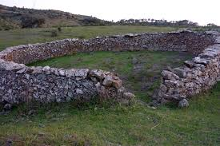
Sheepfold

Slide 9
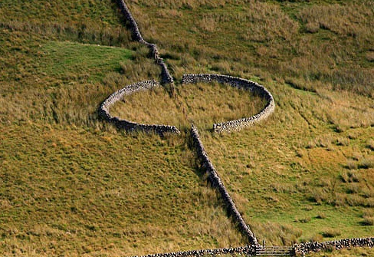
Sheepfold

Slide 10
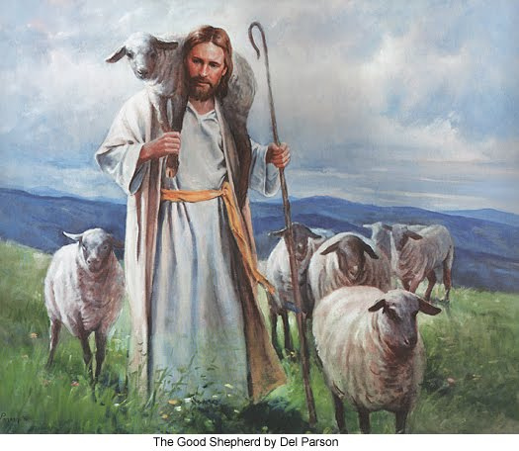
I AM THE Shepherd
Jesus is the Head
One Shepherd
Not the Pharisees
The sheep
Know and follow Him (Jews)
Just like the Blind Man
Pharisees must do likewise
Lesson
Jn 10:1-6

Slide 11
I AM THE Shepherd
Jesus is the Head
Jesus knows his Sheep
Intimacy
Knows every spot and blemish
Lesson
Jn 10:1-6

Slide 12
I AM THE Shepherd
Jesus is the Head
Jesus knows his Sheep
All others are Thieves and Robbers
Pharisee
They currently hold a position but will not in the new kingdom
Lesson
Jn 10:1-6

Slide 13
I AM THE Door
Disciples did not Understand Previous
Jesus is the Door
Those that enter through Him are saved
They will have good pasture
They will have Abundant Life
Don’t worry about being cast out by Pharisee’s
Lesson
Jn 10:7-10
Notes:
Taught in response to their understanding of the previous parable

Slide 14
I AM THE Door
Disciples did not Understand Previous
Jesus is the Door
Those who Falsely claim to be Door
In particular the Pharisees, Jn 9:13-23
Are false Messiah or Prophet
Thief
Steal, kill, and destroy
Lesson
Jn 10:7-10
Notes:
False Prophets/Messiah, Thieves – Like the Blind man and his parents
This continues to be a condemnation on the existing leadership of the Jews

Slide 15
I AM THE Good Shepherd
Jesus is the Good Shepherd
Prophecy: Jesus Gives his life
Jesus yields; Jews do not conquer
Jews (Pharisees)are not victorious
Lesson
Jn 10:11-18
Notes:
Prophecies

Slide 16
I AM THE Good Shepherd
Jesus is the Good Shepherd
Prophecy: Jesus Gives his life
Prophecy: Apostles Flee
Hireling flees from the wolves
Lesson
Jn 10:11-18

Slide 17
I AM THE Good Shepherd
Jesus is the Good Shepherd
Prophecy: Jesus Gives his life
Prophecy: Apostles Flee
Knows his Sheep
Their needs
Implies care and concern
Every blemish and flaw
Lesson
Jn 10:11-18

Slide 18
I AM THE Good Shepherd
Jesus is the Good Shepherd
God the Father knows and loves Jesus
Jesus knows God the Father
Jesus is accepted by God the Father
Pharisee’s?
Lesson
Jn 10:11-18

Slide 19
I AM THE Good Shepherd
Jesus is the Good Shepherd
God the Father knows and loves Jesus
Prophecy: Kingdom Expansion
There are more Sheep
Gentiles will be accepted
There will be One Shepherd
There will be One herd
Lesson
Jn 10:11-18

Slide 20
I AM THE Good Shepherd
Remember Context:
Pharisees had just cast the healed Blind Man out of Temple
Jn 9:26-34, They openly rejected Jesus
Jn 9:35-38, Blind Man openly followed Jesus
The Point of the 3 Parables

Slide 21
I AM THE Good Shepherd
Jesus is Head of the New Kingdom
All that participate in the new kingdom must follow Jesus
Must follow the Shepherd
Must enter by the Door
The Point of the 3 Parables

Slide 22
I AM THE Good Shepherd
Jesus is Head of the New Kingdom
All that participate in the new kingdom must follow Jesus
Not the Pharisees
They reject Jesus
They have no part in the Kingdom
They destroy and scatter the Kingdom
The Point of the 3 Parables

Slide 23
I AM THE Good Shepherd
Jesus will give his life for the Sheep
There will be One Shepherd
There will be more Sheep
There will be One Herd
Hirelings will Flee
Wolves will attempt to scatter, steal, and destroy
Prophecies

