Slide 1
Jesus’ Last Week A Day of Rejections
Lk 19:1-10, Zacchaeus
Mk 11:1-11, Jesus Triumphal
Notes:
Only Luke gives us the account of Zachaeus

Slide 2
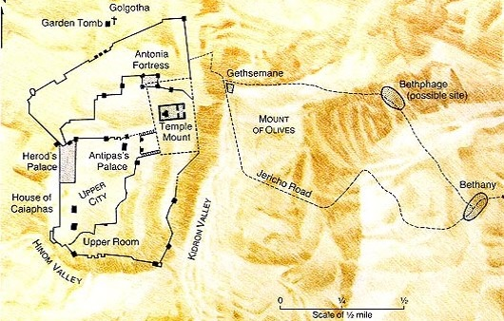
Jesus Travels – Sunday
Zacchaeus
Jericho
Lk 19
Jesus on Donkey
Mk 11
The King Enters Jerusalem

Slide 3
Jesus’ Last Week King Rejections
Mk 11:12-14
Mk 11:20-26

Slide 4
Jesus Travels – Monday
Jesus
Spends Night
Mt 21:17

Slide 5
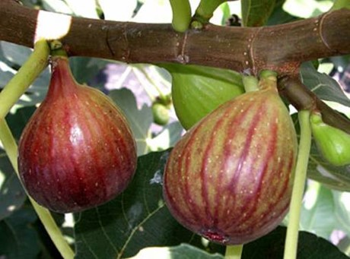
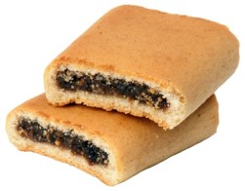
Barren Fig Tree
Notes:
Have you seen a fig? Not a fig newton

Slide 6
A Day of Rejection
Mk 11:12-14
Mt 21:19, Fig tree immediately withers
Similar to a Parable
Lk 13:1-9, unless you repent you shall likewise perish
Jesus’ last year of his Ministry
Given opportunity
This latter was not
The Barren Fig Tree
Rejected by the King

Slide 7
A Day of Rejection
Lesson
Time for repentance was past
Time for “judgment”
Mt 23:34-39
Application
God has a purpose for us
Lk 13, repent or we shall likewise perish
Patience and Effort
But one day…
The Barren Fig Tree
Rejected by the King

Slide 8
Jesus Travels – Tuesday
Jesus
Spends Night

Slide 9
A Day of Rejection
Mk 11:20-24
The Next Day (Tuesday)
Vs. 20, The fig tree is Dried up
Have Faith in God
To Move Mountains
Disciple had a weak faith
Mt 17:14-21, healing of the son who had a devil
Lk 17:5-6, move trees
Dead Fig Tree
Notes:
We have skipped the cleaning of the temple, next weeks lesson.

Slide 10
A Day of Rejection
Mk 11:25-26
Forgive Others
Mt 11:4, Jesus’ Model Prayer
Mt 18:21-35, Parable of the Unforgiving Servant
Dead Fig Tree

Slide 11
A Day of Rejection
Applications
Faith in Prayer
Jas 1:5-8, ask for wisdom in faith
Jas 5:13-18, example of Elijah
Forgive Others
Mt 18:21-35, Parable of the Unforgiving Servant
Dead Fig Tree

Slide 12
A Kings Rejection
Barren Fig Tree
Opportunity had Past – Time of Judgment
Fulfill God’s Purpose
Bear Fruit – Or be Rejected
Have Faith
Forgive – Or be Rejected

