Slide 1
Jesus’ Last Week A Day of Rejections
Introduction
Lk 19:1-10, Zacchaeus
Mk 11:7-11, Jesus Triumphal
Notes:
The King goes to Zacchaeus a publican
The King enters Jerusalem on a donkey, a sign of peace; not on a horse (fast and strong - a sign of war)

Slide 2
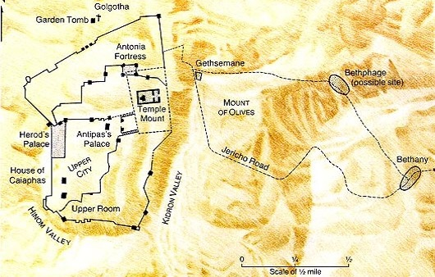
Jesus Travels – Friday/Sunday
Zacchaeus
Jericho
Lk 19
Jesus on Donkey
Mk 11

Slide 3
Jesus Travels – Monday
Barren Fig Tree
?
?
Jesus Laments
Jesus
Spends Night
Mt 21:17

Slide 4
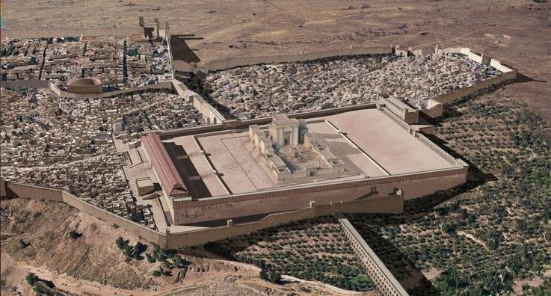
Temple Structure
Lk 19:41-44
Their View
Notes:
View from Mt Olives would have been at a higher elevation than the Temple
Also other places along the road(s) going to Jerusalem from the West.

Slide 5
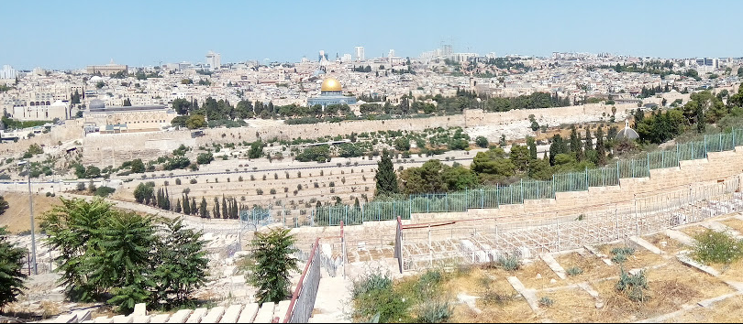
Temple Structure
Their View
Notes:
View from Mt Olives would have been at a higher elevation than the Temple
Also other places along the road(s) going to Jerusalem from the West.

Slide 6
A Day of Rejection
Lk 19:41-44
Wept – Strong’s to sob, wail aloud
Jn 11:35 “Jesus Wept” is rather to cry silently
Lamenting over Jerusalem

Slide 7
A Day of Rejection
Lk 19:41-44
Jesus has pity/shows empathy
Though rejected and about to carryout judgment against
Mt 23:37-39, the same day
Jas 1:20, For the wrath of man works not the righteousness of God
Lamenting over Jerusalem

Slide 8
A Day of Rejection
Mk 11:15-19
Large “market area”
Temple Cleansing
Notes:
Market Area likely displaced the Gentiles from the “temple”

Slide 9
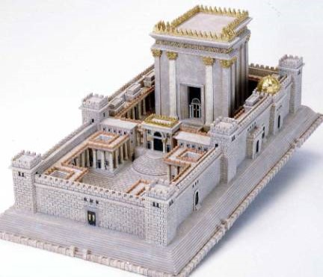
Temple Structure
Notes:
The Temple

Slide 10
Temple Structure
The Temple
Market Areas
Market Areas
Notes:
The entire “temple” area, including additional areas around the temple

Slide 11
A Day of Rejection
Mk 11:15-19
Jn 2:13-16, Similar event in first year of Jesus’ ministry
Jesus Clears the Floor
House of Merchandise
Din of Thieves
Temple Cleansing
Notes:
Would have been full of vendors in preparation of the Passover
Likely displaced Gentiles and others who would worship

Slide 12
A Day of Rejection
Mk 11:15-19
Temple Purpose Perverted
House of Prayer
II Sam 24:18-25, Sacrificing from ones own possessions
Temple Cleansing
Notes:
Would have been full of vendors in preparation of the Passover
Likely displaced Gentiles and others who would worship
Should have been bringing their best to offer, not leaving their best at home to purchase general stock from a pen like the stock yards.
The irony; only Jewish money was accepted for the temple tax but you could purchase your sacrifice

Slide 13
A Day of Rejection
Lessons
A Rebuke of the Religion of the Jews
Mk 7:1-13, Vain worship
Mt 7:21-24, depart from me workers of iniquity
Jews were doing their own thing
Ex 30:9, no strange incense
Ex 30:37-38, “God’s” incense was sacred
Lev 10:1-7, Nadab & Abihu
Lev 22:17-25, Free will offerings specified
Temple Cleansing
Notes:
The Temple was “built” for God and “belonged” to God
Owner determines purpose
Guidelines were very stringent when dealing with things that pertain to worshiping God; even a free will or voluntary offering had to be according to God’s pattern.

Slide 14
A Day of Rejection
Application
Are we Perverting God’s Purpose?
Our Body
I Cor 3:16-17, Temple of God – Is Holy
I Cor 6:19-20, temple of God – do not pollute
II Cor 6:14-18, temple of God – be separate
Temple Cleansing

Slide 15
A Day of Rejection
Application
Are we Perverting God’s Purpose?
Christ’s Church
Eph 1:22, 5:23, Belongs to Christ
Act 4:34-35, Giving to “Church”
Act 5:4, was theirs, now church
Temple Cleansing

Slide 16
A Day of Rejection
Application
Are we Perverting God’s Purpose?
Our Lives
Cleanse
Behave like a Christian
Temple Cleansing
Notes:
Make point about
Christian is obliged to obey God, we belong to God, we are designed for a purpose; so is the Church.
But from OT Pattern we so see a difference in what is devoted to God and the individual.

Slide 17
A Day of Rejection
Application
Are we Perverting God’s Purpose?
Christ’s Church
House of Prayer
Displacing worship with…
Do we add to what has been instructed?
Do we do less than what has been instructed?
Temple Cleansing
Notes:
Make point about
Christian is obliged to obey God, we belong to God, we are designed for a purpose; so is the Church.
But from OT Pattern we so see a difference in what is devoted to God and the individual.

Slide 18
A Day of Rejection
Cleansing of the Temple
Opportunity had Past
Time of Judgment
But If you had Repented…
Fulfill God’s Purpose
In Ourselves
In Christ’s Church

