Slide 1
Jesus’ Last Week
Notes:
Purpose is to evaluate the events of Jesus last week and take lessons from the teachings.

Slide 2
Outline of the Last Week
Week(s) leading up
Lk 17:11, Travels in Samaria & Galilee to Jericho, then to Bethany
Lk 19:10, Seek and Save the Lost
10 lepers (Samaritan)
Advocate for Widow’s (Orphans)
Publican, Children, Zacchaeus, & Blind men
Notes:
Our purpose is to evaluate the events of Jesus last week and take lessons from the teachings.
Luke records detailed teaching and events of Jesus as he makes his way to Jerusalem for the final time. By doing this we can see the Holy Spirit giving us a picture and meaning deeper than the individual teachings as we often look at them. We see a summary of Jesus ministry here. Luke – Contrasted those Jesus accepted and rejected.

Slide 3
Outline of the Last Week
Sunday
Mk 11:1-11, Rides Donkey into Jerusalem
Monday
Mk 11:12-26, Curses the Barren Fig Tree and Cleanses the Temple
Tuesday
Mt 21-23, Interrogation & Teaching in the Temple
Notes:
Our purpose is to evaluate the events of Jesus last week and take lessons from the teachings.

Slide 4
Jesus’ Last Week Teachings on Mt Olive
Tuesday
Prophesies and parables
Mt 24-25

Slide 5
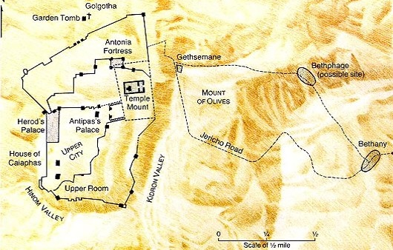
Jesus Travels – Tuesday

Slide 6
Teachings On Mt Olive
Mt 23:36, All these things shall come upon this generation
Mt 23:38, your house is left unto you desolate
Mt 23:39, Ye shall not see me henceforth, till ye shall say, Blessed is he that cometh in the name of the Lord
Preamble for Next Teachings

Slide 7
Teachings On Mt Olive
Mt 24:1-3
Jesus discusses the Temple with Disciples
On the way to Mt Olives
Likely looking back at Jerusalem in elevated position
Preamble for Next Teachings

Slide 8
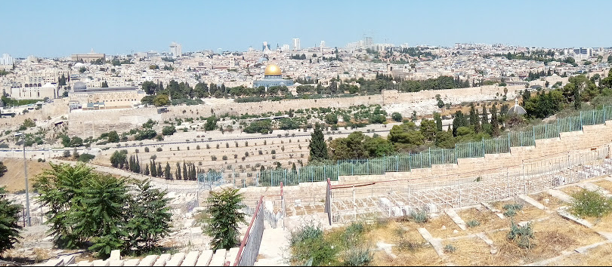
Temple Structure
Their View
Notes:
View from Mt Olives would have been at a higher elevation than the Temple
Also other places along the road(s) going to Jerusalem from the West.

Slide 9
Teachings On Mt Olive
Mt 24:1-3, Jesus discusses the Temple with Disciples
Disciples Questions:
When will Temple be Destroyed
What are the signs of your coming
What are the signs of the end of the age
Mt 24&25 are His answers
Preamble for Next Teachings
Notes:
Note that the disciples still had man misconception about the nature of the kingdom. See Acts 1:6. in their mind, all 3 of these probably coincided with the same event, but Jesus teaches 2 distinct events.

Slide 10
Teachings On Mt Olive
Mt 24:4-35, Destruction of Jerusalem
Answering When
Mt 24:4-14, Events leading up to “The Day”
Signs the day is approaching
Vs. 9, that generation
Vs. 14, Gospel will be preached to all nations

Slide 11
Teachings On Mt Olive
Mt 24:4-35, Destruction of Jerusalem
Mt 24:15-22, Flee
Vs. 15-18, when you see… Then…
Matthew identifies the abomination of desolation that is prophesied by Daniel
Dan 9:26-27, 11:31-32, 12:11
Luke references the siege of Jerusalem
Lk 21:20-21
Both giving the same warning
Notes:
Luke possibly records from the gentile perspective; he does not mention the prophecy in Daniel which they may not be familiar with

Slide 12
Teachings On Mt Olive
Mt 24:4-35, Destruction of Jerusalem
Mt 24:15-22, Flee
Vs. 15-18, when you see… Then…
Vs. 19-22, Great tribulation

Slide 13
Teachings On Mt Olive
Mt 24:4-35, Destruction of Jerusalem
Mt 24:23-28, Warning of false prophets
Mt 24:29-35, Sign it is near
Vs. 32-33, parable of the Fig Tree
Know it is near
Vs. 34, it will be THIS generation

Slide 14
Teachings On Mt Olive
Mt 24:4-35, Destruction of Jerusalem
Mt 24:4-14, Be watchful for these events that lead up to “The Day”
Mt 24:15-22, Flee…
Mt 24:23-28, Warning of false prophets
Mt 24:29-35, Signs it is near

Slide 15
Teachings On Mt Olive
Mt 24:36-25:46, Final Judgment
Mt 24:36-41, Comparing Judgment with the Flood
Vs. 36, No man or angel knows the day or hour
Vs. 38-39, day will come WITHOUT warning
Emphasis has changed to be PREPARED because there will NOT be a sign
Notes:
A very distinct change in instructions here
Before: When you see…. Flee
Now: be prepared because there will be NO signs…

Slide 16
Teachings On Mt Olive
Mt 24:36-25:46, Final Judgment
Mt 24:42-44, Comparing Judgment with a Thief
Nobody knows when a thief comes, else we would be standing guard
No sign or indication of this event!
Be prepared because there will not be notice

Slide 17
Teachings On Mt Olive
Mt 24:36-25:46, Final Judgment
Mt 24:45-51, Parable of the Householder
Vs. 45-47, blessed is the good householder who is found to be working
Vs. 48-51, the evil householder who is found to be idle will receive the wrath of God
Be prepared because there will not be notice
Man will think “my lord is delayed”
Same point with Noah and he flood
Notes:
When the cat’s away the mice will play
When the boss is away, the inmates run the asylum

Slide 18
Teachings On Mt Olive
Mt 24:36-25:46, Final Judgment
Mt 25:1-13, Parable of the 10 Virgins
All 10 were prepared
5 not prepared enough
Watch, You do not know the day or hour
Be prepared because there will not be notice
When event happens there will not be time to prepare

Slide 19
Teachings On Mt Olive
Mt 24:36-25:46, Final Judgment
Mt 25:14-30, Parable of the Talents
5, 2, & 1 Talent men
Vs. 19, They labored for a “long time”
1 talent man did not put forth any effort
Punishment – cast into outer darkness, weeping and gnashing of teeth
Must work according to abilities

Slide 20
Teachings On Mt Olive
Mt 24:36-25:46, Final Judgment
Mt 25:31-46, Parable of the Sheep and Goats
Jesus comes with his Angels
Sits on throne
Gathers all nations
Separate Sheep from Goats

Slide 21
Teachings On Mt Olive
Mt 24:36-25:46, Final Judgment
Mt 25:31-46, Parable of the Sheep and Goats
Sheep
Inherit kingdom prepared for you
Goats
Depart into everlasting fire with devil and his angels

Slide 22
Teachings On Mt Olive
Mt 24:36-25:46, Final Judgment
Mt 24:36-41, Comparing Judgment with the Flood
Mt 24:42-44, Comparing Judgment with a Thief
Mt 24:45-51, Parable of the Householder
Mt 25:1-13, Parable of the 10 Virgins
Mt 25:14-30, Parable of the Talents
Mt 25:31-46, Parable of the Sheep and Goats
Notes:
Time will be long
Example of Noah and Flood
Evil Servant said in his heart…, parable of the householder
After a long time… parable of the talents
Be ready for the final judgment for time will be no more

Slide 23
Jesus Travels – Tuesday

Slide 24
Temple Structure
Their View
Notes:
View from Mt Olives would have been at a higher elevation than the Temple
Also other places along the road(s) going to Jerusalem from the West.

Slide 25
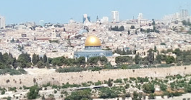
Temple Structure
Notes:
Muslim mosque sitting on the temple site!

Slide 26
Jesus’ Teachings on Mt. Olive
Lessons
Mt 24:1-35, Jerusalem/Temple
Mt 24:36-25:46, Final Judgment
Be ready
It will be a long time
Temptation to be slothful
Tortious and the Hare

Slide 27
Jesus’ Teachings on Mt. Olive
Lessons
Mt 24:1-35, Jerusalem/Temple
Mt 24:36-25:46, Final Judgment
Be ready
It will be a long time
Mostly ready will not be enough
Being Idle is not enough
Generosity of the Faithful

Slide 28
Jesus’ Teachings on Mt. Olive
Lessons
Mt 10:22, And ye shall be hated of all men for my name's sake: but he that endures to the end shall be saved.
Labor
Endure
Persevere

