Slide 1
Jesus’ Last Hours
Prayer
Jn 17:20
Notes:
We find the prayers (events) of Jesus in his last hours
We see the selflessness and earnestness of Jesus in his prayer
In his prayers we see his humanity

Slide 2
Jesus’ Last Hours
Upper Room, Mt 26:17-30
Mt 26:17-19, Preparing the Passover
Mt 26:20-21, Ate the Passover
Mt 26:26-29, Instituted the Lords Supper
Prayer for the emblems representing his body and blood of the Covenant
Jn 13-17, Preparing his Disciples
Jesus Prays
The Last Supper
Notes:
This surely was a somber, surreal, emotional, and troubling event:
enhanced the reality of the events that were about to take place
the suffering, the ridicule, berating, and all the other offences (including being forsaken) that came against Jesus would come into Jesus’ full view (Forbearance – enduring wrong)
This fits in the lesson on preparing the Disciples in Jn 13-17.
What we discover Jesus is not just preparing present company but all future disciples.

Slide 3
Jesus’ Last Hours
Jn 17, Jesus Intercessory Prayer
Intercessory – On the behalf of others
Himself
His Disciples
His Future Disciples
Jesus Prays
The Lords Prayer
Intercessory

Slide 4
Jesus’ Last Hours
Jn 17:1-5, Prayer for Himself
Prayer
That he would be Glorified by his death & resurrection
That he would be Light
Statements
He Glorified God
He accomplished his work
Prayer
That he would be Glorified as he was before creation
Jesus Prays
The Lords Prayer
Intercessory

Slide 5
Jesus’ Last Hours
Jn 17:6-19, Prays for His Disciples
Jesus their Advocate
That they would be united
That they may have His joy fulfilled in them
Sanctify them
Jesus Prays
The Lords Prayer
Intercessory
Notes:
Disciples had still be arguing over who would hold great positions; are to be servants; wash each others feet

Slide 6
Jesus’ Last Hours
Jn 17:20-26, Prays for all Future Disciples
Jesus their Advocate
That they may be united
That they may have His glory
That they may have the love of the Father
Jesus Prays
The Lords Prayer
Intercessory
Notes:
Similarly previous teachings were spoken for the benefit of his current disciples and future (Comforter)

Slide 7
Jesus’ Last Hours
Mt 26:36-46, Prayer
Late at Night
Mt 26:40, indicated it to be one hour
Mt 26:43, for their eyes were heavy
Jesus Prays
Gethsemane

Slide 8
Jesus’ Last Hours
Mt 26:36-46, Prayer
Great Destress of Jesus
Disciples Slept
Jesus Could not Sleep
Mt 26:37, sorrowful and very heavy
Mt 26:38, soul is exceeding sorrowful, even unto death
Lk 22:44, in an agony he prayed more earnestly: and his sweat was as it were great drops of blood
Jesus Prays
Gethsemane

Slide 9
Jesus’ Last Hours
Mt 26:36-46, Prayer
Great Destress of Jesus
Disciples Slept
Jesus Could not Sleep
Angels Strengthening Him
Lk 22:43
Jesus Prays
Gethsemane

Slide 10
Jesus’ Last Hours
Mt 26:36-46, Prayer
Mt 26:39, “O my Father, if it be possible, let this cup pass from me: nevertheless not as I will, but as thou wilt.”
Mt 26:42, “O my Father, if this cup may not pass away from me, except I drink it, thy will be done”
Ends prayers with a view to all mankind
Jesus Prays
Gethsemane
Notes:
Praying that the Fathers will be done
He knows what is best
he knows what is needed

Slide 11
Jesus’ Last Hours
Mt 26:36-46, Prayer
Jesus Ready to Face His Fate
Mt 26:46, Rise, let us be going: behold, he is at hand that doth betray me.
Jesus Prays
Gethsemane

Slide 12
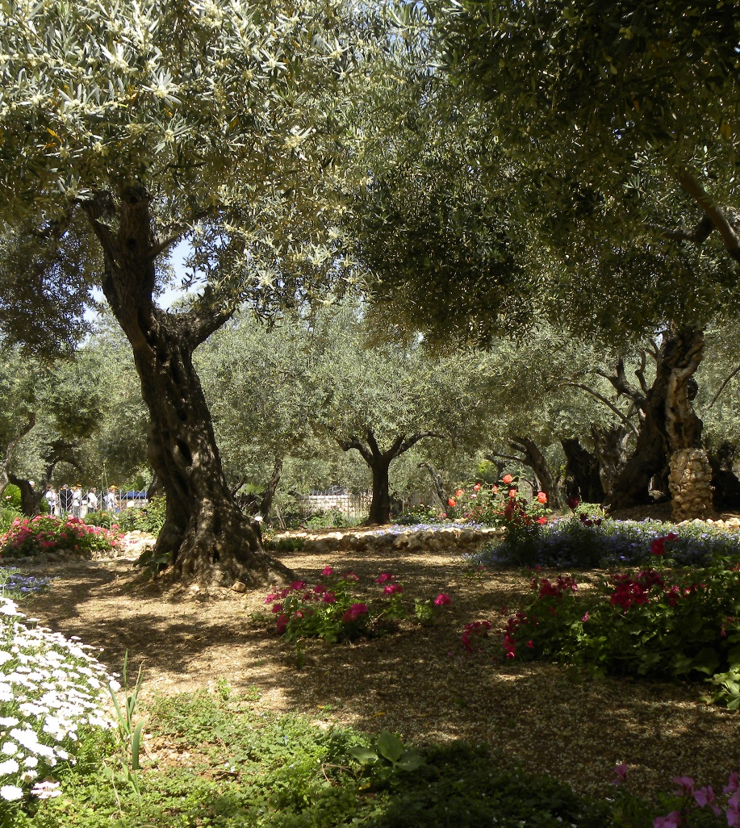
Jesus’ Last Hours Prayer
Last Supper
Preparing disciples
Intercessory Prayer
For himself and all Disciples
Gethsemane
For himself and all Disciples

Slide 13
Jesus’ Last Hours
Jesus is Selfless
Preparing his disciples
Not wholly focused upon himself
Preparing future disciples
Lords Supper
Intercessory Prayer
Gethsemane
Jesus’
Concern for his Disciples
Notes:
Selfless
All lessons for us

Slide 14
Jesus’ Last Hours
Humanity of Jesus
Pours out his heart in prayer
Desires the comfort and support of his disciples
Personal distress
Petitioning God on His behalf
Praying for God’s will be done
Jesus’
Humanity
Notes:
All lessons for us
Following events continue to show his humanity and love for all man kind

