Slide 1
Character Study Moses
Ex 1:8-14

Slide 2
Moses Birth
Ex 2:1-10

Slide 3
Israel in Egypt
Ex 5:1-19
Notes:
Non-Egyptians making bricks

Slide 4
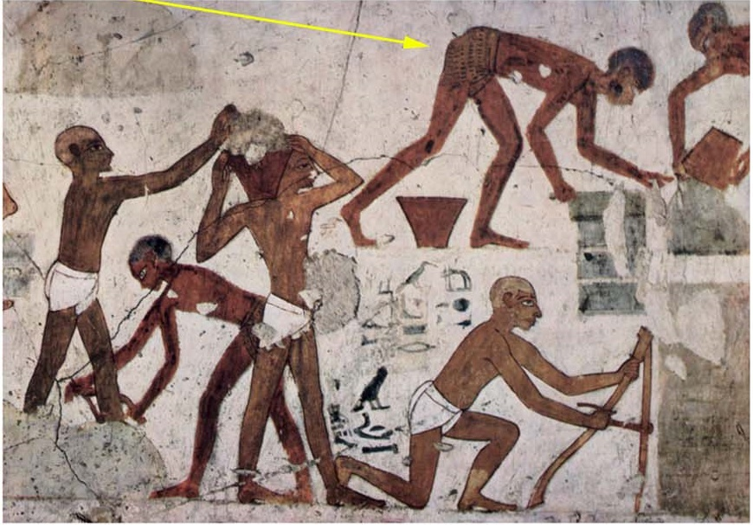
Israel in Egypt
Notes:
Non-Egyptians making bricks

Slide 5
Israel in Egypt
Notes:
Wall showing Egyptians, pond, brick wall, and brick making by non-egyptians

Slide 6
Archeology
Evidence of Moses and the events of Exodus 1-13
Notes:
Adversaries of the bible say that it is all fables, event to the point of not even referencing it when searching for ancient cities.
Story about archeologist who had found a certain city. Bible stated another city was in a certain specific location from the one found. It was said that upon finding this second city precisely where written, he became a believer. Was this the alter at Mt Gerishm?? Across from Mt Ebal.

Slide 7
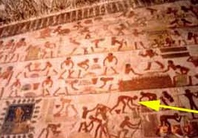
Moses in Archeology

Slide 8
Archeology
Notes:
Notice the naming of Pharaoh’s Thutmoses,

Slide 9
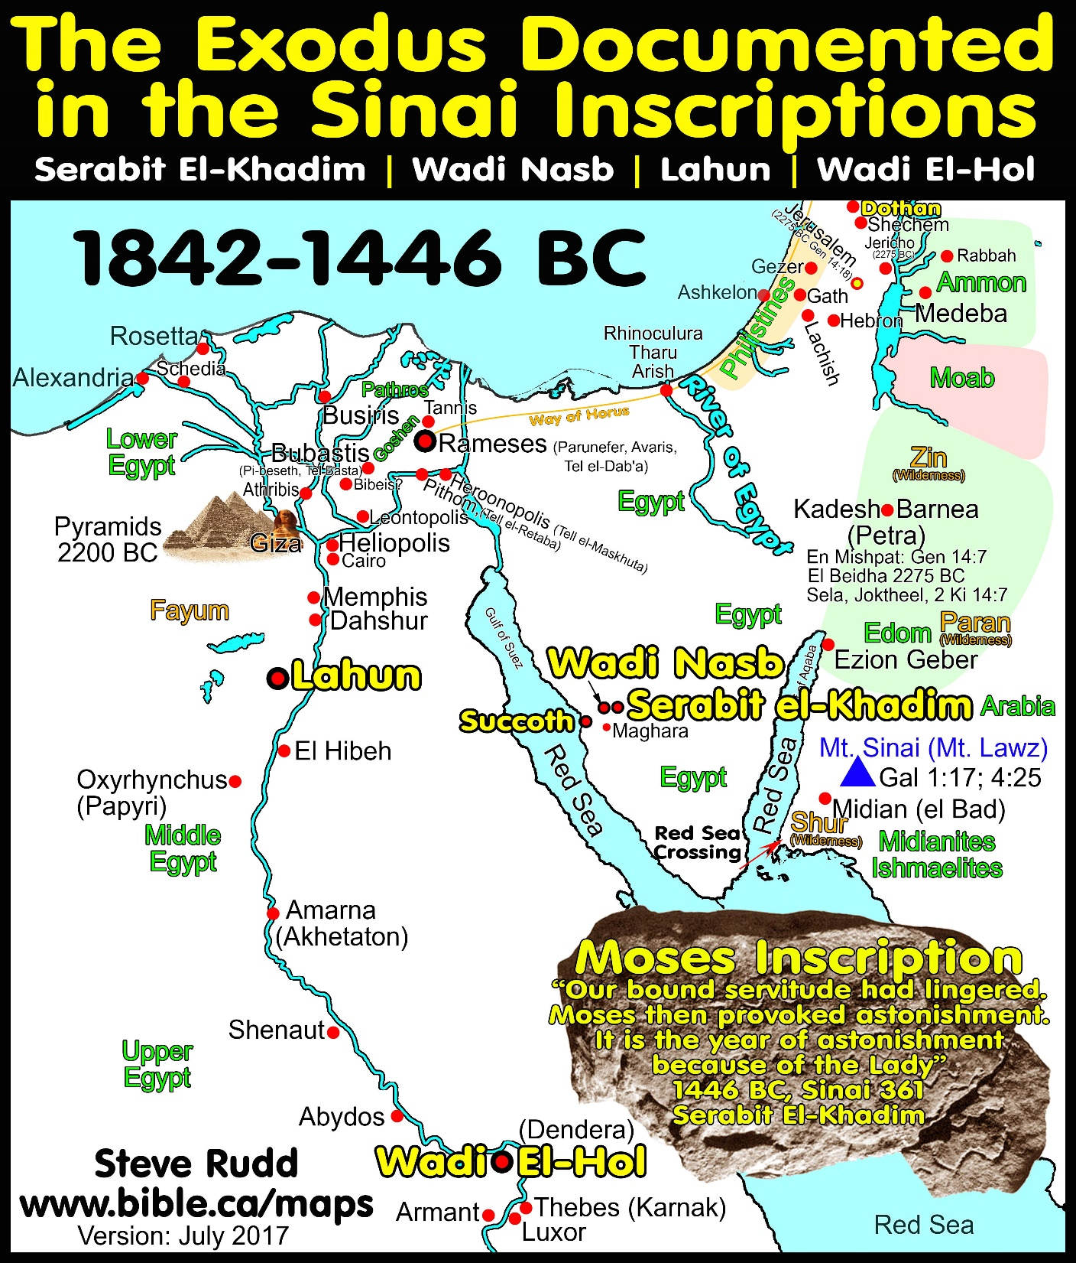
Notes:
Archeological finds in the wilderness point to the narrative of Exodus
Hebrew and Egyptian Writings.
Egyptian mines for Copper & Turquoise, Bible.ca

Slide 10
Moses in Archeology
Notes:
An Idol, with Hebrew and Egyptian writings. This shows a co-existance of the two nations
Akin to a calf; image of Aaron may have taken similar form, this a reproduction of it? This one is certainly not of Gold that was ground up and they drank!
An Egyptian god which Aaron would have mimic’d. The Israelites were certainly idolatrous living in Egypt.

Slide 11
Moses in Archeology
Ex 1:7-14, 16
Ex 5:20-23
Notes:
Man presumptions here by me
Hathor a god,
quiver of brothers (Egyptians or Israelites who held to the Egyptian life) – despised so he performed terror against “Their quiver”
Great wailing (Eluding to the death of the first born/plagues?)

Slide 12
Moses in Archeology
10 Plagues Ex 7-12
Notes:
Bound servitude lingered – Israel slaves of Egyptians
Moses provoked astonishment – 10 plagues and such
The lady? Cow goddess, Baalat, Hathor,

Slide 13
Archeology
Evidence of Moses and the events of Exodus 1-13
Pieces fit in the Puzzle!
Notes:
There are archeological evidences of Israel and Moses in Egypt

Slide 14
Moses
Moses Spoke with God
Ex 33:9-11
Num 12:7-8
God Knew Moses
Ex 33:17
Deut 34:10, Moses face to face
Moses Saw God
Ex 33:20-23,
Ex 3:2-6, Burning Bush
Knew God
Notes:
Do we realize the great power and influence our upbringing has upon us. Moses overcame the temptation to become an Egyptian. Though there was the allure of great wealth and power.

Slide 15
Moses
Acts 7:17-29, Stephen Recounts Moses’
Worldly Allurements
Educated
Mighty in words and in deeds
Pleasure of Sin
His Upbringing
A Man of Faith
Notes:
Do we realize the great power and influence our upbringing has upon us. Moses overcame the temptation to become an Egyptian. Though there was the allure of great wealth and power.

Slide 16
Moses
Heb 11:24-29
He Gave up
Great Wealth
“Family” Inheritance
Worldly Allurements (Acts 7)
Educated
Mighty in words and in deeds
Pleasure of Sin
A Man of Faith

Slide 17
Moses
Heb 11:29, By faith they passed through the Red sea as
Ex 14:13-14, at the edge of the Red Sea
Ex 39:42-43, followed all the instructions
A Man of Faith
Notes:
Do we realize the great power and influence our upbringing has upon us. Moses overcame the temptation to become an Egyptian. Though there was the allure of great wealth and power.

Slide 18
Character Study: Moses
Raised in Rich Culture
Archeology Evidences of Moses and Israel in Egypt
Knew God
God Knew Moses
Man of Faith

Slide 19
Jesus – The Prophet
Deut 18:18, I will raise them up a Prophet from among their brethren, like unto thee, and will put my words in his mouth; and he shall speak unto them all that I shall command him.
Acts 7:37, This is that Moses, which said unto the children of Israel, A prophet shall the Lord your God raise up unto you of your brethren, like unto me; him shall ye hear.

Slide 20
Jesus – The Prophet
Deut 18:19, And it shall come to pass, that whosoever will not hearken unto my words which he shall speak in my name, I will require it of him.

