Slide 1
Investigation of One’s Faith
“If a faith will not bear to be investigated, if its preachers and professors are afraid to have it examined, their foundation must be very weak.”
Apostle George A. Smith, First Presidency, LDS Church Journal of Discourses, XIV:216, August 13, 1871

Slide 2
Test LDS Religion with the Bible
“I say to the whole world, receive the truth, no matter who presents it to you.
“Take up the Bible, compare the religion of the Latter-day Saints with it, and see if it will pass the test.”
President Brigham Young Journal of Discourses, XVI:46, May 18, 1873

Slide 3
Testing Doctrine
“The doctrines of false teachers will not stand the test when tried by the accepted standards of measurement, the Scriptures.”
Joseph Fielding Smith Doctrines of Salvation, I:188

Slide 4
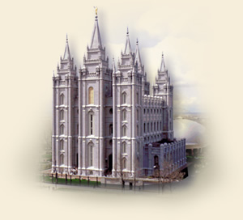
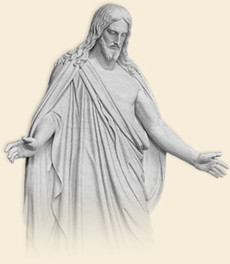
THE CHURCH OF JESUS CHRIST OF LATTER-DAY SAINTS
The Temples of Mormonism (Part 5)

Slide 5
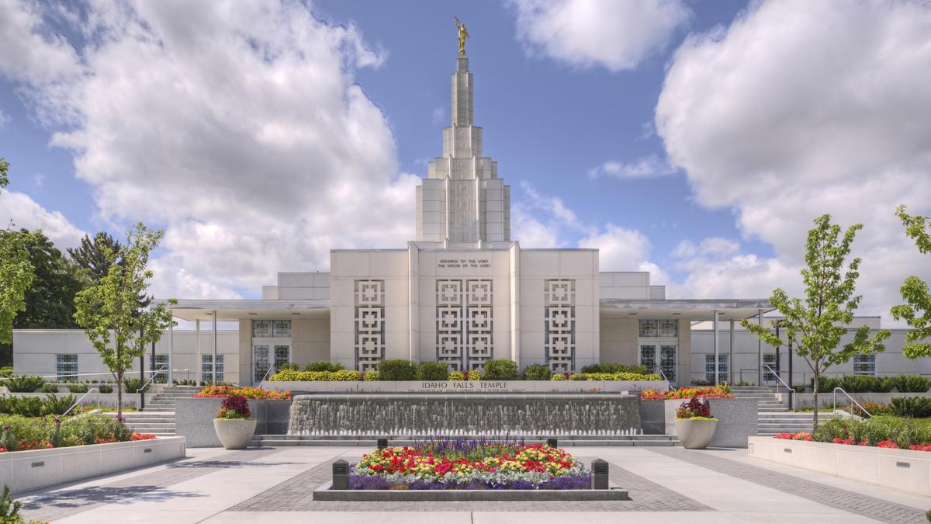
Temples and Mormonism
161 worldwide (2019)
Sacred building for religious ceremonies and instruction
Only baptized, qualified LDS Church members may enter
https://www.mormonnewsroom.org/facts-and-statistics
Idaho Falls, Idaho

Slide 6
Temples and Mormonism
“In order really to understand present-day Mormonism and the hold it has upon its people it is necessary to know about the work that goes on in Mormon temples.”
Jerald and Sandra Tanner The Changing World of Mormonism, 512

Slide 7
Temples and Mormonism
What is the purpose of the temple?
To members of The Church of Jesus Christ of Latter-day Saints, the temple is the “House of the Lord.” It is a sacred building, and after its dedication only faithful members of the Church may enter.

Slide 8
Temples and Mormonism
What is the purpose of the temple?
Inside, members learn more about the purpose of life and make covenants to serve Jesus Christ and their fellow man. In addition, they participate in religious ceremonies that reach beyond mortality, such as baptisms on behalf of deceased ancestors and eternal marriage. (www.lds.org/temples/faq)

Slide 9
Temples and Mormonism
“Was there ever a man or woman who, in a time of quiet introspection, has not pondered the solemn mysteries of life?
Has he or she not asked, “Where did I come from? Why am I here? Where am I going?

Slide 10
Temples and Mormonism
“What is my relationship to my Maker? Will death rob me of the treasured associations of life? What of my family? Will there be another existence after this, and, if so, will we know one another there?

Slide 11
Temples and Mormonism
“…Temples of The Church of Jesus Christ of Latter-day Saints are sacred structures in which these and other eternal questions are answered. Each is dedicated as a house of the Lord, a place of holiness and peace shut apart from the world.

Slide 12
Temples and Mormonism
“There truths are taught and ordinances are performed that bring knowledge of things eternal and motivate the participants to live with an understanding of our divine inheritance as children of God and an awareness of our potential as eternal beings.” -President Gordon B. Hinckley, “Why These Temples?,” www.lds.org/temples/purpose

Slide 13
The Bible and Temples
God does not dwell in temples made with hands, Acts 7:47-50; 17:24
Not physical place, but the heart and the how that matters in worship, John 4:23-24
Church is the temple of God, Ephesians 2:19-22
Christians are priests in God’s house, 1 Peter 2:5

Slide 14
The BOM and Temples
Book of Mormon does not mention:
Baptism for the dead
Temple marriages
Temple endowment ceremonies
Yet, the Book of Mormon is said to contain “the fulness of the everlasting gospel” (J. Smith, Jr., HOC 1:34; D&C 42:12)

Slide 15
Concerning Temples
The Temple of Mormonism is NOT the Temple of the Bible
Bible doctrine is NOT Mormon doctrine, and Mormon doctrine is NOT Bible doctrine
They are NOT one and the same
No Mormon truly believes the Bible, and a true Bible believer cannot be a Mormon!

Slide 16
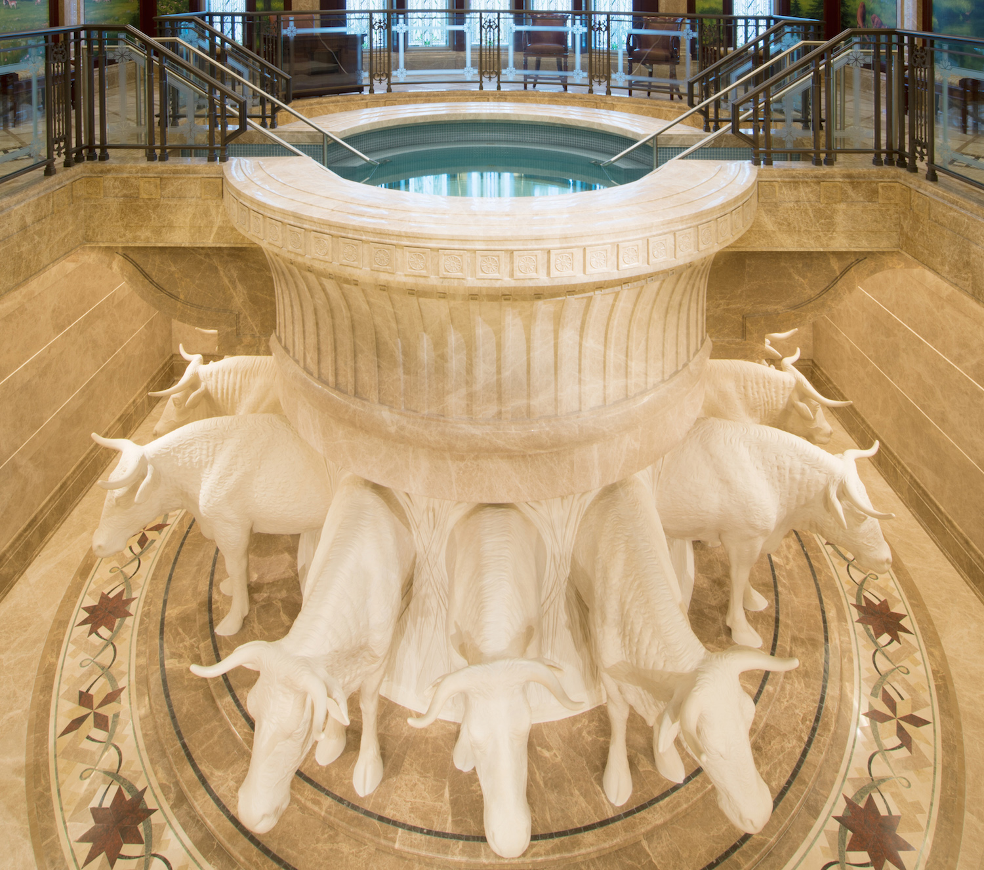
LDS Baptism for the Dead
Summary:
Those without an opportunity to hear the fulness of the gospel in this life will have the gospel preached to them in the next life. Vicarious baptism provides these people with an opportunity to accept salvation for themselves.

Slide 17
LDS Baptism for the Dead
Saving ancestors
“The greatest responsibility in this world that God has laid upon us is to seek after our dead.”
(The Teachings of the Prophet Joseph Smith, J. Smith, Jr., 356)

Slide 18
LDS Baptism for the Dead
Saving themselves
“...our salvation and progression depends upon the salvation of our worthy dead with whom we must be joined in family ties. This can only be accomplished in our temples.”
(Doctrines of Salvation, Joseph F. Smith, II:147)

Slide 19
Bible and Baptism for the Dead
Genealogies produce disputes, not faith, unprofitable, vain…avoid, 1 Tim. 1:3-4; Titus 3:9
One baptism, Ephesians 4:5
Context of 1 Cor. 15:29 is resurrection of the dead
If choice is available in next life, then LDS should not preach their gospel now (Mark 16:15)
All are commanded to repent now (Acts 17:30)

Slide 20
One Baptism
Ephesians 4:5; Galatians 1:6-9
BIBLE: Great Commission | LDS: Baptism for the Dead
For the living | For the dead
Personal | Proxy
Remission of sins | Gives a choice
Biblical | Non-Biblical
TRUE! | FALSE!
LDS Baptism for the Dead is a Different Gospel!

Slide 21
Concerning Baptism for the Dead
The Baptism of Mormonism is NOT the Baptism of the Bible
Bible doctrine is NOT Mormon doctrine, and Mormon doctrine is NOT Bible doctrine
They are NOT one and the same
No Mormon truly believes the Bible, and a true Bible believer cannot be a Mormon!

Slide 22
LDS Temple Marriage
Marriage is “for time and for all eternity”
Sealing of couples and families for all of eternity (“Families are forever”)
D&C 132: Teaches eternal marriage and plural marriage
Plural marriage in “Celestial Kingdom”

Slide 23
LDS Temple Marriage
To receive exaltation
“…a man must have a wife, and a woman a husband, to receive the fulness of exaltation. They must be sealed for time and for all eternity in a temple; then their union will last forever, and they cannot be separated because God has joined them together, as he taught the Pharisees.” (Doctrines of Salvation, Joseph F. Smith, II:43-44)

Slide 24
LDS Temple Marriage
To receive exaltation
“…No man shall receive the fulness of eternity, of exaltation, alone; no woman shall receive the blessing alone; but man and wife, when they receive the sealing power in the temple of the Lord, if they thereafter keep all the commandments, shall pass on to exaltation, and shall continue and become like the Lord. And that is the destiny of men; that is what the Lord desires for his children.” (Doctrines of Salvation, Joseph F. Smith, II:43-44)

Slide 25
Eternal Marriage and Plural Marriage
Eternal marriage depends on plural marriage
“All these principles…pertaining to eternal marriage, the very moment that they are admitted to be true, it brings in plurality of marriage, and if plurality of marriage is not true, or in other words, if a man has no divine right to marry two wives or more in the world, then marriage for eternity is not true, and your faith is all vain…for as sure as one is true, the other also must be true. Amen.”
-Apostle Orson Pratt, Journal of Discourses, XXI:296 (July, 1880)

Slide 26
The Bible and Marriage
Marriage is for this life, Rom. 7:2; 1 Cor. 7:39
One man and one woman (Genesis 2:24)
No marriage in resurrection, Luke 20:34-36
This LDS doctrine has tremendous emotional appeal and persuasion

Slide 27
Concerning Marriage
The Marriage of Mormonism is NOT the Marriage of the Bible
Bible doctrine is NOT Mormon doctrine, and Mormon doctrine is NOT Bible doctrine
They are NOT one and the same
No Mormon truly believes the Bible, and a true Bible believer cannot be a Mormon!

Slide 28
THE CHURCH OF JESUS CHRIST OF LATTER-DAY SAINTS
Teaching Mormons the Gospel

Slide 29
Teaching Mormons the Gospel
Be informed (read the Book of Mormon)
Moroni 10:4-5 v. John 7:16-17
Mormons: Desire + Prayer = Know Truth
Jesus: Desire to Obey God + Hearing = Know the Truth (Acts 17:11-12)

Slide 30
Teaching Mormons the Gospel
Problem: Believe they have had personal revelation
Experience is accepted as revelation
Bible: Way of man is not in himself, Jeremiah 10:23; Proverbs 14:12
God has revealed His mind in a word we can read, understand and obey to be blessed, 1 Cor. 2:6-13; Ephesians 3:3-5; John 13:20

Slide 31
Teaching Mormons the Gospel
Show the error and defend the truth, 2 Timothy 4: 2-4; 1 Peter 3:15; Jude 3
Bible is a reliable and sufficient standard of authority
Bible can be understood and properly applied, Ephesians 3:3-4; 5:17
Bible answers all our spiritual needs, 2 Peter 1:3-4

Slide 32
Galatians 1:6-9
NATURE OF THE WORD OF GOD | FIRST CENTURY APOSTLES AND PROPHETS | LDS APOSTLES AND PROPHETS
All Truth in First Century? | YES John 16:13 | NO 2 Nephi 29:3, 10
First Century Scriptures Adequate? | YES 2 Timothy 3:16-17 | NO 2 Nephi 28:29; 29:6
Incorruptible? | YES 1 Pet. 1:22-25; 2 John 2 | NO 1 Nephi 13:28
Once for all Delivered? | YES Jude 3 | NO Article of Faith, 1:9
Final Authority? | YES John 13:20; 1 Cor. 14:37 | NO President Benson, 1980
Understandable? | YES Eph. 3:3-4; John 7:17 | NO Apos. Bruce McConkie

Slide 33
Teaching Mormons the Gospel
Teach them the saving gospel of Christ
Convict of sin (Romans 3:23)
How to be saved (Mark 16:16; Acts 2:38)
The church of Christ (Matt. 16:18; Acts 2:47)
Faithful, obedient living (Matt. 7:21)

Slide 34
Teaching Mormons the Gospel
Decision time for the Mormon, Joshua 24:15
Cannot accept the LDS faith and the Bible…they contradict! Galatians 1:6-10

Slide 35
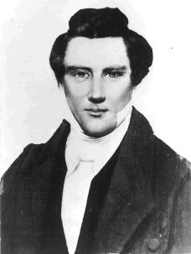
Expose if an Impostor
“If Joseph Smith was a deceiver… then he should be exposed; his claims should be refuted, and his doctrines shown to be false, for the doctrines of an impostor cannot be made to harmonize in all particulars with divine truth.
Joseph Smith, Jr. (1805-1844)

Slide 36
Expose if an Impostor
“If his claims and declarations were built upon fraud and deceit, there would appear many errors and contradictions, which would be easy to detect.”
Joseph Fielding Smith Doctrines of Salvation, I:188
Joseph Smith, Jr. (1805-1844)

Slide 37
The Bible Reveals the Truth
Bible doctrine is NOT Mormon doctrine, and Mormon doctrine is NOT Bible doctrine
They are NOT one and the same
No Mormon truly believes the Bible, and a true Bible believer cannot be a Mormon!

Slide 38
Our Plea To Every LDS Church Member
Repent of this false religion
Obey the simple, complete gospel of Jesus Christ that is fully revealed in the New Testament
Then you will be saved (Acts 2:41)
Then you can be complete in Christ – Without the false doctrines and practices of the Church of Jesus Christ of Latter-day Saints (Colossians 1:28)

