Slide 1
Jesus’ Last Hours
His Crucifixion
I Cor 15:3

Slide 2
Jesus’ Last Hours
  Sleep Deprived
    Thursday after Dark
      Partaking of the Passover & Institution of the Lord’s Supper, Lk 22:7-20
      Teachings to Disciples, Jn 13-16
    Late Thursday Night
      Prayer in Gethsemane, Mt 26:36-46
    Early Friday before Sun Rise
      Betrayal and Arrest of Jesus, Jn 18:1-11
Suffering Prior to Crucifixion

Slide 3
Jesus’ Last Hours
  Abuses During Trial
    Mt 26:57-68, Jesus Before Caiaphas – The High Priest
      spit in his face, and buffeted him; and others smote him with the palms of their hands,
    Mt 27:26-30, Jesus before Pilate
      Scourged
      Crown of thorns, took a reed, and hit him on the head.
Suffering Prior to Crucifixion

Slide 4
Jesus’ Last Hours
Jn 19:16-17, Jesus Carries the Cross
  Mt 27:32-33, Simon commissioned to help
    Jesus unable to carry cross alone
  To Golgotha, Calvary, “kranion”, a Skull
Crucifixion

Slide 5
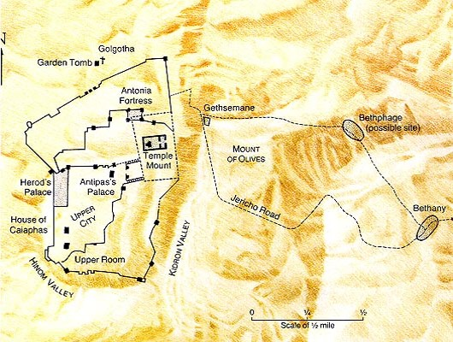
Jesus’ Last Hours

Slide 6
Jesus’ Last Hours
Jn 19:18-27, Jesus Crucified
  Mk 15:25, 3rd hour of Friday
  Gospel writers omit the details of the process
  It was horrendous
    Scourged
    Struck thorn crown on his head with a rod
    Driving nails in hands and feet
    Cross dropped into hole
  It was a spectacle
    not just to execute
    torture, inflict pain, embarrassment
  It Fulfilled Prophecy
Crucifixion

Slide 7
Jesus’ Last Hours
Sayings on the Cross
  Lk 23:34, forgive them…
  Lk 23:39-43, with Thief
  Mt 27:46, My God, my God, why hast thou forsaken me
  Jn 19:28, I thirst
Crucifixion

Slide 8
Jesus’ Last Hours
Jn 19:28-30, Death of Jesus
  Mk 15:33-37, 9th hour
  Mt 27:50-54, God’s Power on Display
    Veil Torn in Temple between Holy & Most Holy
    Earthquake & Rock’s torn
    Graves Open
      After Resurrection of Jesus
    Many Believed
  Jn 10:17-18, power to give and take life
Crucifixion

Slide 9
Jesus’ Last Hours
Jn 19:31-37, Jesus Side was Pierced
  In accordance with prophecy
Crucifixion

Slide 10
Jesus’ Last Hours
Ps 22:1-21, Prophecies of Crucifixion
  His forsaken cry, Ps 22:1 – Mt 27:46
  Mocked, Ps 22:6-8 – Mt 27:27-31
  People wag their heads, Ps 22:7 – Mt 27:39
  Heartbroken, Ps 22:14 – Jn 19:34
  Became very thirsty, Ps 22:15 – Jn 19:28
  Hands and feet pierced, Ps 22:16 – Jn 20:24-28
  People stared at Him, Ps 22:17 – Lk 23:35
  Cloths divided and gambled for, Ps 22:18 – Jn 19:23-24
Notes:
Abundance of trivial details which could apply to many situations in life, all come together at Jesus’ crucifixion

Slide 11
Jesus’ Last Hours
Jn 19:18-27, Jesus Crucified
Jn 19:28-30, Death of Jesus
Jn 19:31-37, Jesus Side was Pierced
Ps 22, Fulfilled Prophecies
Crucifixion

Slide 12
Jesus’ Last Hours
Emphasis’ the cost of our salvation
Reveals the Humanity of Jesus
Reveals the Mercy of Jesus
Reveals the Forbearance of Jesus
Reveals the True Victory
  Over Death & Satan
  Ps 22:22-31
  I Cor 15:54-57
Lessons from Jesus’ death

