Slide 1
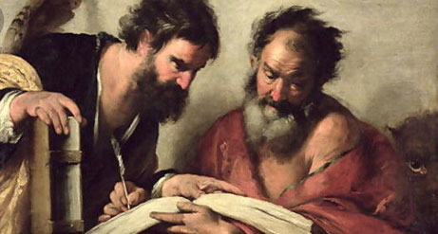
Barnabas
A Servant
Encourager
Acts 4:31-37

Slide 2
Barnabas Encourager
His Work
Acts 4:31-37, Barnabas Active in Early Jerusalem Church
Acts 9:26-30, Approached Saul
Acts 11:19-24, Barnabas Active in Antioch
Acts 11:25-26, Barnabas seeks out Paul
Acts 15:35-41, Barnabas Takes John Mark

Slide 3
Barnabas Encourager
Being a Barnabas
Barnabas Sacrificed of Himself
  Giving of his property for the poor
Barnabas Advocated for Others
  Paul & John Mark
Barnabas Developed (Employed) others in his Work
  Paul & John Mark

Slide 4
Barnabas Encourager
Being a Barnabas
We all have a Purpose and Ability
  Mt 25:14-30, 5, 2, & 1 talent men
  I Cor 12:1-31, Various Gifts
  Rom 12:3-9, Various Abilities
  Eph 4:7-16, Various Offices
  Tit. 2:3-5, Importance of Women
  I Thes 5:9-11, 14, All Christians

Slide 5
Barnabas Encourager
Being a Barnabas
Results according to Ephesian letter
  Unity of Faith
  Knowledge of Jesus
  Complete Man
  Attain Proper Moral Character
  Not Tossed About
  Joined Together
  Compacted Together

Slide 6
Barnabas Encourager
Being a Barnabas
A Servant
  Meekness
  Submission
  Humility
  Forbearance
Notes:
From the lesson on being a servant

Slide 7
Barnabas Encourager
Being a Barnabas
Look out for others Best interest
Develop and Encourage Fellow Workers
Develop and Encourage Teachers & Preachers
Develop and Encourage Participation
Develop and Encourage Elders
Do what we Can
Notes:
Meekness, submission, Humility, forbearance

