Slide 1
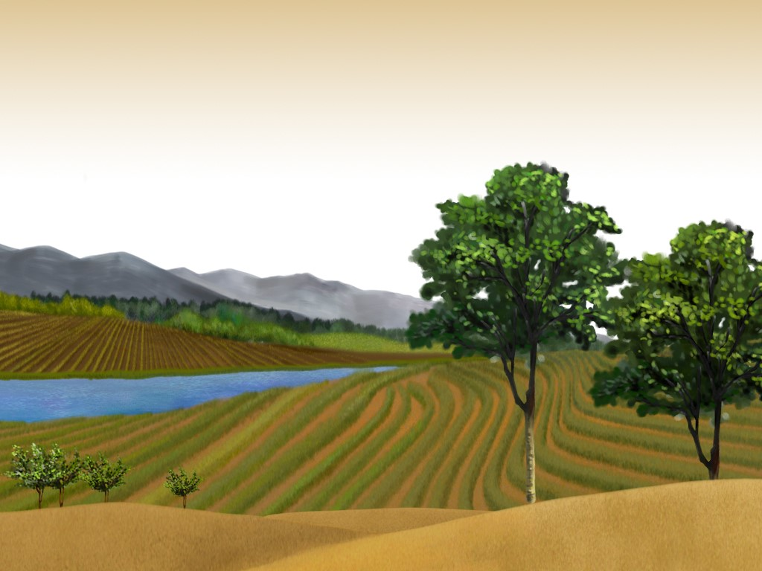
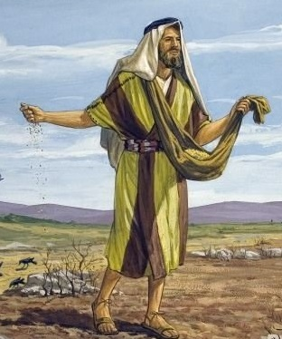
Parable of the Soils
Mt 13:1-9, 18-23

Slide 2
Parable of the Soils
Seed – Word of God
Rom 1:16-17, It is the power of God unto salvation
Heb 4:12, It is alive and powerful
Jam 1:22-25, man will be blessed in his work

Slide 3
Parable of the Soils
Soil – Heart of Mankind
4 different characters of the heart
Seed’s work is limited by the soil and environment

Slide 4
Parable of the Soils
Sower – Teacher
Preacher or Teacher of the Gospel

Slide 5
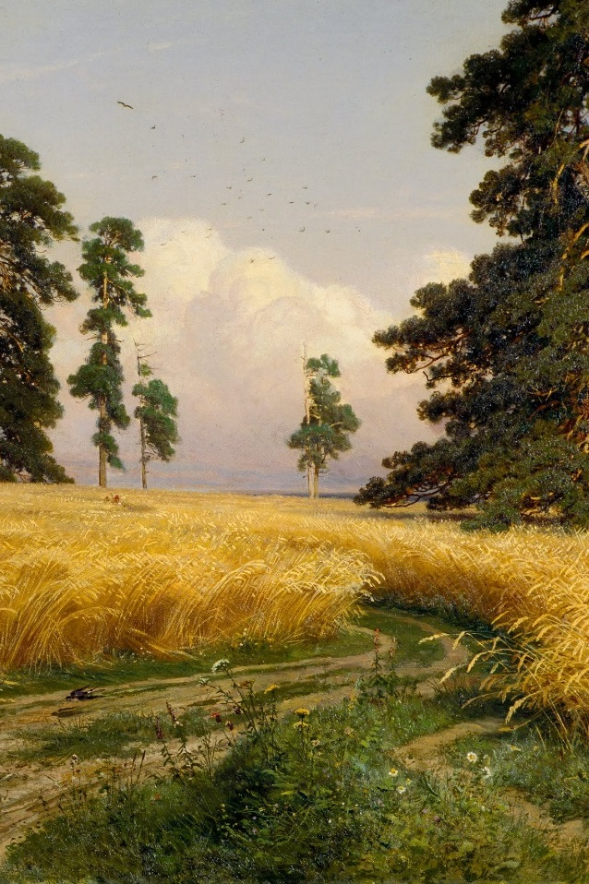
Parable of the Soils
Vs. 4, Wayside
The Parable
Poor Soil Condition
Trampled Down
Uncultivated
Hard
Birds Devoured
Vs. 19, Explanation
hears the word but does not understand
Birds = Wicked one(s)
Notes:
Jam 1:22-25, behold face in a mirror

Slide 6
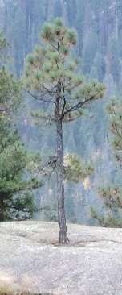
Parable of the Soils
Vs. 5-6, Stony
The Parable
Poor Soil Condition
Not much soil/moisture
See takes Root
Sun scorched
Withered away
Vs. 20-21, Explanation
Hears and receives word
It begins to grow
Succumbs to (External):
Tribulation
Persecution

Slide 7
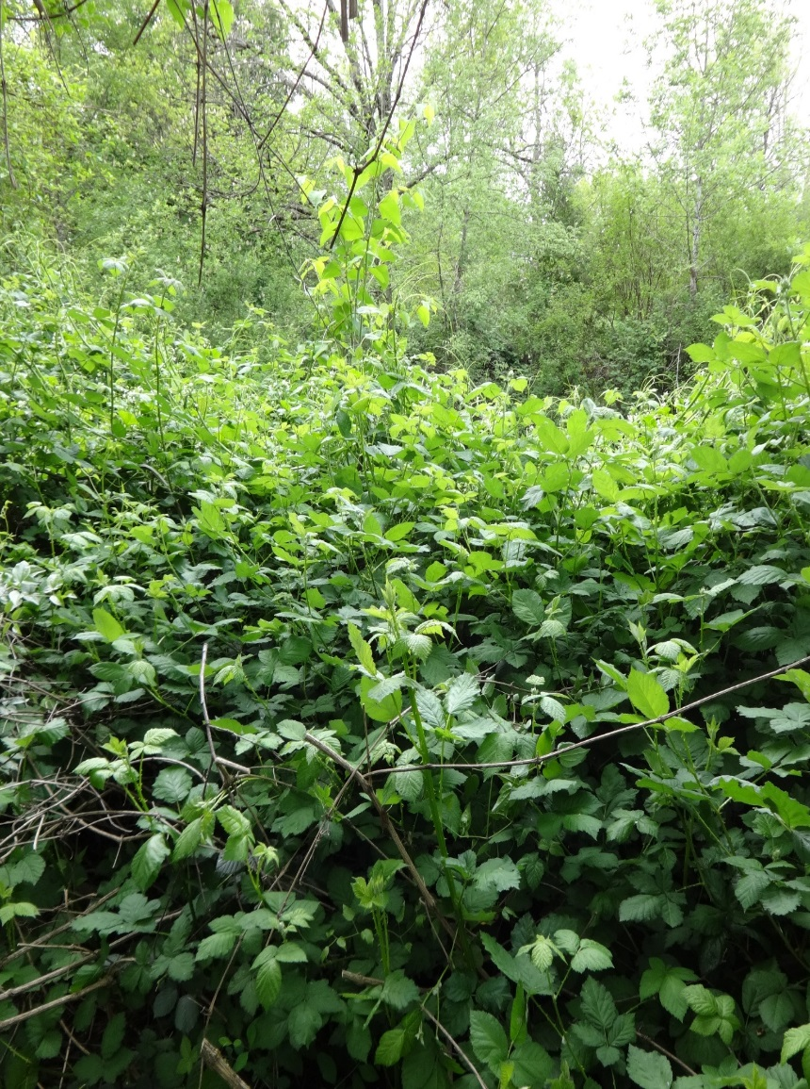
Parable of the Soils
Vs. 7, Thorns
The Parable
Poor Environment
Overtaken and choked out
Vs. 22, Explanation
Hears and receives word
It grows
Not productive:
Cares of World
Riches

Slide 8
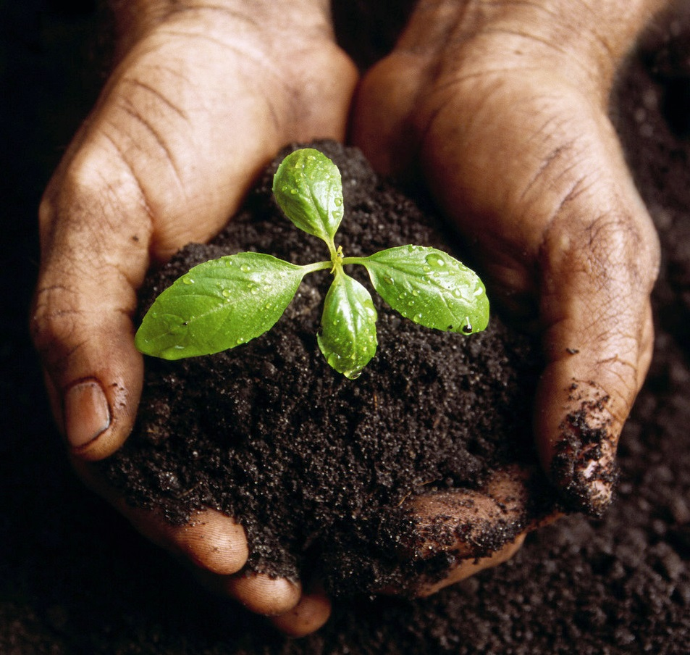
Parable of the Soils
Vs. 8, Good
Parable
Produced Fruit
30
60
100
Vs. 23, Explanation
Hears the word, understands it, bears fruit

Slide 9
Parable of the Soils
One was not Converted
Wayside
Ground is beat down and hard
Seed is picked off ground before it can root
Jam 1:22-25, looking in mirror and not changing

Slide 10
Parable of the Soils
The 3 Believed and Were Converted
Stony – Took root and endured for a while, then dies
Thorns – Took root but cares of world and riches restricted; does not produce fruit
Good – Produced fruit
Notes:
A lot in between stony/thorn and producing lots of fruit

Slide 11
Parable of the Soils
What Enabled Success
The Sun & Rain (Work of God)
1 Cor 3:4-8, who is man?! God gives the increase
Correct Seed (Work of God)
Mt 13:24-30, Parable of the Tares
Notes:
Particular lessons we want to consider
GOD!
It is not our message, it is not our sunshine

Slide 12
Parable of the Soils
What Enabled Success
Good Heart
Notes:
Particular lessons we want to consider
Soil types and impedances
Not just to convert but to grow and produce fruit

Slide 13
Parable of the Soils
What Enabled Success
Sower used the Correct Seed (Word)
1 Tim 4:2, preach the word
Work of the Sower (Teacher)
2 Tim 4:2, patiently teach
1 Cor 3:4-8, planted & watered…
2 Cor 5:11, we persuade men
2 Cor 10:1, beseeched by the meekness and gentleness of Christ
Mt 13:24-30, lesson from Parable of the tares
Notes:
Particular lessons we want to consider
God left the word in the hands of men
A conflict; consequences of life choices; lack of patience on the teacher
We will continue this study from Mt 18 on offending a brother… in another lesson
Teachers can impede progress, prevent progress, destroy progress

Slide 14
Parable of the Soils
Summary
All except the “Wayside soil” believed and were converted
What Enabled Success
The Sun or Rain (Work of God)
The Correct Seed (Work of God)
Good Heart (All of Us)
Work of the Sower (Teacher)

Slide 15
Parable of the Soils
Luke 8:18, Take heed therefore how ye hear: for whosoever hath, to him shall be given; and whosoever hath not, from him shall be taken even that which he seems to have.

