Slide 1
Family
Notes:
Family love is a great real life application and example for us to consider
Charity begins at home

Slide 2
Notes:
Charity begins at home Dual meaning
If we cannot love our own it is impossible to love a neighbor
Charity is taught at home
Parents love their children even when they are distraught

Slide 3
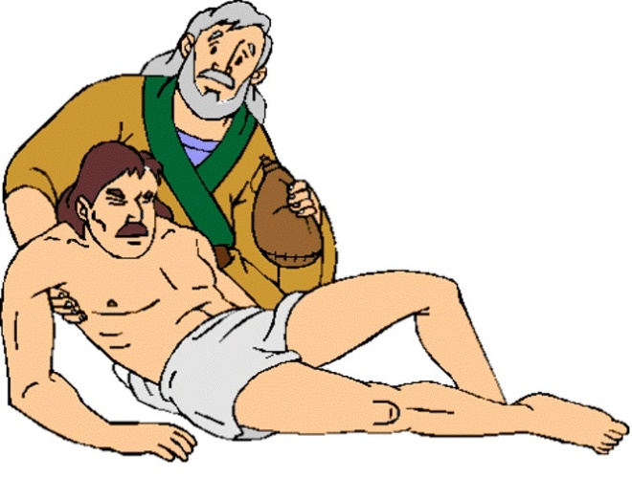
Joy of Giving
The Good Samaritan
  What provokes the response of the Samaritan?
    Love God (Heart, Mind, Soul, & Strength)
    Love Neighbor (better than self)
Notes:
In this lesson we will look at one aspect that might have been in the Samaritan but needs to be in every Christian.
Taking pleasure in giving; that is in “suffering loss”.

Slide 4
Joy of Giving
Finding Joy in helping others:
Giving of our selves
(money, time, possessions…)
Acts 20:35
Notes:
Finding Joy in helping others
Giving of our selves; money, time, possessions
Joy, one of the fruits of the spirit

Slide 5
Joy of Giving
Cheerful Giver
  2 Cor 9:6-7, Cheerful Giver
    Greek – hilaros
      Strong’s & Thayer – Prompt to do anything or willing
    Eager and Merry
    Performing work we don’t want to do
    This is in regards of the Church
Notes:
Not an affliction or of constraint
Though this is about giving to the church, I want to stay focused on how we give, not the where

Slide 6
Joy of Giving
Cheerful Giver
  Rom 12:8, …he that shews mercy, with cheerfulness.
    Cheerfulness, Noun of previous
      Eagerly
    Giving is rooted in mercy, not merit
      If of merit then we owe
    Negative of this is covered by Paul in Corinthian letter:
      Grudgingly or by constraint
Notes:
Giving of the church is owed but we do it of Love, Cheer, not indebtedness;
I prefer using the words “opportunity” to give instead of obliged, indebted, etc.

Slide 7
Joy of Giving
With Love
  I Cor 13:1-8a Definition of Greek Agape Love
    Vs. 3, …though I bestow all my goods to feed the poor, …have not charity, it profits me nothing
    Concern for the betterment of another
    Eddie Caskey, “A choice of individual will to act in the best interests of another, even when another is not fully deserving and even when personal sacrifice is necessary in the action of this affection.”
    I Jn 3:16, Hereby perceive we the love of God, because he laid down his life for us…
Notes:
Not just simply yearning for the betterment of another; but that one would act upon that concern.

Slide 8
Notes:
Charity starts a home: Can we give to our children good things, best things, better things,…
Do so promptly, eagerly,
What do they deserve?

Slide 9
Joy of Giving
With Joy
  Heb 12:2, Looking unto Jesus the author and finisher of our faith; who for the joy that was set before him endured the cross, despising the shame…
    Cheerfulness, calm delight, gladness
    Taking delight in … “Injury”
Notes:
The last cheerful focused on being eager, ready, prompt, as well as merry…

Slide 11
Joy of Giving
With Sincerity
  Rom 12:8, …he that giveth, let him do it with simplicity…
    With generosity & honesty
    Without dissimulation or self-seeking
      Not as Pharisees, Mt 6:1-18.
Notes:
Not to be returned.

Slide 12
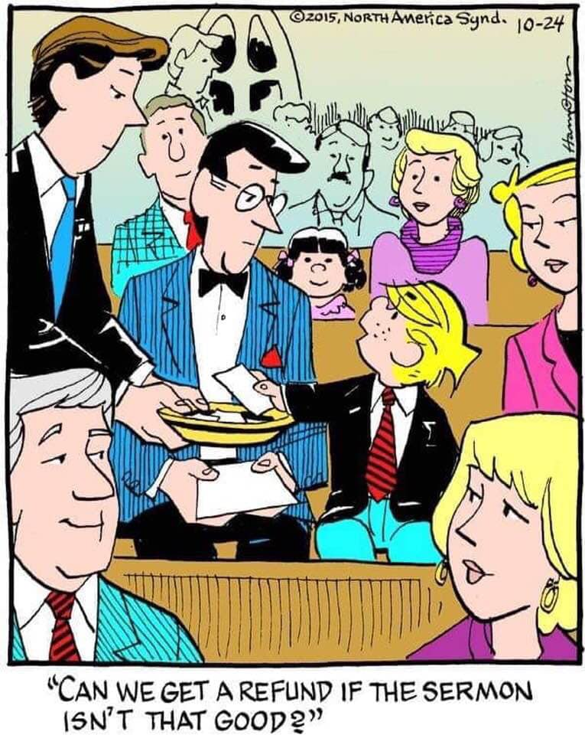
Notes:
Not to be returned.

Slide 13
Joy of Giving
With Contentment
  I Tim 6:6-10, godliness with contentment is great gain…
    Came with nothing, taking nothing with us
    Be content with food and raiment
    I Chr 29:14, for all things come of thee, and of thine own have we given thee
    Acts 7:50, Stephens defense, God’s hands made all these things

Slide 14
Joy of Giving
With Contentment
  Eph 4:28, Let him that stole steal no more: but rather let him labor, working with his hands the thing which is good, that he may have to give to him that needs.

Slide 15

Notes:
We really thing our possessions are ours. They are not; God made them; God allows man to control them; God does not want man to be controlled by them. They are for the betterment of others

Slide 16
Joy of Giving
In the Whole
  The ability to look beyond “injury”
    Suffering
    Taking a Loss
    The Cost
    It all belongs to God

Slide 17
Joy of Giving
In the Whole
  The ability to look beyond “injury”
  To see it through the eyes that God desires, 2 Cor 9:6-7
    Not of necessity
    Not grudgingly
    Eagerly
    Joyfully

Slide 18
Joy of Giving
Cheerful – Eager & Prompt to Give
Love – The Betterment of Another
Joy – Delight & Cheerful
Sincerity – Pure Heart
Content – Satisfied with the meager

Slide 19
Joy of Giving
Acts 20:35, Blessed!
even when One is not so lovable.
Notes:
Good parents will see to the betterment of their children, even when they are not so lovable. That is the Love of God

