Slide 1
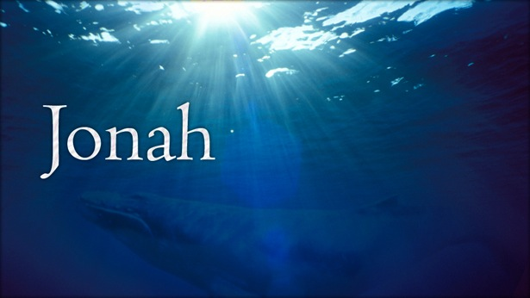
We all know the story, but have we really gotten the point?
Notes:
Has captured imaginations for centuries. It seems to have it all:
God’s requirement,
Jonah’s rebellion and retreat,
God reigns him with a raging storm,
the sailors’ reluctance,
Jonah’s repentance and report,
Nineveh’s redemption,
Jonah’s resentment, and
God’s reminders.

Slide 2
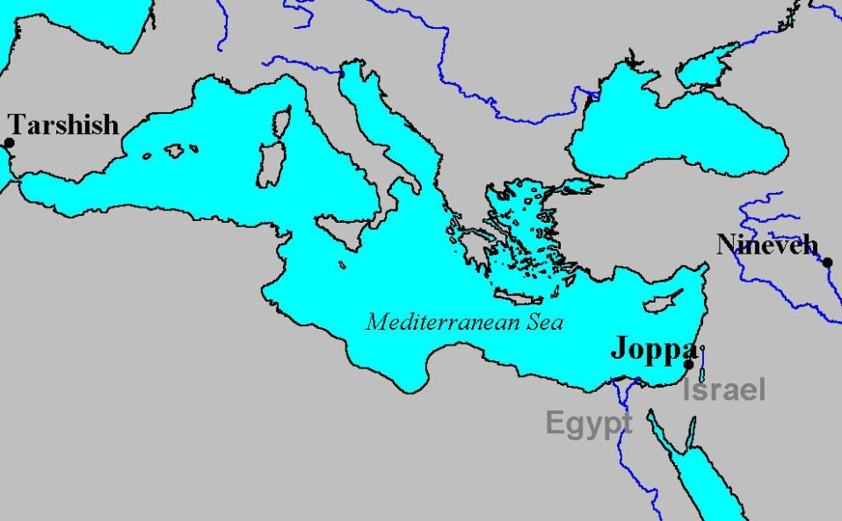
1:3, But Jonah retreated toward Tarshish!
God required Jonah to report .
to Nineveh, 1:1-2

Slide 3
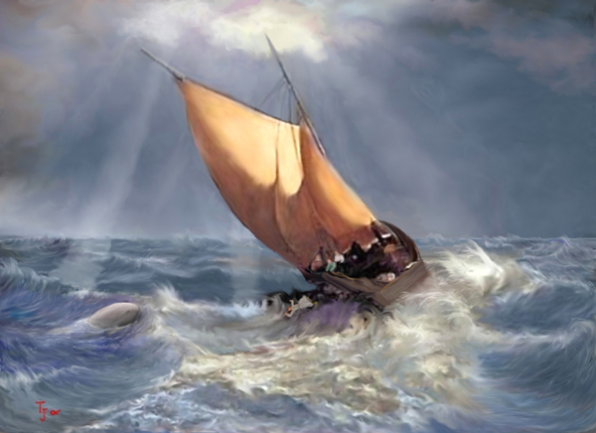
“So they picked up Jonah, threw him into the sea, and the sea stopped its raging.”
God then reigns Jonah with a raging tempest, 1:4-9
Jonah realizes and reports the resolution, 1:9-12
The sailors are reluctant, but relent, 1:13-16

Slide 4
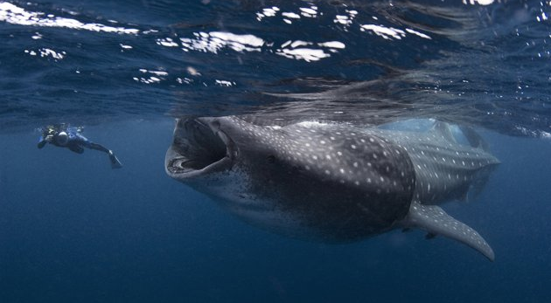
“And the Lord appointed a great fish to swallow Jonah, and Jonah was in the stomach of the fish three days and three nights.” 1:17
“Then Jonah prayed to the Lord his God from the stomach of the fish…” 2:1-9

Slide 5
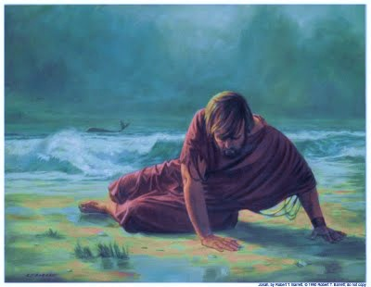
“Then the Lord commanded the fish, and it vomited Jonah up on dry land.” 2:10
“Now the word of the Lord came to Jonah a second time, saying:
‘Arise, go to Nineveh the great city and proclaim to it the proclamation which I am going to tell you.’” 3:1-2
“So Jonah arose and went to Nineveh according to the word of the Lord…” 3:3a

Slide 6
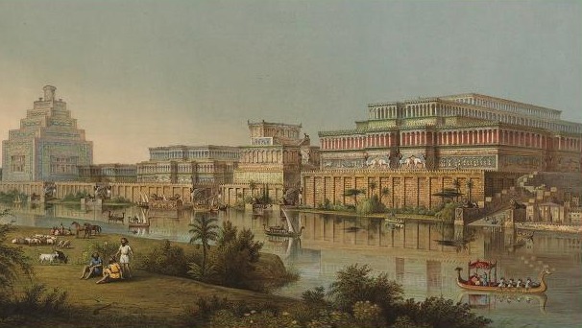
Nineveh’s repentance, 3:4-9
God relents and Nineveh is redeemed, 3:10!

Slide 7
Jonah’s Resentment, 4:1-3
Jonah Hoped for God’s Wrath, 4:4-5
God’s Patience & Mercy, 4:6-11
  For Nineveh
  For Jonah

Slide 8
Jonah
Wrath of Man – Mercy of God
Lessons
  Jonah’s Faults
    Wrath
      Nineveh was worthy of Gods wrath!
      1:2, God judged wicked
      3:8, evil way, violence in their hands
      Nah 3:1, Woe to the bloody city! it is all full of lies and robbery
Notes:
This book spends more time showing the error of the prophet than it does establishing the sin of the condemned!!!

Slide 9
Jonah
Wrath of Man – Mercy of God
Lessons
  Jonah’s Faults
    Wrath
      Jonah’s deep resentment toward Nineveh
      4:1, exceedingly displeased
      4:5, sat and watched the city hoping for its destruction
      Jam 1:20, For the wrath of man worketh not the righteousness of God.
Notes:
Jonah whittling on God’s end of the stick; sitting in God’s seat

Slide 10
Jonah
Wrath of Man – Mercy of God
Lessons
  Jonah’s Faults
    Wrath
    Pride, prejudice, and superiority of the Jew
    Selfishness
      Rejoiced in the Gourd that he did not labor for
      Despised mercy of God over 120,000 people

Slide 11
Jonah
Wrath of Man – Mercy of God
Lessons
  God’s Mercy
    4:2, Jonah knew of God’s Mercy
    3:5-9, Nineveh hoped for God’s Mercy
    4:11, God provided Nineveh Instruction of righteousness
Notes:
Nineveh was a sinful city

Slide 12
Jonah
Wrath of Man – Mercy of God
Lessons
  God’s Mercy
    On Nineveh
      3:10, God saw their works, that they turned from their evil way and God repented of the evil

Slide 13
Jonah
Wrath of Man – Mercy of God
Lessons
  God’s Mercy
    On Jonah
      1:2-3, Jonah fled from God
      1:4-14, Storm battered the ship
      1:15-2:10, Fish swallowed Jonah
      4:6-11, seen in the gourd and following interaction
Notes:
Even with his resentment, selfishness, anger, wrath, rebellion, …
There is more errors recorded of this prophet than the city he teaches

Slide 14
Jonah
Wrath of Man – Mercy of God
Lessons
  God’s Mercy
  God’s Patience
    Seen in his mercy
    Gen 19:15-22, Lot Lingered at the destruction of Sodom & Gomorrah

Slide 15
Jonah
Wrath of Man – Mercy of God
Lessons
  God’s Wrath
    Real
      Nah 1:2-3, eventual judgment against Nineveh
      Mt 24:36-39, Noah and flood
      II Pet 3:1-13, Warnings of final Judgment

Slide 16
Jonah
Wrath of Man – Mercy of God
Lessons
  Balancing God’s Wrath & God’s Mercy
    Adhere to his instructions
    Jam 2:13, God’s Mercy Triumphs over his wrath

Slide 17
Jonah
Wrath of Man – Mercy of God
Lessons
  God Judged Ninevites Worthy of Mercy
  God Judged Jonah Worthy of Mercy

Slide 18
Jonah
Wrath of Man – Mercy of God
Lessons
  Greatness of the Mercy of God
  Unrighteousness of Man’s Wrath
  Patience of God with Man’s Sin

