Slide 1
Knowing God What God Cannot Do
1 Pet 1:15-17
1 Jn 2:5-6
Notes:
Like with Jesus we want to understand who our God is; his nature, is works, these things define who he is. We worship him and understanding this is critical to our worship

Slide 2
Knowing God
Terms
Omni-Science
Omni-Presence
Omni-Potent
Sovereignty
These are taught in scripture but not labeled as such
Divinity or Deity
Review
Notes:
These are not biblical terms but are founded upon biblical concepts

Slide 3
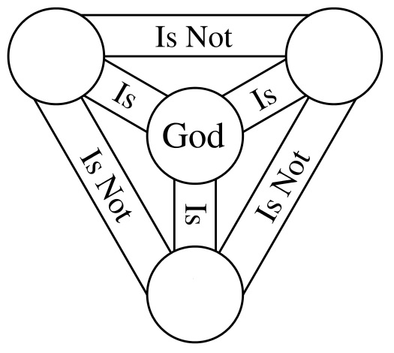
Father
Son
Spirit

Slide 4
Knowing God
Prejudice
Nature of Man
Jas 2:1-9, The Early Church
Not the Nature of God
1 Pet 1:15-16, God is Holy
1 Pet 1:17, “Father” who without respect of persons judges according to every man's work
Eph 6:8-9, whatsoever good thing any man does, the same shall he receive of the Lord, whether he be bond or free
What God Cannot Do
Notes:
As we study the bible we learn that there are things God CANNOT do, though he be Omni-, sovereign, Divine!
He is Holy Therefore there are things he WILL NOT DO.

Slide 5
Knowing God
Prejudice
Not the Nature of God
Acts 10:34-35, Peter said, “Of a truth I perceive that God is no respecter of persons:35 But in every nation he that fears him, and worketh righteousness, is accepted with him.
Prejudice toward ones works, not birth, race, height, career, sex, etc.
What God Cannot Do
Notes:
As we study the bible we learn that there are things God CANNOT do, though he be Omni-, sovereign, Divine!
He is Holy Therefore there are things he WILL NOT DO.

Slide 6
Knowing God
Lie
Not the Nature of God
Tit 1:2, In hope of eternal life, which God, that cannot lie, promised
Heb 6:18, That by two immutable things, in which it was impossible for God to lie
2 Tim 2:12-13, if we deny him, he also will deny us:13 If we believe not, yet he will remain faithful: he cannot deny himself.
What God Cannot Do

Slide 7
Knowing God
Forget Promises
Tit 1:2, In hope of eternal life, which God, that cannot lie, promised
2 Pet 3:4, 9-10, When is he coming? The Lord is not slack concerning his promise, But the day of the Lord will come
What God Cannot Do

Slide 8
Knowing God
Tempt Man To Sin
Jas 1:13-15, Let no man say when he is tempted, I am tempted of God: for God cannot be tempted with evil, neither tempts he any man
1 Cor 10:13, does not lure us to failure but gives us an escape
What God Cannot Do

Slide 9
Knowing God
Tempt Man To Sin
Proper View of Trails and Temptations
Jas 1:14, But every man is tempted, when he is drawn away of his own lust, and enticed.
Jas 1:2-4, count it all joy when ye fall into various trials
1 Pet 1:6-9, That the trial of your faith, being much more valuable than of gold
Heb 12, Chastening of God
What God Cannot Do

Slide 10
Knowing God
Ignore Sin
Isa 59:2-3, But your iniquities have separated between you and your God, and your sins have hid his face from you, that he will not hear.3 For your hands are defiled with blood, and your fingers with iniquity; your lips have spoken lies, your tongue hath muttered perverseness
What God Cannot Do

Slide 11
Knowing God
Ignore Sin
Jer 5:25, Your iniquities have turned away these things, and your sins have withheld good things from you.
1 Cor 6:9-11, Know ye not that the unrighteous shall not inherit the kingdom of God… such were some of you: but ye are washed, but ye are sanctified, but ye are justified
What God Cannot Do

Slide 12
Knowing God
Ignore Sin
Acts 3:19, Repent ye therefore, and be converted, that your sins may be blotted out
What God Cannot Do

Slide 13
Knowing God
Remember Forgiven Sins
Heb 1:3, he had by himself purged our sins
Heb 8:6-13, For I will be merciful to their unrighteousness, and their sins and their iniquities will I remember no more
Heb 10:17, And their sins and iniquities will I remember no more.
Acts 3:19, your sins may be blotted out
Rom 4:7-8, Saying, Blessed are they whose iniquities are forgiven, and whose sins are covered
What God Cannot Do

Slide 14
Knowing God
Remember Forgiven Sins
Eph 1:7, we have redemption through his blood, the forgiveness of sins
Acts 2:38, Repent, and be baptized every one of you in the name of Jesus Christ for the remission of sins
Acts 22:16, And now why tarry? arise, and be baptized, and wash away thy sins
Forgiving is Forgetting
What God Cannot Do

Slide 15
Knowing God
Save Those Who Reject the Gospel
Acts 4:12, Neither is there salvation in any other: for there is none other name under heaven given among men, whereby we must be saved
Mk 16:16, He that believeth and is baptized shall be saved; but he that believeth not shall be damned.
What God Cannot Do

Slide 16
Knowing God
Prejudice
Lie
Forget Promises
Tempt Man To Sin
Ignore Sin
Remember Forgiven Sins
Save Those Who Reject the Gospel
What God Cannot Do

Slide 17
Knowing God
1 Tim 2:4, Our Savior will have all men to be saved, and to come unto the knowledge of the truth.
1 Cor 6:9-11, Know ye not that the unrighteous shall not inherit the kingdom of God… such were some of you: but ye are washed, but ye are sanctified, but ye are justified
What God Cannot Do

