Slide 1
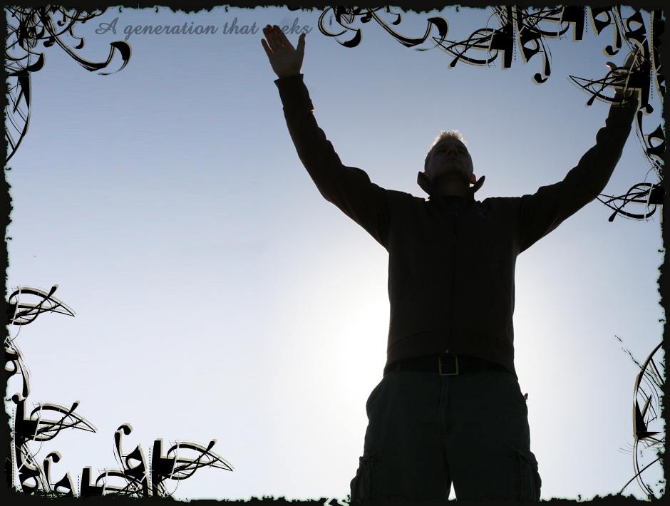
Worship –
In Spirit
and Truth
Jn 4:19-25
Notes:
With the corona virus and all going on it seems many are talking a look at worship. What is approved and acceptable as well as what is forbidden

Slide 2
Review – Worship
God – The Object of Worship
Only God/Deity/Divinity
Sovereign
Omni-potent, -science, &
-present
Holy & Righteous
Including Jesus & Holy Spirit
Notes:
Emphasize the importance of all these attributes
we do not worship something or someone just because they are one of them
Actually we worship God because he is our Sovereign; that is it!!?? Is this true??

Slide 3
Review – Worship
God – The Object of Worship
Not Spiritual Beings
Not Man
(Not even Apostles)
Not Objects

Slide 4
Worship Spirit & Truth
Controversary of the Day
Jn 4:19-20, Where to Worship?
Recognized Jesus was a Prophet
What would be foremost on your mind if you met a prophet?
Samaritans – Mt Gerizim
Jews – Jerusalem
Notes:
When the nations divided, the northern tribe could not worship with the southern tribe, so now there are 2 places to worship
Animosity toward Samaritans over this issue; at least in part

Slide 5
Worship Spirit & Truth
Future Worship
Jn 4:21-22, A Change is Coming
The Hour is Coming
Notes:
Implication it would be very Soon

Slide 6
Worship Spirit & Truth
True Worshippers
Jn 4:23, Spirit & Truth
True Worshippers
Genuine, real
What is Jesus’ Focus
The Worshipper?
The Worship?

Slide 7
Worship Spirit & Truth
True Worshippers
In Spirit
“They shall worship God with a sincere “mind;” with the simple offering of gratitude and prayer; with a desire to glorify him, and without external pomp and splendor.” Albert Barns
Notes:
Not with works of the Holy Spirit
Contrasting Ritualism and worship of self
Not ritualism, formalities, show, locative worship; worship of self or things

Slide 8
Worship Spirit & Truth
True Worshippers
Spirit
With Genuine or sincere Heart
Heart, soul, and mind
Jew’s “Worship”
Mt 6:1-17, to be seen of men
Mt 15:1-9, “gave at the temple”
They worshiped self and things
Notes:
Devotions to themselves

Slide 9
Worship Spirit & Truth
True Worshippers
Truth
Jn 17:17, the Word is Truth
Mt 7:21-23, who is approved

Slide 10
Worship Spirit & Truth
Because: God Seeks Them
Jn 4:23, for the Father seeks such to worship him
God Desires
Acts 17:27, God wants his creation to seek for Him and honor Him
Notes:
Primarily: Seeks them, not it

Slide 11
Worship Spirit & Truth
Because: God is a Spirit
Jn 4:24, God is a Spirit
God is not material
Act 7:48, dwelleth not in temples made with hands
Act 17:24, dwelleth not in temples made with hands
Notes:
As if his material creation and determine the right way

Slide 12
Worship Spirit & Truth
Because: God is a Spirit
Jn 4:24, God is a Spirit
God is not material
Jews focused physical
Temple in Jerusalem
Jn 4:20, Mt Gerizim
Lineage of Abraham
Mt 3:9, Jesus response to the Pharisees & Sadducees
Notes:
As if his material creation and determine the right way

Slide 13
Worship Spirit & Truth
A Change in Worship
Not the Venue
Not in Jerusalem or Mt Gerizim

Slide 14
Worship Spirit & Truth
A Change in Worship
True Worshippers
Spirit & Truth
Because:
God Desires Them
God is a Spirit

Slide 15
Worship Spirit & Truth
True Worshippers
Focus: God vs. Self
Source: Heart vs. Ritual/ External

