Slide 1
Woman of Worth
Prov 31:1-31

Slide 2
Woman of Worth
Understanding Women
Vs. 1-9, Mother to Son
Many Kings (men) fall due to:
Women
Wine
In-Justice

Slide 3
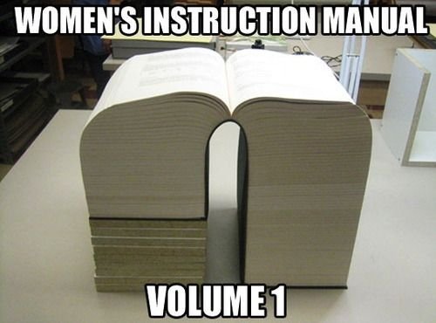
Woman of Worth
Understanding Women
Vs. 1-9, Mother to Son
Many men fall due to:
Women
Wine
In-Justice
Notes:
A Mothers Prophecy taught to her Son,
Understanding women; for a man; they are not men; but they are…
Men Are from Mars, Women Are from Venus, by John Gray

Slide 4
Woman of Worth
Of Great Value
Vs. 10-12, her price is far above rubies
Virtuous
Strength, might, wealth
181x it is a term used of physical strength
29x of (Great) wealth
4x of virtue (context of women)

Slide 5
Woman of Worth
Of Great Value
Vs. 10-12, her price is far above rubies
Precious Jewels
Her husband trust her
She does him good
Respect her!
Honor her!
Notes:
Let your wife have strength, she is valuable and capable
Kings hoard
Things of value, power, resources, honor
King my son – honor and value your wife, the woman of might, of value
The Godly woman can be trusted

Slide 6
Woman of Worth
Of Great Strength
Vs. 13-20, works willingly with her hands
Works willingly
Great Intellect
Physical work
A Woman of “Virtue”
Strength or Might
Notes:
Willingly – Pleasure/Delight/Joy

Slide 7
Woman of Worth
Of Great Character
Vs. 21-27, She is clothed with Strong Character
Husband is of strong character
High Quality Clothing
Not Fearful but Rejoicing
Strength and Honor
Speech
Concern over her household
Notes:
She is clothed with Strong Character
She makes these fine clothes, but she is clothed with something even greater, moral virtue

Slide 8
Woman of Worth
She is Praiseworthy
Vs. 28-31, a woman that fears the Lord, she shall be praised
Her Children
Her Husband
Fears the Lord
Her Works Praise Her

Slide 9
Woman of Worth
Summary
Understanding Women
Do not Give Your Strength
But
Cherish Her Great Value
Cherish Her Great Strength
Cherish Her Great Character
Because
She is Praiseworthy
Notes:
Stepping back and looking at the big picture
Why give your strength to a woman, she is capable of her own

Slide 10
Woman of Worth
Summary
Understanding Women
Prophecy of His Mother
Respect Her
Value Her
Nurture and Develop Her
Notes:
Things of value, power, resources, honor
King my son – honor and value your wife, the woman of might, of value
Fearing strength
Fearing those who are better than us

