Slide 1
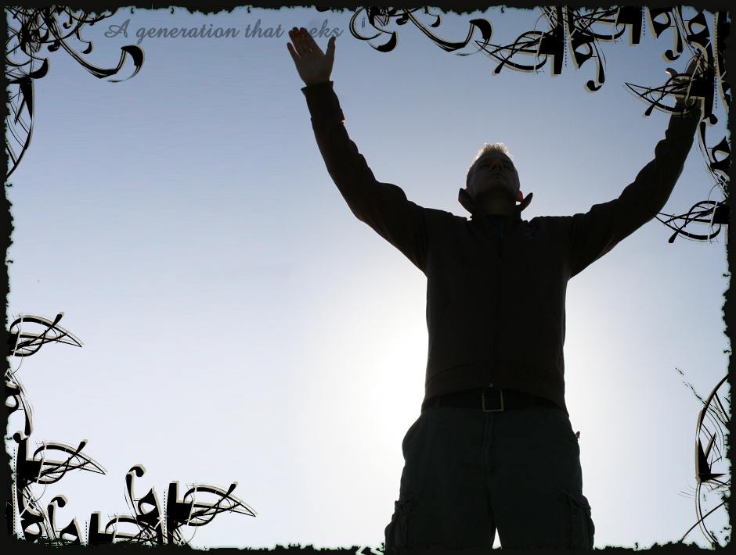
Worship –
In Spirit
and Truth
Heb 13:15-16
Notes:
With the corona virus and all going on it seems many are talking a look at worship. What is approved and acceptable as well as what is forbidden

Slide 2
Worship Spirit & Truth
True Worshippers
Jn 4:19-25
With the Heart
According to Truth

Slide 3
Worship Spirit & Truth
True Worshippers
Eph 5:19, Sing
Speaking to yourselves
Psalms and hymns and spiritual songs
Melody in your heart
To the Lord

Slide 4
Worship Spirit & Truth
True Worshippers
Eph 5:19, Sing
Col 3:16, Edification
Teaching and admonishing one another
Grace in our Hearts
To the Lord
1 Cor 14:14-17, with Spirit and Understanding

Slide 5
Worship Spirit & Truth
True Worshippers
Sing
Other Methods Not Included:
Whistling
Hand Clapping
Dancing
Instruments & Bands
Concerts
Fireworks
Active Participation
Worship is not a performance
Notes:
Explain active participation
Praying prayer that everybody can pray

Slide 6
Worship Spirit & Truth
True Worshippers
Eph 5:20, Pray
Giving thanks always for all things
1 Cor 14:14-17, with Spirit and Understanding
Notes:
Improperly using Jesus’ Prayer; Just repeating it
Praise, thankful, supplications (Needed and desires))

Slide 7
Worship Spirit & Truth
True Worshippers
Eph 5:20, Pray
Lk 11:1-4, Jesus’ Lesson
Reverent address
The Kingdom to come (Church)
God’s will to be done
Daily Bread (Basic Needs)
Forgive our sin
Deliver us from temptation and evil
Amen (Mt 6:13)
Notes:
Improperly using Jesus’ Prayer; Just repeating it
Praise, thankful, supplications (Needed and desires))

Slide 8
Worship Spirit & Truth
True Worshippers
Eph 5:20, Pray
Active Participation
Worship is not a performance
Jas 5:13-18, Power of Prayer
Notes:
Improperly using Jesus’ Prayer; Just repeating it
Praise, thankful, supplications (Needed and desires)
Explain active participation
Praying prayer that everybody can pray

Slide 9
Worship Spirit & Truth
True Worshippers
1 Cor 11:21-29, Lord’s Supper
Purpose:
Remembrance of Jesus
Proclaim the Lords death (Life)
Each to examine
Discerning the Supper from a common meal
Eat at home
Notes:
Paul’s teaching to the Corinthians brings out the biggest examples of a disturbed worship and lessons for us
Chapter 14: Decently and in order; all participating, understanding, and edifying
Chapter 11: Respecting the sacrifice of Jesus and the assembly (no common meal)
Only the “Assembly” of the saints; what about???

Slide 10
Worship Spirit & Truth
True Worshippers
1 Cor 11:21-29, Lord’s Supper
Elements
Unleavened Bread & Fruit of the Vine (Mt 26:17-29, with Passover Feast)
Collective Worship Only?
Exceptions?
Notes:
Only the “Assembly” of the saints; what about???

Slide 11
Worship Spirit & Truth
True Worshippers
1 Cor 11:21-29, Lord’s Supper
Remember – Purpose:
Remembrance of Jesus
Proclaim the Lords death (Life)
Active Participation
Worship is not a performance
Notes:
Is the purpose for the assembly or for the Christian to remember?!
I’m not implying one can forsake the assembly and partake on their own and be justified.
But what about the shut-ins?!

Slide 12
Worship Spirit & Truth
True Worshippers
Sacrifice
Mt 2:11, worshiped and brought gift to Jesus’ family
1 Cor 16:1-2, instruction for the collective Church
II Cor 9:6-7, eagerly bountiful
Mk 12:41-44, Widows Mite
Notes:
Collective for the works of the church

Slide 13
Worship Spirit & Truth
True Worshippers
Sacrifice
Jas 1:27, Pure and Genuine Religion
Eph 4:28, Work to give
Rom 12:1-2, a living sacrifice
II Cor 9:9-15, brings Glory to God
Notes:
Individual accountability

Slide 14
Worship Spirit & Truth
True Worshippers
Actively Worship God
Pray
Sing
Lords Supper
Sacrifice

Slide 15
Worship Spirit & Truth
True Worshippers
Actively Worship God
From the Heart
According to Truth
Edify One Another
Glorify & Honor God
Collectively & Individually
Issue about Lord’s Supper
Notes:
Focus on the worshipper; not the location
Collective worship vs. individual worship
Collective worship is a requirement; Heb 10
There are considerations, but let's focus on the me worshiping; don’t throw the baby out with the bathwater
Intent was not to delinate the works of the church; separate lesson to consider

