Slide 1
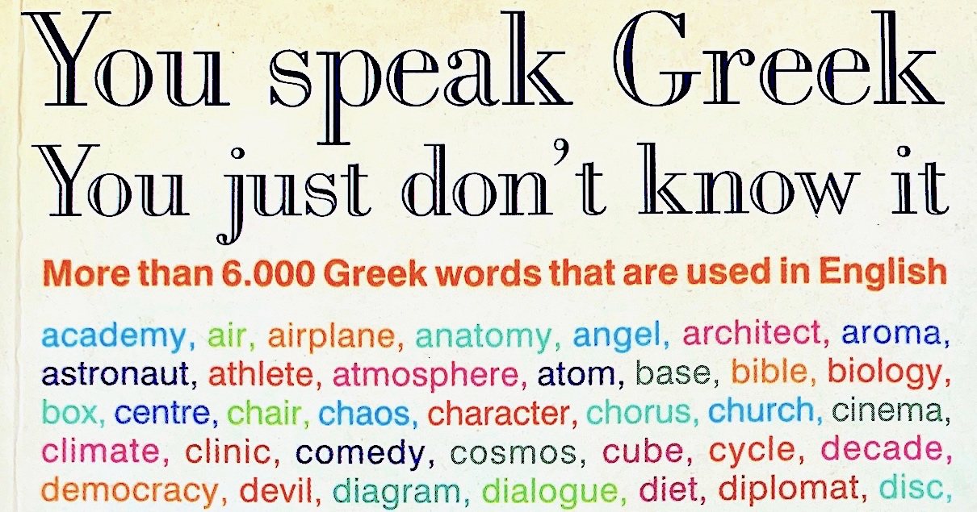

Slide 2
How to Study the Bible
2 Tim 2:15, Rightly Dividing

Slide 3
How to Study the Bible
Confusion about how it fits together
Shot Gun Approach
Bible Class and Sermons
Memorize …
Reliance on others
Word Scholars
Commentators
Other Preachers

Slide 4
How to Study the Bible
Need for Personal Study
Making sense of the bible
Proof texting does not make sense of the bible
Memorize what we study
i.e. Study entire books
Never study what we memorize

Slide 5
How to Study the Bible
Need for Personal Study
Example
Acts 2:38, defining for vs. because of
Gal 5, define the Works of Flesh & Fruit of Spirit

Slide 6
How to Study the Bible
Need for Personal Study
Lest we just take man’s word for it
But, We do not speak Greek
But, We do not speak old English
We may not be good at English
…
Goal: Wet the Appetite for Personal Study

Slide 7
How to Study the Bible
Communication
Bible – Written Word
Words
Phrases
Paragraphs
Books
Beginning and ending of a topic

Slide 8
How to Study the Bible
Language Barriers
New Testament
Greek
KJV – 1611 & 1800 English
Learning Spanish

Slide 9
How to Study the Bible
Language Barriers
Finish
Complete
Terminate
End
Achieve
Accomplish
Expire
Attain

Slide 10
How to Study the Bible
Communication
How We Communicate
Speech
Tone
Body Language
Examples

Slide 11
How to Study the Bible
Context
Books in the Bible were written to specific audience, at a specific time, for a specific purpose
Old Testament Vs. New Testament
Understanding the
Audience
Purpose (Theme)

Slide 12
How to Study the Bible
Context
Audience – Jew Sects
Samaritan
Pharisee
Sadducee
Zealot
Libertines, Cyrenians, and Alexandrians
Nazarenes/Christian (Judaizers)

Slide 13
How to Study the Bible
Context
Audience – Jew Traits
Religion - rituals (physical acts)
Self-righteous
View of Publicans, sinners, sick, poor
Hard of Hearing
Militant
Loved Preeminence
Notes:
Gospels (Esp Mathew) and the Book of Romans & James

Slide 14
How to Study the Bible
Context
Audience – Gentile
Roman
Galatia
Ephesians (Asia)
Athens/Corinth (Greek)
Unique Cultural and Religious Norms

Slide 15
How to Study the Bible
Context
Purpose (Theme)
John’s Gospel
Acts
1 Corinthians
Galatians
1&2 Timothy
Old Testament
Notes:
Understanding the purpose helps to put the individual letters into proper context, makes since of the teaching

Slide 16
How to Study the Bible
Context
Common Purpose (Theme)
Elders (1 Tim & Titus)
Desire for preeminence
Fruit of the spirit and works of the flesh
Work of Redemption

Slide 17
How to Study the Bible
Context vs. Topical
We do this in REVERSE!
Refuting Baptism
Refuting Instrumental Music
Refuting…
Study of Books
Why are we worried about refuting when we have yet to learn…

Slide 18
How to Study the Bible
Context
Learn what is being taught in the Book
We must first understand what is being taught lest we misuse what was said
Error of Proof Texting
How we come to knowledge matters
Notes:
We

Slide 19
How to Study the Bible
Contextual
Common Errors
Doctrine of Baptism in Romans-Revelation
Gal 4:1-5:1, Liberty in Jesus
1 Cor 1:21, Foolish Preaching
Mt 25:14-30, Using our talents
Lk 15:11-32, Lost Son/Gracious Father

Slide 20
How to Study the Bible
Topical
Necessarily proof texting
Necessary to exhaust all aspects of a topic
After understanding the Context

Slide 21
How to Study the Bible
Topical
Doctrine of the Holy Spirit
Jn 14-16, prophecy of Holy Spirit
Acts 2:1-22, realization and demonstration of Holy Spirit
Acts 8:18, Apostles received this
I Cor 2:9-13, how the Holy Spirit worked in the Apostles

Slide 22
How to Study the Bible
Figurative Language
Bottom of the hour
Rock around the clock, happy day’s theme song
Knock knock jokes
Phone References
Dial tone
Dial a phone number

Slide 23
Bible
Figurative Language
We can’t speak without using figures of speech
Jew’s Had Difficulty with
Jn 3, Nicodemus
Jn 6, Jesus the Bread of Life
Literalist

Slide 24
Bible
Figurative Language
Jesus Used
Mt 13:10-17, some would not see nor hear
Paul Used
Gal 4, Allegory
Bible is FULL of Figurative Language

Slide 25
Bible
Figurative Language
Repeated Word
Emphasizes
“Verily Verily” – John 25x
Rejoice – Phil 4:4, 10
Phil 1:9, Super abound more and more

Slide 26
Bible
Figurative Language
Transliterated Words
We Speak Greek
Amen
Christ
Baptism

Slide 27
Bible
Figurative Language
Hyperbole
Exaggeration
Mt 10:34-35, Jesus brought a sword
Lk 12:51, parallel
Lk 14:26, Disciples must hate…

Slide 28
Bible
Figurative Language
Ellipsis
Added missing word
Implied by context
Mt 11:18-19, John did not eat or drink
1 Cor 15:53, what is corruptible and immortal?

Slide 29
Bible
Figurative Language
Book Ends
Important to recognize change of topic
Jn 1:1-18, Jesus is God
Jn 1:19-51, Witnesses of Jesus
Jn 3, Jesus teaching Nicodemus
Acts 8-11, Gospel Spread
1 Cor 1-4, Preeminence among Christians
We are not studying words but the entire context of a writing

Slide 30
Bible
Figurative Language
Prophetical Teachings
Revelation
2 Thes 2:1-12, man of sin, son of perdition…
God Reveals
Hindsight – 20/20
Foresight – Blind/Veiled

Slide 31
Bible
Personal Study Notes
Figurative Language

Slide 32
Bible
Personal Study Notes
Figurative Language

Slide 33
Bible
Personal Study Notes
Figurative Language

