Slide 1
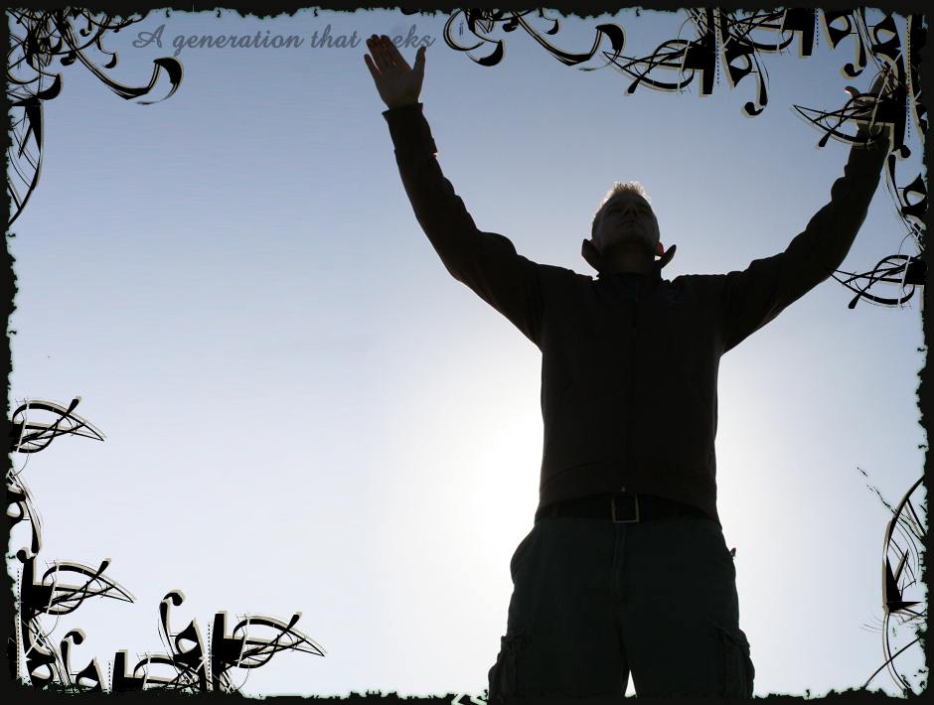
Religion –
Pure and Genuine
Jas 1:18-27

Slide 2
Worship Spirit & Truth
True Worshippers
Jn 4:19-25
With the Heart
According to Truth

Slide 3
Worship Spirit & Truth
Jas 1:18-2:26, Contrast
Doing vs. hearing only
Quick to hear vs. Slow to speak & wrath
Unspotted vs. dirty and abundant bad
Ministering to the rich vs. ignoring the destitute
Faith with works/without works

Slide 4
Pure and Genuine Religion
Definitions
Religion (Ceremonial)
Strong’s, ceremonial observance
Thayer, 1) religious worship especially external, that which consists of ceremonies
Righteous living
Notes:
Not worship of Jn 4; but rightous living

Slide 5
Pure and Genuine Religion
Jas 1:18-25, Warning for the Hearer Only
Deceived
Ex. One looking in a mirror
Forgets what he saw
II Thes 2:8-12, loves unrighteousness over truth
2 Pet 3:3-7, ignores previous judgments
Mt 13:10-17, hard of heart
Notes:
Prophecy of Isaiah about those who will not hear

Slide 6
Pure and Genuine Religion
Jas 1:22-25, Doer of the work
Continues in the word
Is blessed
Jas 2:14-26, faith without works is dead
Jas 4:17, to know good and not do; it is sin
Jas 5:19-20, results of one who does

Slide 7
Pure and Genuine Religion
Jas 1:26, Controls Tongue
Uncontrolled
Vain religion (ceremonial worship)
Deceives heart
Jas 1:19-21, Be a Good Hearer
Do apply to self (Receive with meekness)
Don’t justify self
Don’t lash out in anger

Slide 8
Pure and Genuine Religion
Jas 1:27, Helps Destitute
Defining Visit
Thayer, to look upon or after, to inspect, examine with the eyes
RWP, common verb to go to see, to inspect, present tense for habit of going to see.

Slide 9
Pure and Genuine Religion
Jas 1:27, Helps Destitute
Look After
Fatherless
Widows
Society Perception of these
Jas 2:1-9, prejudice toward rich
Mt 25:33-40, Benevolent attitude of the Godly
Notes:
Remember the belief of the Jew; those who are afflicted are afflicted by God; being punished.
Actively pursue, not passive

Slide 10
Pure and Genuine Religion
Jas 1:27, Helps Destitute
Look After
See to their needs
Alleviate their affliction
Actively pursue
Delegating our Responsibilities
Delegate the training of our children
Delegating evangelism
Delegating faith
Delegating …
Notes:
I gave at the office

Slide 11
Pure and Genuine Religion
Jas 1:27, Remain Un-Spotted
Cleansed
Remember your Salvation
1:21, lay aside filth and abundance of bad
Rom 6:3-6, new life
Eph 4:21-24, Col 2:9-13, put off the old body by circumcision of Jesus
Tit 3:3-8, washing of regeneration
1 Pet 1:21-23, purified souls being born again
2 Cor 5:17-20, new creature
Notes:
Remember the belief of the Jew; those who are afflicted are afflicted by God; being punished.

Slide 12
Pure and Genuine Religion
Summary
Jas 1:18-25, Warning for the Hearer only
Jas 1:22-25, Be a Doer
Jas 1:26, Good Hearer
Jas 1:27, Help Destitute
Jas 1:27, Remain Un-Spotted
Jas 5:19-20, results of one who does

Slide 13
Pure and Genuine Religion
Summary
A contrast in the religion of the day
1:21, Receive word with meekness vs. 1:22-26, hearer only…
1:27, remain spotless vs. 1:21, dirt and abundant bad
1:27, visit the fatherless and widows vs. 2:1-9, waited on the rich

